Slide 1
Nomenclature
Unit 8

Slide 2
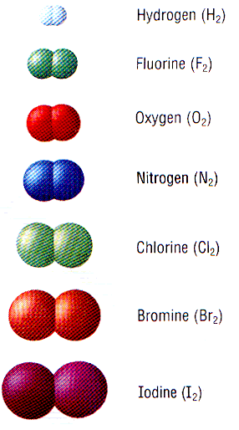
Elements
Elements are usually written with just their chemical symbol:
7 of the elements exist as diatomic’s (two atoms together). These are called the diatomic 7:
All elements are neutrally charged (0 charge), the # protons = # electrons.
When elements gain or lose electrons they are called ions.
Metals tend to lose electrons and become positively charged.
When naming metal ions, the name does not change, just add ion at the end.
Nonmetals tend to gain electrons and become negatively charged.
Nonmetal ions change the ending to –ide.
Au = gold
carbon = C
Mg = magnesium
sulfur = S
H₂, O₂, F₂, Br₂, I₂, N₂, Cl₂
Ca⁺² = calcium ion
Na⁺¹ = sodium ion
O⁻² = oxide
Cl⁻¹ = chloride
Notice: The diatomics are only diatomic when they are atoms, not ions!

Slide 3
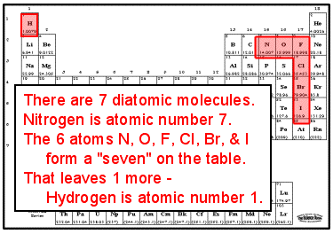

Slide 4
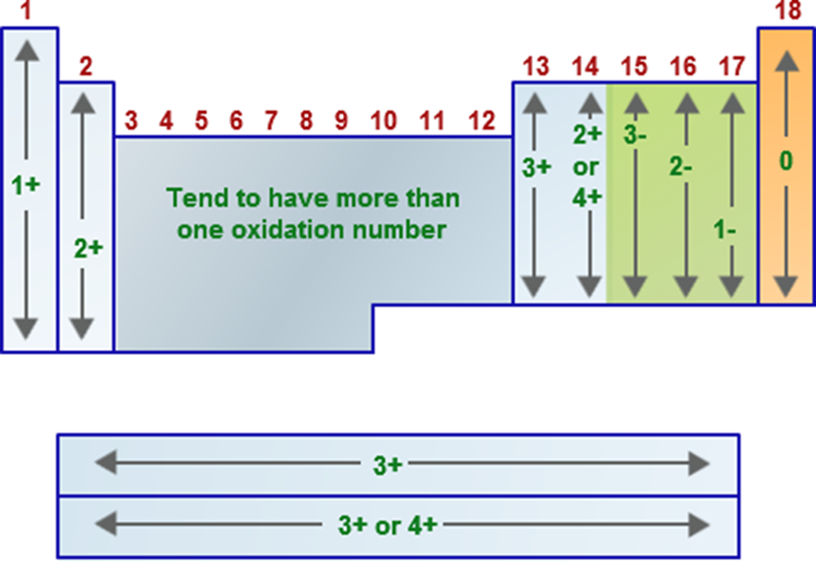
Binary Ionic Compounds
Binary ionic compounds are composed of 2 elements.
The chemical formula for an ionic compound will have the metal written first followed by the non-metal. The metal will be given its elemental name and the non-metal will have a modification of its element’s name so that it includes an –ide ending.
Chemical formula: NaCl
Chemical formula: LiBr
Chemical formula: CaCl₂
Name: sodium chloride
Name: lithium bromide
Name: calcium chloride
To write the chemical formula for an ionic compound, the positive and negative charges must be equal. In order to determine if the charges are equal, you must look at the oxidation number of each element present in the compound (recall the oxidation state number for elements in group 1A is +1, for elements in group 6A is -2 etc.)
In order to balance the charge, subscripts will be written below the chemical symbols.

Slide 5
Ex: Write the chemical formula for sodium bromide:
⁺¹
⁻¹
Na
Br
Charges are balanced, erase oxidation #’s
Ex: Write the chemical formula for potassium oxide:
⁺¹
K
⁻²
O
₂
Ex: Write the chemical formula for barium fluoride:
⁺²
⁻¹
Ba
F
₂
Ex: Write the chemical formula for calcium phosphide:
⁺²
Ca
⁻³
P
₃
₂

Slide 6
Ionic Compounds Containing Transition Metals:
Many transition metals have more than one charge as ions.
Exceptions: Ag⁺¹, Cd⁺², Zn⁺²
When writing the name of an ionic compound with a transition metal, it is important to indicate the charge of the transition metal.
The charge will be indicated as a roman numeral after the transition metal.
Ex:
Write the name of CuCl
Write the name of CuCl₂
Stock name: Copper (I) chloride
Stock name: Copper (II) chloride
Classical name: Cuprous chloride
Classical name: Cupric chloride

Slide 7
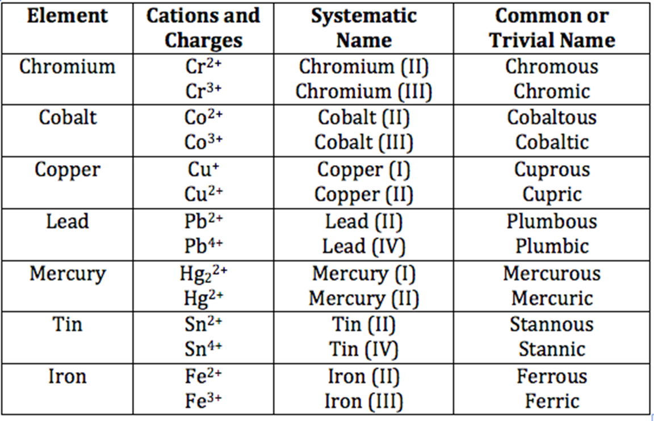
Use the back of your periodic table!
Write the chemical formula for Iron (II) Oxide:
⁺²
⁻²
Fe
O
Write the chemical formula for Ferric Sulfide:
Fe
⁺³
⁻²
S
₃
₂
Write the chemical formula for Mercury (I) Oxide and Mercury (II) Oxide:
Hg₂
⁺²
⁻²
Hg
⁺²
⁻²
O
O
Write the chemical formula for Plumbous Chloride:
Name the compound SnCl₄ using the classical and stock names.
tin chloride
( )
⁺²
⁻¹
Stock Name:
IV
Pb
Cl
₂
Classical Name:
stannic chloride

Slide 8
HW8.1
Assigned: Monday, Nov 20 Due: Tuesday, Nov 21 DUE ON SEPARATE SHEET OF PAPER
DAY 1
1. Write the names for the following binary ionic compounds:
(For transition metal compounds use the Stock and Classical Names when applicable)
a. KCl b. NaI c. K₂O d. CuS e. Li₂S f. Na₃N g. AgI h. FeO i. ZnO
2. Write the chemical formula for the following binary ionic compounds:
a. Lithium Oxide b. Tin(IV) Sulfide c. Hydrogen Chloride d. Silver Chloride
e. Manganese (II) Nitride f. Mercury (I) Oxide g. Mercury (II) Bromide h. Cadmium Sulfide

Slide 9
HW8.2
Assigned: Tuesday, Nov 21 Due: Monday, Nov 27 DUE ON SEPARATE SHEET OF PAPER
DAY 2
1. Write the names for the following binary ionic compounds:
(For transition metal compounds use the Stock and Classical Names when applicable)
a. SnO b. Ag₂Se c. K₃N d. Hg₂S e. Co₂S₃ f. MgI₂
g. Fe₂O₃ h. CsF i. SrS j. PbCl₄ k. Mn₂O₃ l. CoBr₂
2. Write the chemical formula for the following binary ionic compounds:
a. sodium nitride b. strontium selenide c. cobaltous chloride d. aluminum sulfide
e. beryllium phosphide f. potassium oxide g. cesium bromide h. cupric nitride
i. ferrous phosphide j. Mercurous Chloride k. Cupric Fluoride l. Chromous Sulfide
3. Write the names and chemical formulas for 4 of the diatomic 7

Slide 10
Polyatomic Ions
The same rules apply to ionic compounds containing polyatomic ions as did for binary ionic compounds except there will be no changing of the end of the anion.
Write the name of metal first (use stock (roman numerals) and classical name if necessary)
Then write the name of the polyatomic ion (most polyatomic ions end in –ite or –ate except; hydroxide (OH⁻), peroxide (O₂⁻²) and cyanide (CN⁻).
Ex:
Write the chemical formula for the following:
a. Sodium Phosphate
b. hydrogen peroxide
c. ferrous hypochlorite
d. ammonium sulfate
e. calcium carbonate
f. copper (II) nitrate
⁻²
Fe
⁻¹
Ca
⁻²
⁺²
⁺²
Cu
NO₃
⁻³
H
ClO
⁻¹
⁺¹
O₂
⁺²
Na
PO₄
( )
⁺¹
CO₃
( )
⁺¹
( )
⁻²
₃
₂
₂
NH₄
SO₄
₂
₂
Write the chemical name for the following (include classical and stock names):
a. Fe₂(SO₄)₃
c. Cr₂(C₄H₄O₆)₃
stock
b. Na₂CrO₄
sulfate
stock
chromium ( )
iron ( )
III
tartrate
III
sodium
chromate
classical
ferric sulfate
classical
chromic tartrate
e. NH₄HCO₃
d. Mn(OH)₂
f. (Hg₂)₃(PO₄)₂
ammonium
bicarbonate
stock
mercury ( )
phosphate
stock
manganese (II) hydroxide
I
classical
manganous hydroxide
ammonium
hydrogen carbonate
classical
mercurous phosphate

Slide 11
HW8.3
Assigned: Monday, Nov 27 Due: Tuesday, Nov 28 DUE ON SEPARATE SHEET OF PAPER
1. Write the names for the following ionic compounds:
(For transition metal compounds use the Stock and Classical Names when applicable)
a. AlPO₄ b. KNO₂ c. CaCO₃ d. NH4NO3 e. Ba(CN)₂ f. CuH₂PO₄
g. MnSO₄ h. CsCl i. SnSO₄ j. PbS₂ k. Mg₃(PO₄)₂ l. NaBr
2. Write the chemical formula for the following ionic compounds:
a. tin (IV) chlorite b. mercury (II) phosphate c. tin (II) carbonate d. mercury acetate
e. lead (II) chromate f. copper (I) sulfite g. strontium bromide h. cupric phosphide
i. ferrous nitrate j. tin (II) dichromate k. Cupric cholride l. Iron (II) hydroxide
3. Write the names and chemical formulas for 4 of the diatomic 7

Slide 12
Naming Covalent (molecular) Compounds
Covalent compounds are compounds composed of non-metals (or metalloid/non-metal).
For these compounds prefixes will be used to indicate the numbers of that element present (exceptions mono- will not be used on the first element (CO is carbon monoxide).
The last element will be given an –ide ending.
Prefixes:
di = 2
tri = 3
tetra = 4
penta = 5
hexa = 6
hepta = 7
octa = 8
nona = 9
deca = 10
Mono = 1
Examples:
1. Name the following:
a. NO b. NO₂ c. N₂O d. P₄O₇
2. Write the chemical formula for the following:
a. dinitrogen pentoxide b. boron trifluoride c. carbon tetrachloride
Summary:
When the first element of a compound is a metal then it is ionic. Don’t use prefixes (if it is a transition metal give the classical and stock name labeled properly (no s or c)).
When the first element of a compound is a non-metal or metalloid then it is covalent (use prefixes).
nitrogen dioxide
tetraphosphorus heptoxide
nitrogen monoxide
dinitrogen monoxide
N₂O₅
BF₃
CCl₄

Slide 13
HW8.4
Assigned: Tuesday, Nov 28 Due: Wednesday, Nov 29 DUE ON SEPARATE SHEET OF PAPER
1. Write the chemical formula for the following:
a. potassium carbonate b. silver nitrate c. magnesium hydroxide
d. iron (II) sulfate e. carbon disulfide f. chromic nitrite
g. dinitrogen heptoxide h. manganous perchlorate i. dinitrogen tetrahydride
2. Name the following: a. CBr₄ b. Ca(ClO)₂ c. Cu₂HPO₄ d. SF₆ e. Sn₃(PO₄)₂ f. BaSO₄

Slide 14
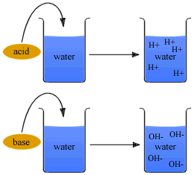
Naming Inorganic Acids
Acids are named for the Latin word acidus which means sour or tart. Acids taste sour and substances that are bases are bitter.
The Arrhenius theory of acids state that acids release H⁺ when dissolved in water and bases release OH⁻ when dissolved in water.
Rules for Naming Acids: General Chemical formula for acids HX (aq) – the (aq) means the substance is dissolved in water. Dissolving an acid in water results in the releasing of an H+ ion.
When the X anion ends in –ide use hydro-stem-ic acid.
Ex:
HCl (aq)
HBr (aq)
HCN (aq)
hydrochloric acid
hydrobromic acid
hydrocyanic acid
Hydrosulfuric acid
⁺¹
⁻²
HCl (g)
hydrogen monochloride
H
S
₂

Slide 15
When the X anion ends in –ate use stem-ic acid.
Ex:
HClO₄ (aq)
HNO₃ (aq)
H₃PO₄ (aq)
perchloric acid
nitric acid
phosphoric acid
carbonic acid
acetic acid
⁺¹
⁻²
H
CO₃
⁺¹
⁻¹
₂
H
C₂H₃O₂
When the X anion ends in –ite use stem-ous acid.
Ex:
H₂SO₃ (aq)
HClO (aq)
sulfurous acid
hypochlorous acid
phosphorous acid
chlorous acid
⁺¹
⁻³
(aq)
⁺¹
⁻¹
H
PO₃
H
(aq)
₃
ClO₂

Slide 16
Summary:
1. If the first element of the compound is a metal (or ammonium ion) then it is ionic (NO PREFIXES!).
-if the metal has more than 1 charge use classical and stock names
2. If the first element of the compound is a metalloid or non-metal (other than hydrogen) then it is covalent (USE PREFIXES!)
3. If the first element of the compound is H and there is an (aq) symbol, then it is an acid.
if anion ends in –ide; use hydro stem ic acid
if anion ends in –ite; use stem ous acid
if anion ends in –ate use stem ic acid
My ride has hydroulics
Sprite is delicious
I ate something icky

Slide 17
HW8.5
Assigned: Wednesday, Nov 29 Due: Thursday, Nov 30 DUE ON SEPARATE SHEET OF PAPER
DAY 1
Name the following compounds Write chemical formulas for the compounds
1. H₂CrO₄ (aq) 1. nitrous acid
2. HF (aq) 2. hydroselenic acid
3. HClO₂ (aq) 3. phosphoric acid
4. PI₃ 4. calcium carbonate
5. K₂CO₃ 5. mercury (I) phosphate
6. HMnO₄ (aq) 6. sulfur trioxide

Slide 18
HW8.6
Assigned: Thursday, Nov 30 Due: Friday, Dec 1 DUE ON SEPARATE SHEET OF PAPER
DAY 2
Name the following compounds Write chemical formulas for the compounds
1. P₂O₇ 1. hydrosulfuric acid
2. HNO₃(aq) 2. iron (II) carbonate
3. SO₃ 3. nitrous acid
4. N₂O₄ 4. cupric hypochlorite
5. H₂C₂O₄(aq) 5. aluminum carbonate
6. CO 6. bromide ion
7. Cl₂O₇ 7. phosphorous pentabromide
8. CaH₂ 8. perchloric acid
9. CuC₂H₃O₂ 9. hydroiodic acid
10. H₂S (aq) 10. acetic acid
11. Na₂O₂ 11. hydrocyanic acid
12. H₃PO₄ (aq) 12. sulfuric acid
13. SO₃⁻² 13. fluorine

Slide 19
Percentage Composition:
Percentage composition is a statement that relates the ________ of one element in a compound to the sum of all the masses of all the elements within the compound.
This may be determined in a couple of ways:
1. Percentage composition from experimental data
A chemist determines that there is 1.58 g of Copper present in 1.98 g of a compound that contains Copper and Sulfur. Determine the percentage composition of Sulfur and Copper in the compound.
% Cu = mass _{Cu . 100}
mass _{cmp}
% Cu = 1.58 g _{. 100}
1.98 g
% Cu = 79.8 %
2. Percentage composition from Chemical Formula:
Is the compound shown in sample 1a. Copper (I) Sulfide or Copper (II) Sulfide?
mass
% S = 100 - % Cu
% S = 100 – 79.798 %
% S = 20.2 %
Cu₂S
% Cu in Cu₂S
Cu₂S
CuS
% Cu in CuS
% Cu = mass Cu . ₁₀₀
mass CuS
% Cu = mass Cu . ₁₀₀
mass Cu₂S
% Cu = 63.546 g/mol . ₁₀₀
63.546 g/mol + 32.06 g/mol
% Cu = 2(63.546 g/mol) . ₁₀₀
2(63.546 g/mol) + 32.06 g/mol
% Cu = 79.86 %
% Cu = 66.47%

Slide 20
HW8.7
Assigned: Friday, Dec 1 Due: Monday, Dec 4 DUE ON SEPARATE SHEET OF PAPER
A chemist determines that 1.26 g of iron reacts with 0.54 g of oxygen to from rust. What is the percent composition of each element in the new compound?
In the lab, a chemist analyzed a sample of methanol and found that it was made of 6.2 g of carbon, 4.1 g of hydrogen, and 15.9 g of oxygen. What is the percent composition of each element?
In an experiment, a student took a 12.2 g sample of table salt and chemically separated the chlorine from the sodium. He determined that there were 5.2 g of chlorine in the sample. What is the percent composition of each element in the table salt?
Name the following: a. P₃O₆ b. FeCl₂ c. H₃PO₃ (aq)
Write the formula of the following: a. thiosulfuric acid b. plumbic sulfate c. nonanitrogen heptasulfide
Bonus: In an experiment, 0.05 moles of iron and 0.05 moles of sulfur are heated in a test tube to create a new substance. What is the percent composition by mass of each element in the new compound?

Slide 21
Empirical Formula:
Empirical Formula is the simplest ratio of atoms present in a molecule
The empirical formula for C₆H₆ is _________
2. Empirical Formulas may be determined from masses of elements or % composition data. Here you must determine the simplest whole number ratio of _________ for each element.
Determine the empirical formula for a compound that contains 0.900 g Ca and 1.60 g Cl.
CH
moles
moles Ca =
0.900 g Ca
mol Ca
40.08 g Ca
= 0.022455 mol Ca
__________________
0.022455 mol
= 1.00
moles Cl = 1.60 g Cl
mol Cl
35.453 g Cl
= 0.045130 mol Cl
__________________
0.022455 mol
= 2.01
To obtain the simplest ratio of moles, divide by the smaller value
If values are within 0.1, round to the nearest whole number
CaCl₂

Slide 22
Determine the empirical formula for a compound that contains 40.0 % C, 6.71 % H and 53.3 % O. When %'s are given merely assume that you have ______ g of the compound.
100
mol C
12.011 g C
moles C =
40.0 g C
= 3.3302 mol C
__________________
3.3302 mol
= 1.00
mol H
1.008 g H
moles H =
6.71 g H
= 6.6567 mol H
__________________
3.3302 mol
= 2.00
CH₂O
mol O
15.999 g O
moles O =
53.3 g O
= 3.3315 mol O
__________________
3.3302 mol
= 1.00
Determine the empirical formula for a compound that contains 25.9 % Nitrogen and
74.1 % Oxygen. This example will show what to do when the mole ratio is not a whole number.
moles N =
mol N
14.007 g N
25.9 g N
= 1.8491 mol N
_______________
1.8491 mol
x 2
= 2
= 1.00
N₂O₅
moles O =
mol O
15.999 g O
74.1 g O
= 4.6315 mol O
_______________
1.8491 mol
= 5
x 2
= 2.50
Not within 0.1, multiply each by a # so that each will be a whole #

Slide 23
A compound is 32.38% Na; 22.65%S and the rest is oxygen. What is the empirical formula?
= 1.40789 mol Na
moles Na =
32.38 g Na
mol Na
22.999 g Na
__________________
0.706400 mol
= 1.993
22.65 g S
mol S
32.064 g S
Na₂SO₄
moles S =
= 0.706400 mol S
__________________
0.706400 mol
= 1.000
moles O =
44.97 g O
mol O
15.999 g O
= 2.81080 mol O
__________________
0.706400 mol
= 3.979

Slide 24
HW8.8
Assigned: Monday, Dec 4 Due: Tuesday, Dec 5 DUE ON SEPARATE SHEET OF PAPER
1. A compound is found to contain 63.52% iron and 36.48 % sulfur. Determine it’s empirical formula.
2. A compound is found to contain 26.56% K, 35.41% Cr with the remainder
being oxygen. Determine it’ empirical formula.
Analysis of 20.0 g of a compound containing only calcium and bromine indicates that 4.00 g of calcium are present. What is the empirical formula of the compound?
A compound is formed when 9.03 g Mg combines completely with 3.48 g N. What is the percent composition of this compound?
5. Name or write the chemical formula each of the following compounds:
a. Hg₂SO₄ b. Hg₃(PO₄)₂ (on b. also determine % of P in the compound)
c. PBr₃ d. XeF₄ e. HNO₂(aq)

Slide 25
Molecular Formulas from Empirical Formulas (pg. 332-333)-this is the true chemical formula of a compound and can be determined from the ____________ formula and the ___________________ of the compound. A compound has an empirical formula of CH₂O and a molar mass of 180. g/mol. Determine the molecular formula.
empirical
molar mass
Step #1: Determine the # of empirical formula units that fit within the molecule
This is obtained from the quotient of molar mass of compound and the molar mass of the empirical formula
# = 180. g/mol________
(12.011 g/mol + 2(1.008 g/mol) + 15.999 g/mol)
# = 180. g/mol________
30.026 g/mol
# = 6
Step #2: Multiply each subscript of the empircal formula by the # calculated above.
C₆H₁₂O₆

Slide 26
10.150 g of a sample contains 4.433 g phosphorus, the rest is oxygen. The molar mass of the compound is 284 g/mol. What are the emprical and molecular formulas for the compound?
Empirical Formula:
moles P =
4.433 g P
mol P
30.974 g P
= 0.143120 mol P
_______________
0.143120 mol
x 2
= 1.000
= 2
moles O =
5.717 g O
mol O
15.999 g O
= 0.357335 mol O
_______________
0.143120 mol
= 2.497
= 5
x 2
10.150 g – 4.433 g
Not within 0.1, multiply each by a # so that each will be a whole #
P₂O₅
Molecular Formula:
Step #1: Determine the # of empirical formula units that fit within the molecule
# = 284 g/mol________
2(30.974 g/mol) + 5(15.999 g/mol)
# = 284 g/mol________
141.943 g/mol
# = 2.00
Step #2: Multiply each subscript of the empircal formula by the # calculated above.
P₄O₁₀

Slide 27
HW8.9
Assigned: Tuesday, Dec 5 Due: Wednesday, Dec 6 DUE ON SEPARATE SHEET OF PAPER
1. What is the molecular formula of a molecule that has an empirical formula of CH₂O and a molar mass of 120.12 g/mol.
2. A compound with a molar mass of 42.08 g/mol is found to be 85.64% carbon and 14.63% hydrogen by mass. Determine its molecular formula.
3. Determine the molecular formula of the compound with the empirical formula of CH with a molar mass
78.110 g/mol.
4. A sample of a compound with a molar mass of 34.00 g/mol is found to consist of 0.44 g of H and 6.92 g
of O. Determine its molecular formula.
5. Determine the empirical formula of a compound containing 63.50 % silver, 8.25% nitrogen with the rest
being oxygen.
When a 14.2 g sample of mercury (II) oxide is decomposed into its elements by heating, 13.2 g Hg is obtained. What is the percent composition of the compound?

Slide 28
HW8.10
Assigned: Wednesday, Dec 6 Due: Friday, Dec 8 DUE ON SEPARATE SHEET OF PAPER
Test Review
Write chemical formulas for the following
a. magnesium nitrate b. ammonium sulfate
c. cupric chlorite d. mercury (I) chloride
e. dichlorine octoxide f. dinitrogen tetrasulfide
g. acetic acid h. hydrosulfuric acid
i. nitrous acid j. stannous phosphate
2. Name the following
a. MgC₂O₄ b. Mn(HCO₃)₂. c. XeF₇
d. HClO (aq) e. HBr (aq) f. SO₃
3. Determine the % composition of all elements contained in zinc sulfide.
4. A 154 g sample that is composed of 70.2 g of tin. The rest of the compound is composed of chlorine
Use % composition to determine if the sample is tin (II) chloride or tin (IV) chloride.
5. Determine the empirical formula and molecular formula of the compound:
A substance contains 0.159 g of U and 0.119 g of Cl. The molar mass of the compound is 1245 g/mol.

