Slide 1
Bonding
Unit 7

Slide 2
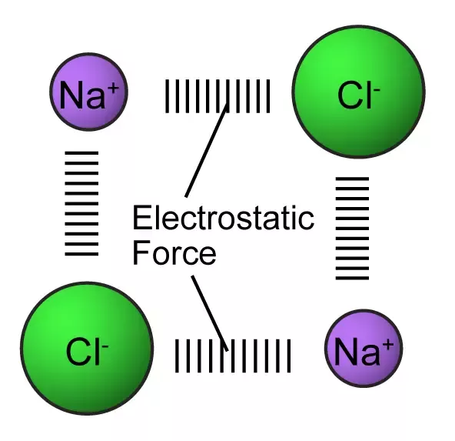
Properties of Covalent Molecules
Small, nonpolar molecules tend to have very low melting and boiling points.
RECALL: Ionic compounds have no defined shape. They are a gigantic crystal where each anion is bonded to several other cations.
These attractions between anions and cations in an ionic bond are called electrostatic forces.
C
C
I
C
C
I
C
C
I
C

Slide 3
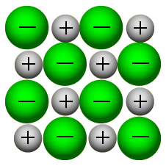
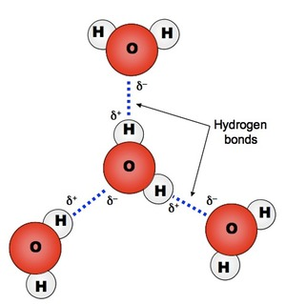
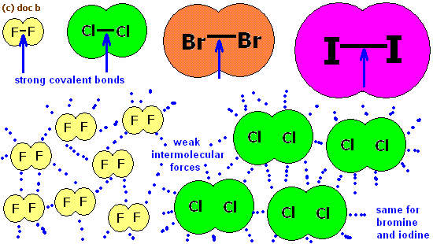
Connections Between Molecules
A lot of energy has to go into ionic bonds to separate the atoms into liquid and then gas phases.
Polar Covalent Bonds have small attractions between the molecules meaning they require an intermediate amount of energy to separate them into gas and liquid phases.
Pure covalent bonds have very weak intermolecular forces.
Very little energy is required to separate these molecules into liquid and gas states.

Slide 4
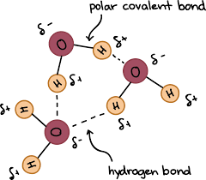
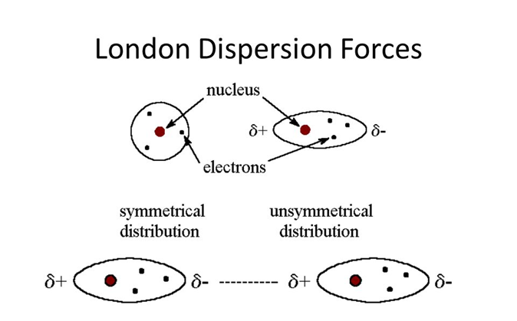
InterMolecular Forces
InterMolecular Forces (IMF’s), the forces between molecules, are divided into three types:
Dipole-Dipole Interactions: Interactions between the polar regions of polar molecules.
Hydrogen Bonds: Special Dipole-Dipole Interactions that exist when Hydrogen is bonded to Nitrogen, Oxygen, or Fluorine. These are the strongest IMF, having the strength of about 5% of a covalent bond.
London Dispersion Forces (LDF’s): Very weak Intermolecular Forces that exist between ALL molecules. LDF’s occur when electrons happen to be more on the side of a molecule closest to its neighboring molecule.
IMF’s are also collectively known as van der Waals forces

Slide 5
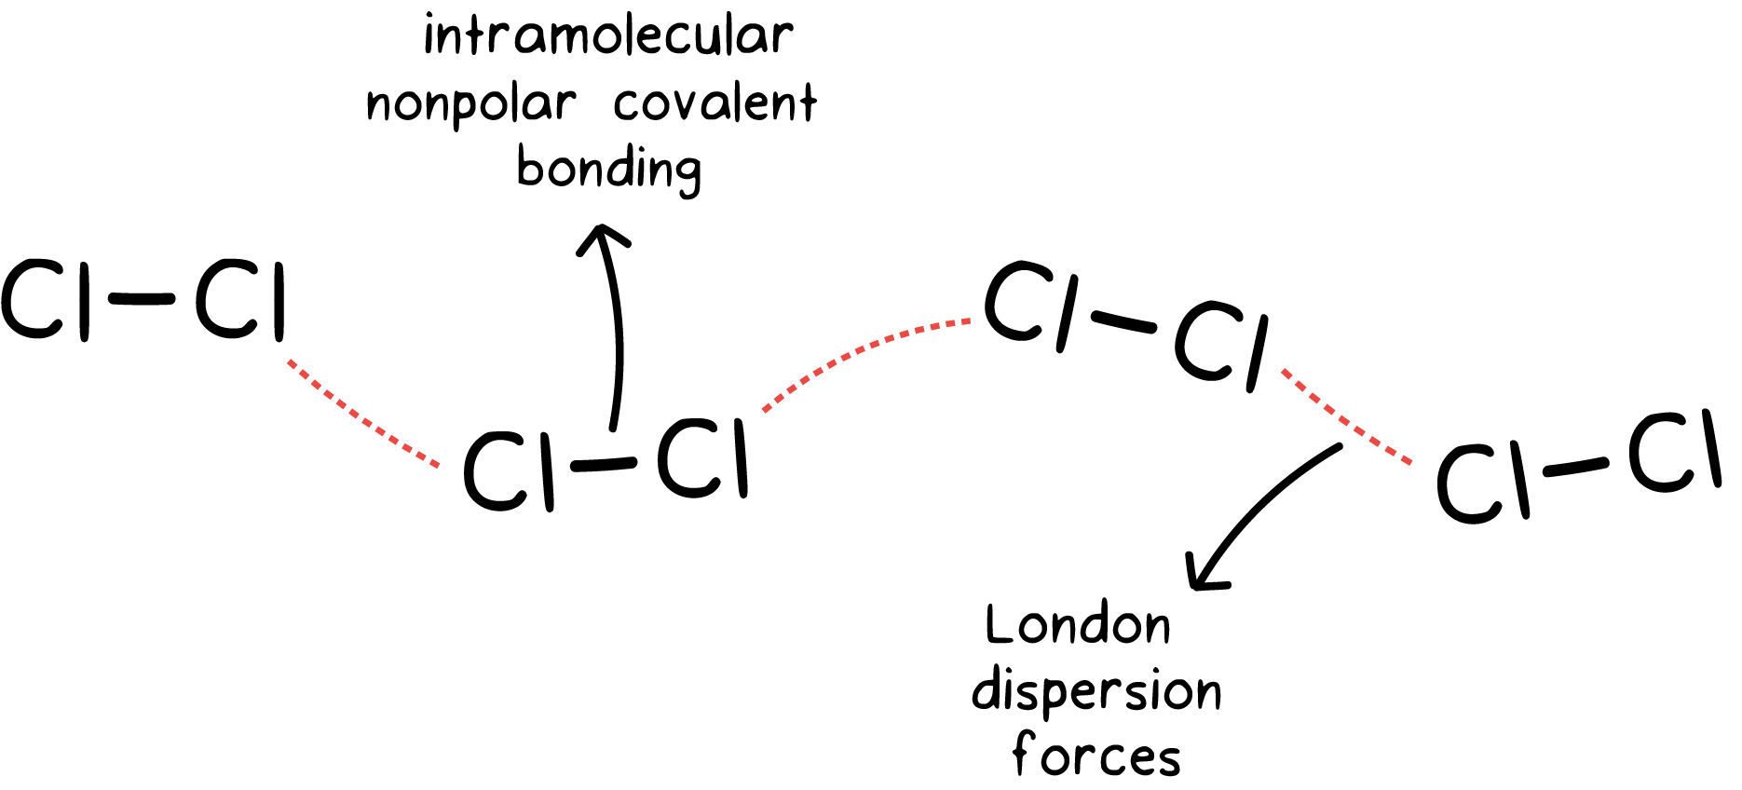
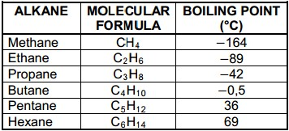
London Dispersion Forces (LDF’s)
ALL molecules have LDF’s.
The strength of the LDF is determined by the number of electrons in the molecule.
C-H is not a polar bond, but as the number of electrons in the molecule increases, so does the boiling point.

Slide 6
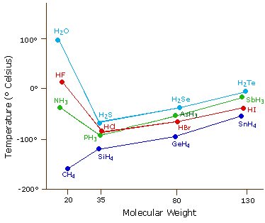
Importance of IMF’s
Hydrogen bonding explains many properties important for life on Earth.
H-bonds increase the boiling point much greater than what would be expected without IMF’s!
What would you drink if water boiled at -90ºC???
Notice the more electrons, the higher the boiling point, LDF’s!

Slide 7
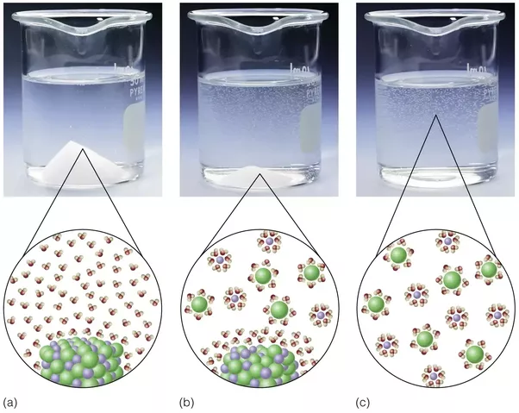
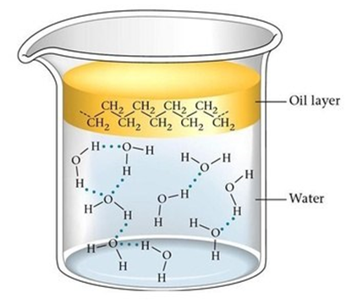
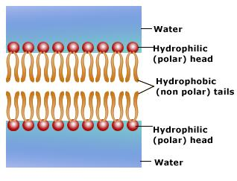
Like Dissolves Like
Due to waters extreme polarity, it is able to dissolve many ionic substances.
Water is also able to dissolve other polar molecules.
Nonpolar molecules, like oil, do not dissolve in water.
Water interacting with polar molecules, and not interacting with nonpolar molecules is what allows for the phospholipid bilayer!

Slide 8
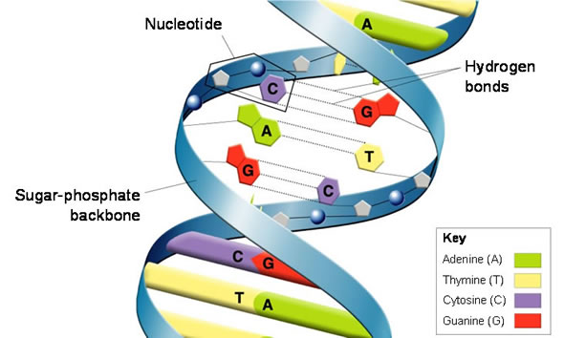
IMF’s ARE EVERYTHING!!

Slide 9
HW7.8
Assigned: Monday, Nov 13 Due: Tuesday, Nov 14 DUE ON SEPARATE SHEET OF PAPER
What determines the strength of London Dispersion Forces?
Draw the Lewis dot structure, state the shape and bond angle for the following: a. HBr b. CH₄ c. NH₃ d. SO₃ e. H₂S
Draw the dipole arrow and δ+ and δ- charges for each bond in problem 2a-e.
Determine whether the molecules in 2a-e are polar or not.
State the intermolecular forces present in 2a-e.
Which of the molecules in 2a-e will dissolve in water?

