Slide 1
Bonding
Unit 7

Slide 2
Ionic/Covalent Bond Spectrum
So far we have been treating every bond as either ionic or covalent.
But really, there is a ‘most ionic’ bond (FrF) and a ‘most covalent bond’ (H₂).
All other bonds fall somewhere in between.
In other bonds, electrons are taken form one element, resulting in cations (+ charge) and anions (-charge) forming pure ionic bonds.
Some bonds, like H2 share electrons perfectly equal, resulting in a purely covalent bond.
But most bonds exist somewhere in the middle, with some properties of both ionic and covalent bonds.

Slide 3
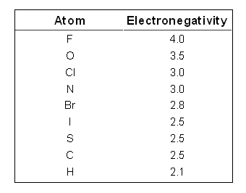
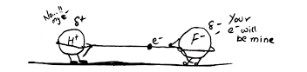
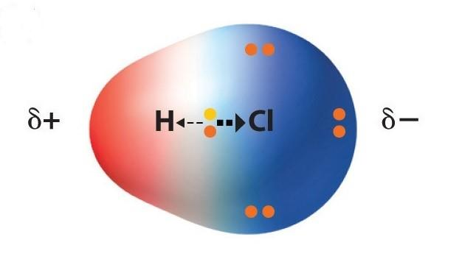
Electronegativity and Shared Electrons
RECALL: Electronegativity is a measure of how well atoms share electrons when they are in a bond.
The more the electronegative the atom, the more it will pull on shared electrons.
Cl
A large difference in electronegativity's results in a polar covalent bond.
In a polar covalent bond, the bonding electrons are not shared equally, resulting in a partial negative (δ -) side (more electronegative atom) and a partial positive (δ +) side (less electronegative atom.

Slide 4
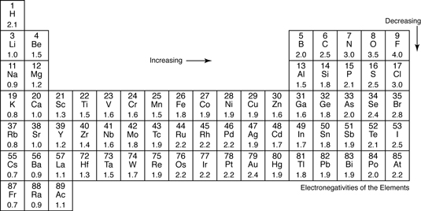
These values will be given on Test

Slide 5
Ionic, Polar Covalent, and Nonpolar Covalent Bonds
Differences in electronegativity's (Δ EN) result in bonds either being classified as:
Ionic: Δ EN > 1.7
Polar Covalent: 1.7 > Δ EN > 0.5
Nonpolar Covalent: Δ EN < 0.5
Special note: Ionic = Metal + Nonmetal supersedes ΔEN. So even if a metal and nonmetal have a difference less than 1.7, it would still be considered an ionic bond.
Special note: bonds with Δ EN < 0.5 still have some polarity, we just classify them as nonpolar covalent.

Slide 6
Drawing Polar Bonds
..
1. Draw your Lewis Dot Structure
..
2. Determine which (if any) element has the greater electronegativity. Assign that element a δ – and the other element a δ +.
..
3. Draw a bond dipole arrow pointing in the direction of the least electronegative element.

Slide 7
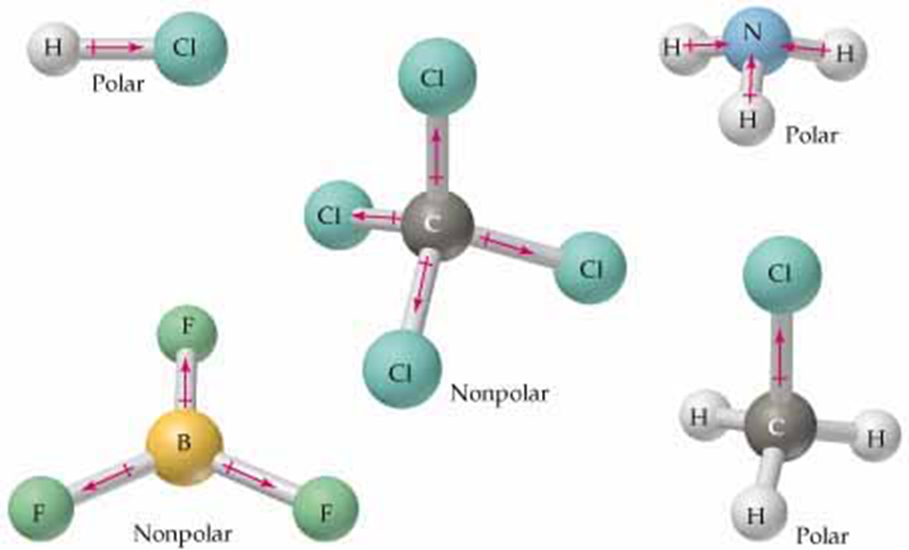
Polar Molecules
In order for molecules to be polar, it must have satisfy 2 criteria:
1. Must have polar bonds
2. Must have oppositely charged regions.
3.0 – 3.0 = 0 Δ EN
Even though CO₂ has polar bonds, both ends of the molecule are δ – resulting in a non-polar molecule.

Slide 8
HW7.7
Assigned: Friday, Nov 10 Due: Monday, Nov 13 DUE ON SEPARATE SHEET OF PAPER
Determine if each of the following would be ionic, polar covalent, or nonpolar covalent: a. Ca and Cl b. C and S c. Mg and F d. N and O e. H and O f. S and O
Draw the Lewis dot structure, state the shape and the bond angle for the following: a. H₂S b. HCl c. Br₂ d. PCl₃ e. CCl₄ f. O₂
Draw the dipole arrow and δ+ and δ- charges for each bond in problem 2a-f.
Determine whether the molecules in 2a-f are polar or not polar.

