Slide 1
Bonding
Unit 7

Slide 2
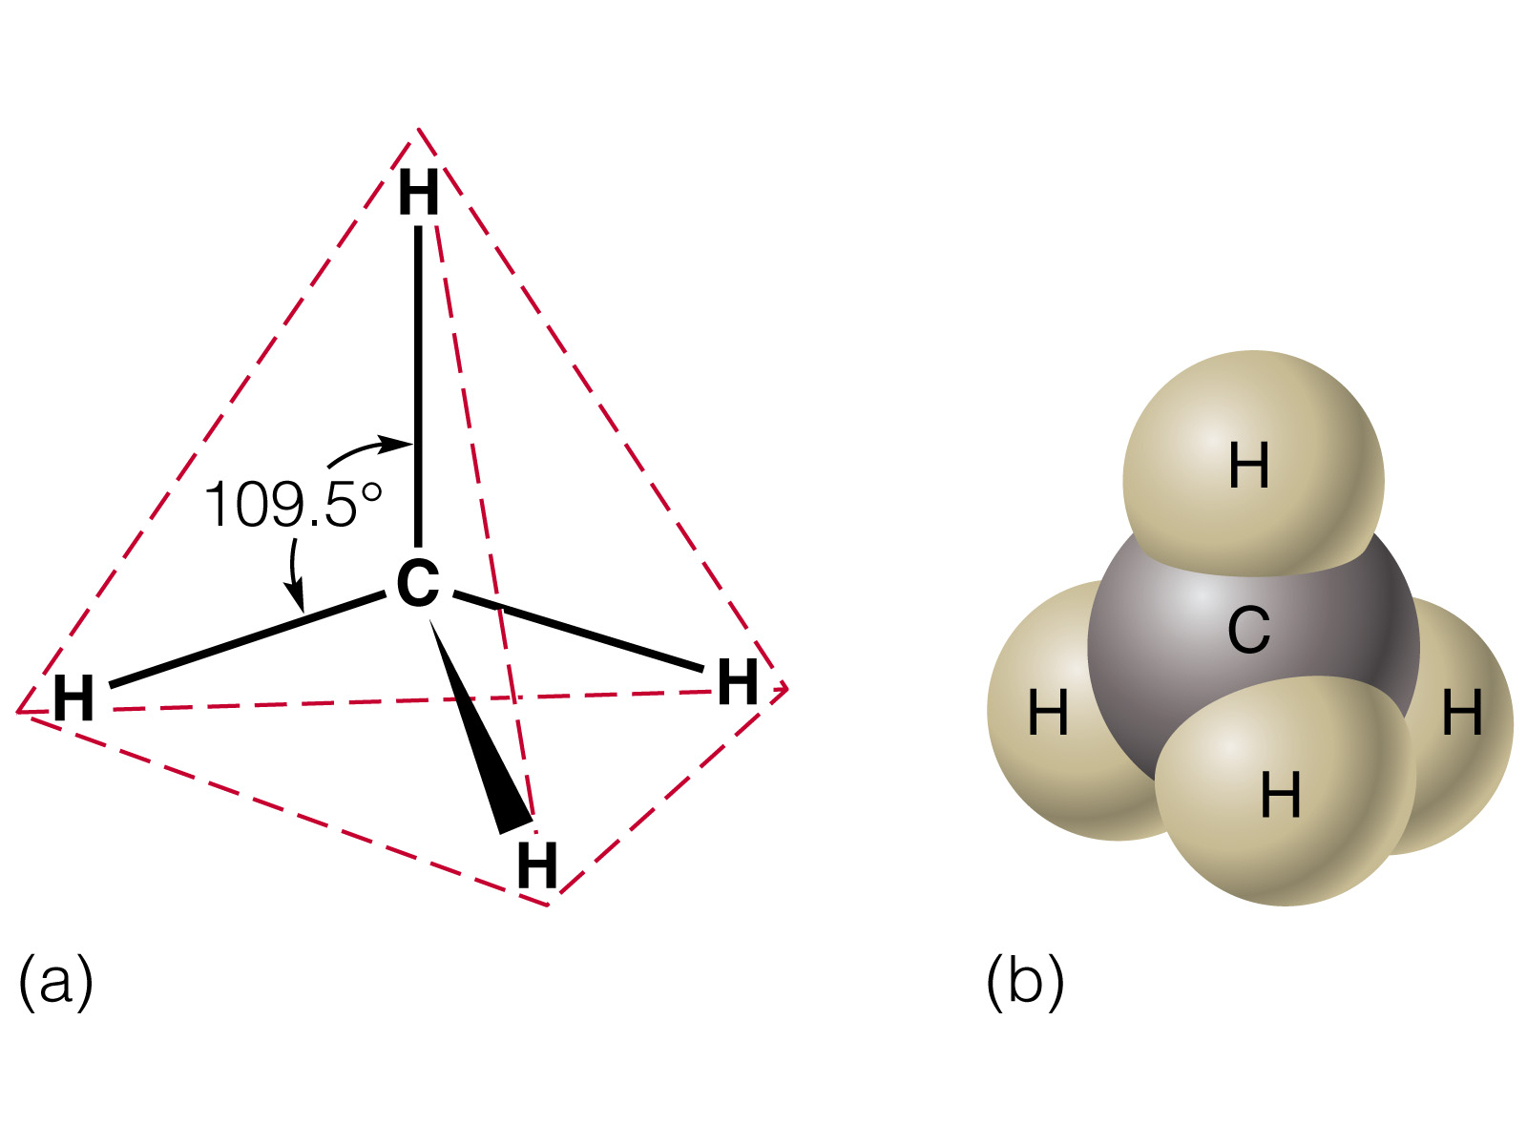
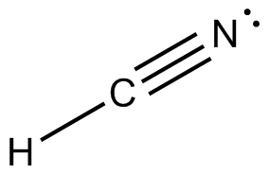
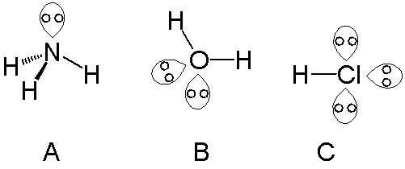
VSEPR Theory Valence Shell Electron Pair Repulsion
VSEPR Theory provides an explanation for the 3-dimensional shape of molecules.
RECALL: Ionic compounds are formula units (for. u.) Covalent compounds are molecules.
Groups of negatively charged electrons will repel one another.
Groups of electrons can be:
Lone Pairs
Bonding Groups
Single Bond, Double Bond, Triple each count as 1 Bonding Group
1
2
1 Lone Pair
3 Bonding Pairs
2
2 Bonding Pairs
1
3 Lone Pairs
2 Bonding Pairs
2 Lone Pairs
1 Bonding Pair
2 Bonding Pairs

Slide 3
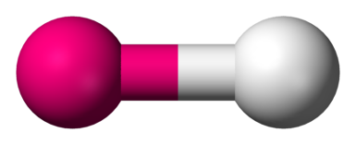
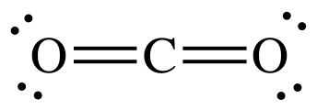
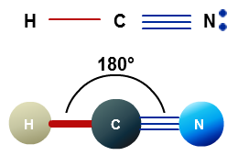
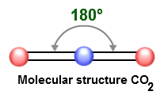
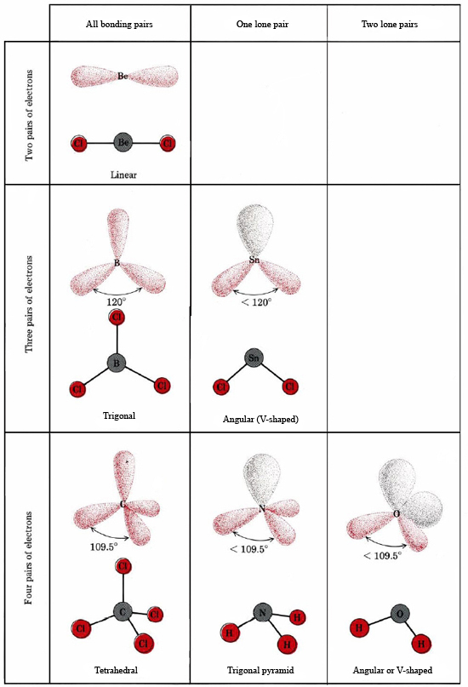
Linear
Any compound that is only 2 elements, regardless of bond type or lone pairs is linear in shape.
Any molecule with 2 bonding pairs and 0 lone pairs will be linear, with a 180º bond angle.

Slide 4
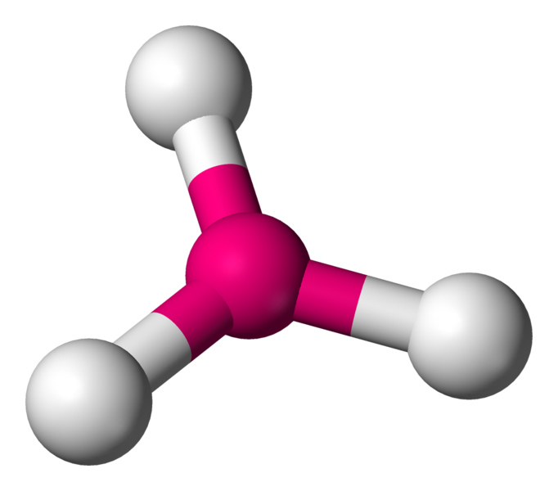
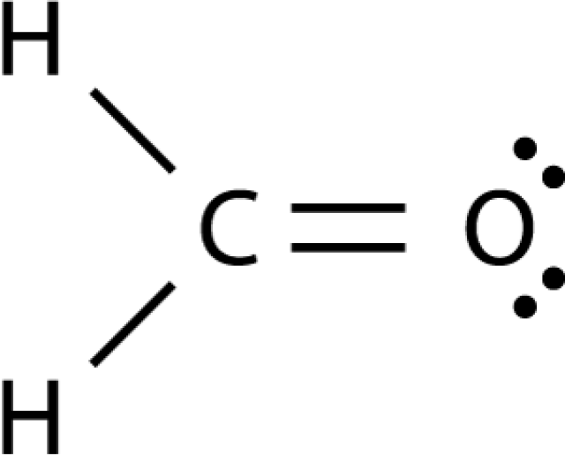
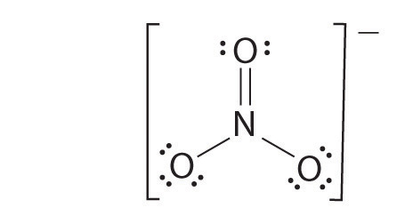
Trigonal Planar
Any molecule with 3 bonding pairs and 0 lone pairs will be trigonal planar with a 120º bond angle.
120º
120º
120º

Slide 5
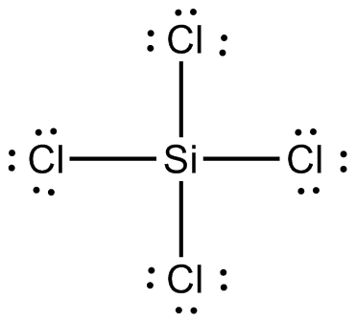
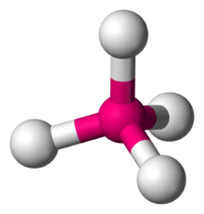
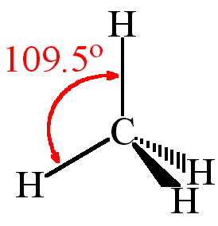
Tetrahedral
When there are 4 bonding pairs of electrons, the shape is tetrahedral with bond angles of 109º.

Slide 6
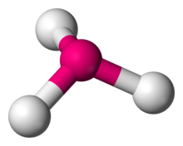
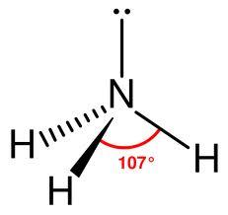
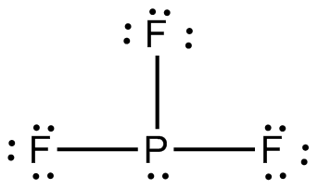
Trigonal Pyramidal
A molecule with 3 bonding pairs and 1 lone pair is called trigonal pyramidal and has 109º angles.
109⁰

Slide 7
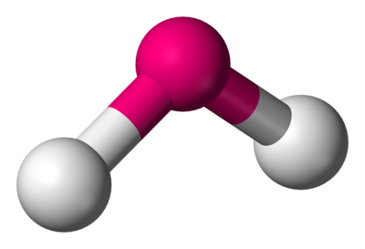
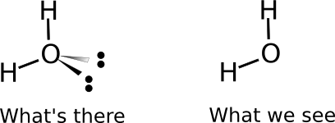
Bent 109º
When there are 2 bonding pairs and 2 lone pairs, the shape is bent with 109º angle.
109º

Slide 8
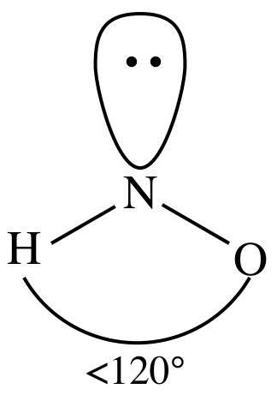
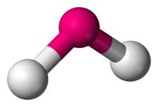
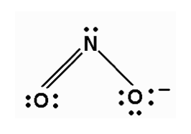
Bent 120º
A molecule with 2 bonding pairs and 1 lone pair still has a 120º angle (3 groups of electrons) but the shape we see is bent 120º.

Slide 9
HW7.6
Assigned: Thursday, Nov 9 Due: Friday, Nov 10 DUE ON SEPARATE SHEET OF PAPER
Draw the Lewis Dot Structure, then state the shape and the bond angle for the following:
HCN
NO₂⁻¹
H₂S
SO₄⁻²
PH₃
SeS₃

