Slide 1
Bonding
Unit 7

Slide 2
Drawing Ionic Bonds
Ex: sodium chloride:
DON’T FORGET THE CHARGES! THESE ARE THE BONDS AFTER ALL!
1. Draw the dot diagrams:
MUST SHOW THE ARROW!
X
3. Redraw the diagrams with appropriate valance electrons. (I like an X to show the transferred electron).
2. Draw a line to show the transfer of electrons from the cation to the anion. (I prefer curved lines for ionic compounds)
Formula Unit: NaCl

Slide 3
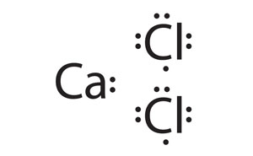
Drawing Ionic Bonds
Ex: calcium chloride
MUST SHOW THE ARROW!
X
X
Chlorine has a full octet, but calcium still has one valance electron…..
Don’t forget, calcium now has a 2+ charge.
Formula Unit: CaCl₂

Slide 4
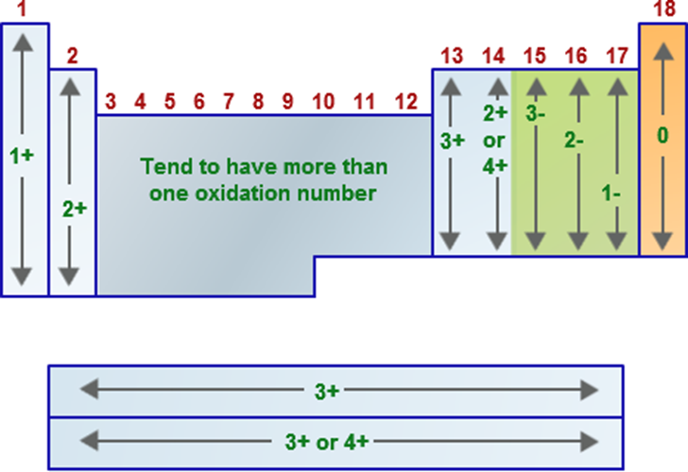
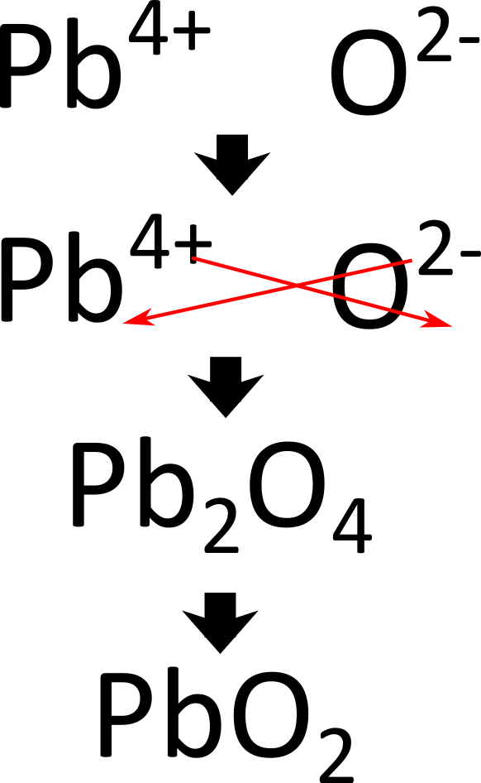
Oxidation States and Crossing Over
When making ionic bonds, do not forget atoms likely oxidation state. (This is the charge the atom is like to form when it ionizes)
An easy trick to determine how many of each atom you will need is called crossing over:
lead (IV) oxide:
Formula Unit: PbO₂
Always remember to reduce whenever possible! Remember, ionic formulas represent a ratio, not the actual number of each atom.

Slide 5
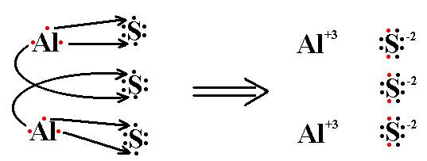
Oxidation States and Crossing Over
aluminum sulfide:
MUST SHOW THE ARROW!
Formula Unit: Al₂S₃

Slide 6
HW7.2
Assigned: Friday, Nov 3 Due: Monday, Nov 6 DUE ON SEPARATE SHEET OF PAPER
Draw the Lewis structures for the following ionic compounds and write the formula unit:
Be & N
Al & F
Rb & O
Ca & I
Mg & P
Be & S
Al & O
Mg & S
K & F
Sr & Cl

