Slide 1
Bonding
Unit 7

Slide 2
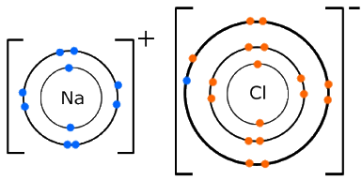
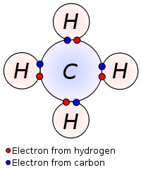
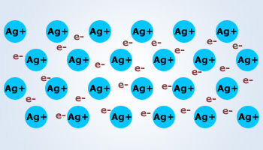
Ionic, Covalent, and Metallic Bonds
A chemical bond is a force that holds two atoms together.
There are three types of bonds we will focus on:
1. Ionic bonds occur between a metal and a nonmetal.
2. Covalent bonds occur between two nonmetals.
3. Metallic bonds occur between two metals.
Notice the (+) and (-). It is these electrostatic charges that hold this bond together.
The shared pairs of electrons hold the bonds of a covalent molecule. Note, not all pairs of electrons are shared equally*
The free floating electrons (‘sea of electrons’) hold the atoms of metals bonded.

Slide 3
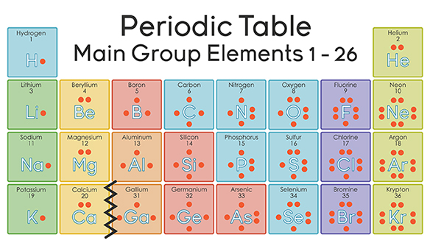
Dot Structures
Elements in the same groups have the same number of valance electrons.
This is why elements on the periodic table have periodically repeating properties. Atoms with the same number of valance electrons will behave similarly.
What would the dot structure of Rubidium be?
Rb
.
How about Iodine?
.
.
.
.
.
I
.
s¹
s²
s²p¹
s²p²
s²p³
s²p⁴
s²p⁵
s²p⁶
(Except He)
.

Slide 4
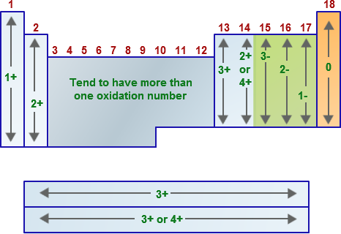
When Forming Ionic Bonds
Atoms gain or lose electrons (ionize) in order to achieve stability (s²p⁶).
Atoms in the same family lose or gain the same number of valance electrons.
Metals will lose electrons, forming cations (positive charge).
Nonmetals will gain electrons forming anions (negative charge).

Slide 5
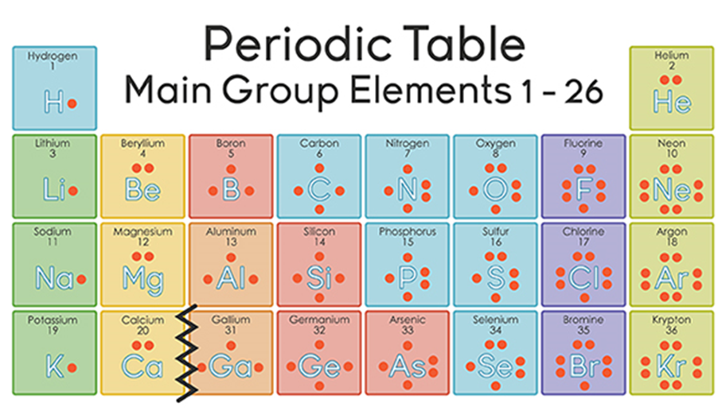
When Forming Covalent Bonds
Recall* Covalent bonds are only between non-metals.
When non-metals form covalent bonds, each atom shares electrons in order to achieve a full octet.
Non-Metal
A full octet means 8 valance electrons.
EXCEPTIONS:
H, He (only 2)
and B (only 6)

Slide 6
HW7.1
Assigned: Thursday, Nov 2 Due: Friday, Nov 3 DUE ON SEPARATE SHEET OF PAPER
How many valance electrons in each of the following families: a. alkali metals b. alkaline earth metals c. halogens d. noble gases
An atom that loses electrons is called what? What charge will it have?
An atom that gains electrons is called what? What charge will it have?
What kindof elements tend to gain electrons? Atoms of which elements tend to lose electrons?
Draw the dot diagrams for the following: a. potassium b. carbon c. magnesium d. oxygen
How many electrons will each element gain or lose in forming an ion? a. calcium b. fluorine c. aluminum d. oxygen
Identify the charge of the ion formed when a. a potassium atom loses one electron. b. a zinc atom loses two electrons. c. a fluorine atom gains one electron.
Write the electron configuration of Cd²⁺
Identify the bonds between atoms of each pair of elements as covalent or ionic: a. H and Br b. K and Cl c. C and O d. Cl and F e. Li and O f. Br and Br

