Slide 1
The Periodic Table
Unit 6

Slide 2
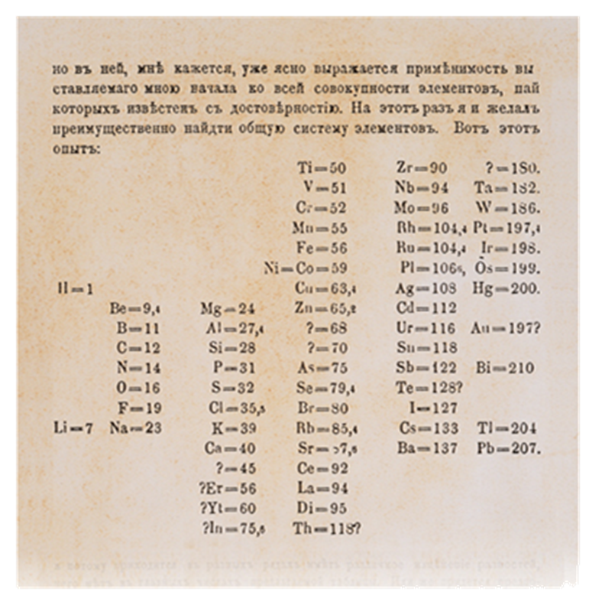
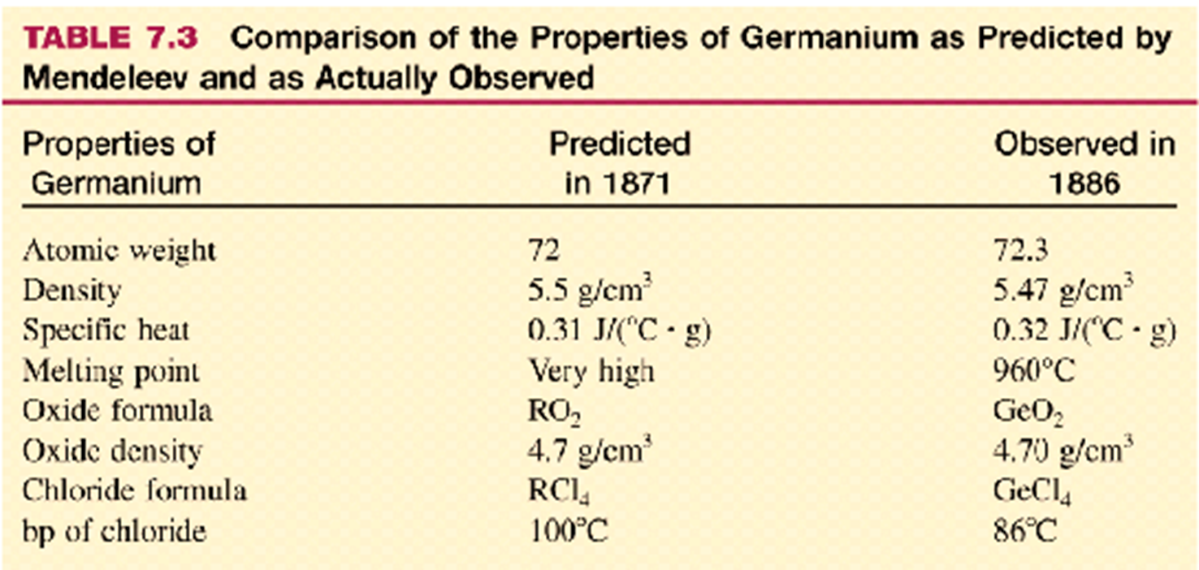
Mendeleev’s Periodic Table
In the 1700’s there were 33 known elements.
By the mid-1800’s there were over 70 known elements.
  A way to organize these elements was needed.
Many scientists developed a way of organizing the elements, but Russian chemist Dmitri Mendeleev developed the first widely accepted periodic table.
It was so widely accepted because it was correctly able to predict the existence of, and proprieties of yet unknown elements.

Slide 3
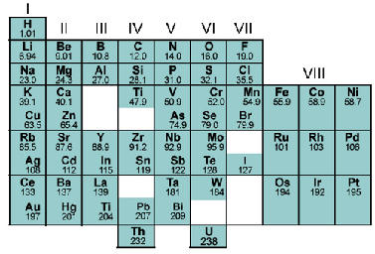
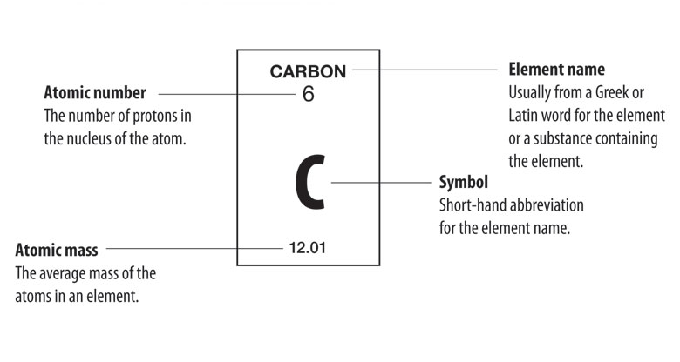
The Modern Periodic Table
Mendeleev arranged the elements in his periodic table in order of increasing atomic mass.
  It is called periodic because properties tend to repeat periodically.
In 1913, British physicist Henry Mosely assigned each known element an atomic number.
  Recall: Atomic number is the number of protons in an atoms nucleus.
  Protons were unknown in Mendeleev’s time.
In the modern periodic table, elements are arranged in order of increasing atomic number.

Slide 4
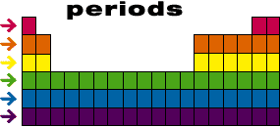
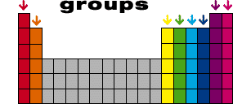
Groups and Periods
Periodic Law: When elements are arranged in order of increasing atomic number, there is a periodic repetition of their physical and chemical properties.
The arrangement of the elements into periods has an important consequence. Elements that have similar chemical and physical properties end up in the same column (groups or families) in the periodic table.
Elements in the same group will have very similar properties to other elements in that group.
Each group is numbered 1-18
Representative Elements
Transition Metals
Inner Transition Metals
Elements in groups 1,2 and 13 thru 18 are known as representative elements or main group elements.
Elements in groups 3 thru 12 are known as transition elements.
Inner transition elements are comprised of the lanthanide and actinide series.

Slide 5
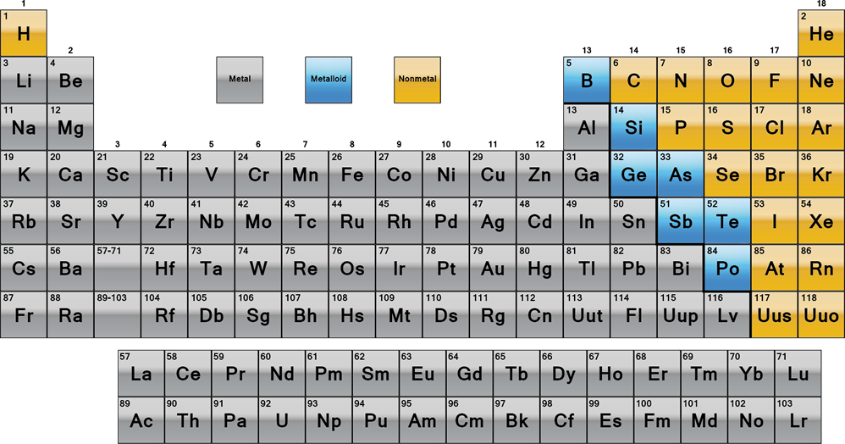
Nonmetals
Metals
Metals are genrally:
  Shiny
  Solids at room temperature
  Good conductors of electricity
  Most are malleable and ductile, meaning they can be pounded into thin sheets and drawn into wires respectively.
Metalloids
Nonmetals are generally:
  Gasses or brittle, dull-looking solids
  Poor conductors of heat and electricity
  Bromine is the only nonmetal liquid at room temperature
Metalloids have chemical and physical properties of both metals and nonmetals.
  Silicon and germanium are two important metalloids used extensively in computer chips and solar cells.

Slide 6
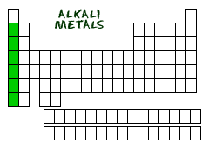
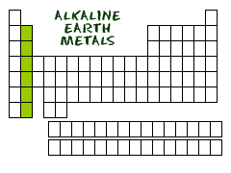
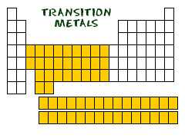
Metal Families
Alkali Metals (Group 1, except hydrogen) (s¹)
  So reactive, alkali metals usually only exist as compounds with other elements.
  Na, found in salt
  Li, found in batteries.
Alkaline Earth Metals (Group 2) (s²)
  Also highly reactive.
  Ca and Mg are important for your health.
Inner Transition Metals (f-block)
  Lanthanide series
  Actinide series
Transition Metals (Group 3-12) (d-block)

Slide 7
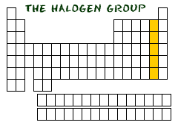
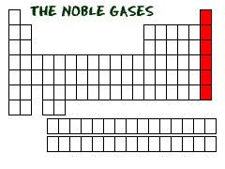
Nonmetal Families
Halogens (Group 17) (p⁵)
  Very reactive elements usually found as part of a compound.
  Compounds made with F are usually found in toothpaste and drinking water to prevent tooth decay.
Noble Gases (Group 18) (p⁶)
  Extremely unreactive elements
  So unreactive, not discovered until 1896
  Used in lasers, variety of light bulbs, and neon signs.

Slide 8
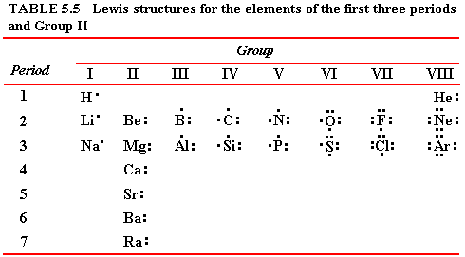
Valance Electrons
Elements in the same family have the same number of valance electrons.
This is one of the most important relationships in chemistry; atoms in the same group have similar chemical properties because they have the same number of valance electrons.

Slide 9
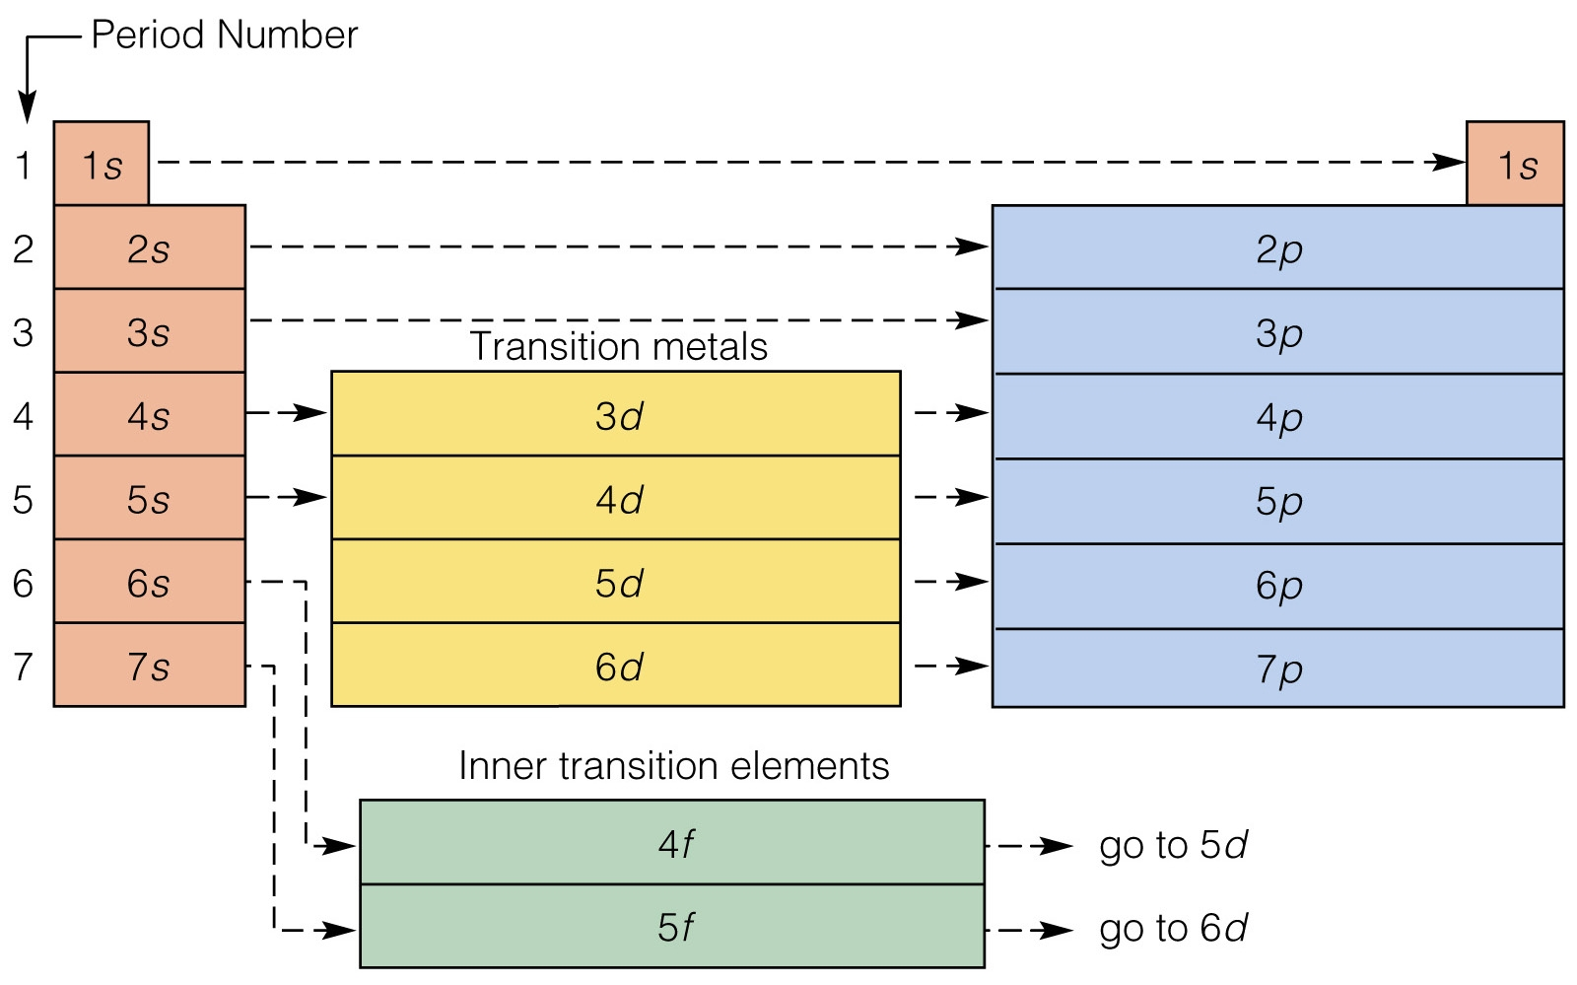
The s-, p-, d-, and f-Block Elements
Because there are four different energy sublevels (s, p, d, and f), the periodic table is divided into four distinct blocks.
The period number identifies the valance shell of elements in that period.

Slide 10
HW6.1
Assigned: Monday, Oct. 23
Due: Tuesday, Oct. 24
DUE ON SEPARATE SHEET OF PAPER
Mendeleev arranged his periodic table in order of increasing atomic ________.
Moseley arranged his periodic table in order of increasing atomic _______.
a. What was wrong with the order that Mendeleev used to arrange elements?
b. What did Mendeleev predict through the use of his table?
a. What is the periodic law?
b. Whose periodic table arrangement agrees with the periodic law?
a. Write the electron configuration for Samarium (Z=62)
b. Show the orbit filled diagram for this electron configuration.
Identify each element as a metal, a metalloid, or a nonmetal.
a. gold b. silicon c. sulfur d. barium
Which of the following sets of elements have similar physical and chemical properties?
a. oxygen, nitrogen, carbon, boron b. strontium, magnesium, calcium, beryllium
c. nitrogen, neon, nickel, niobium.
Name two elements that have properties similar to those of the element sodium.
Identify each element as an alkali metal, an alkaline earth metal, or a halogen:
a. barium b. chlorine c. lithium d. beryllium
Which of these elements are transition metals: Cu, Sr, Cd, Au, Al, Ge, Co?

Slide 11
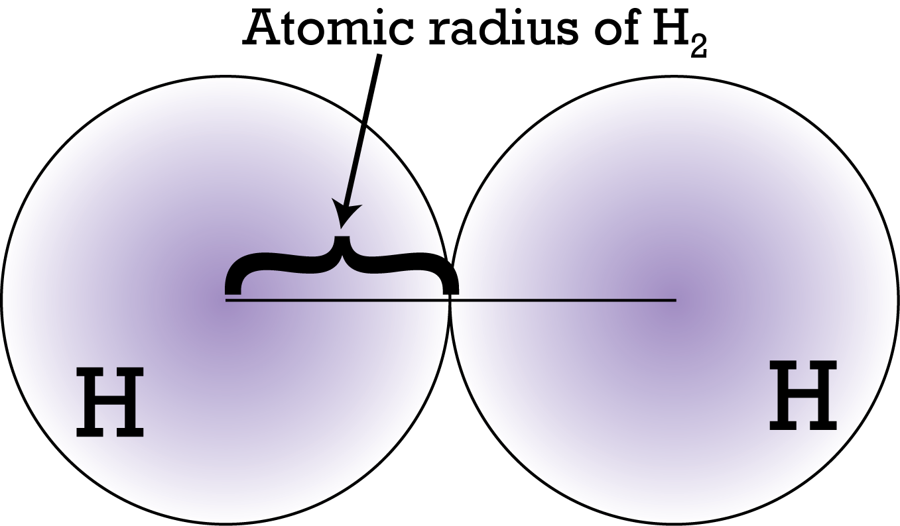
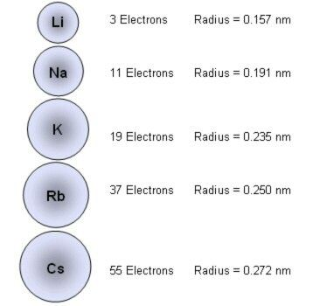
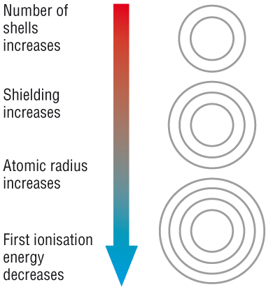
Periodic Trends: Atomic Radius (size)
Atomic radius is half the distance between the nuclei of two atoms of the same element when the atoms are joined.
Atomic radius increases down a group.
WHY?
As you move down a group, more and more energy levels are added, thus the size of the atom increases.

Slide 12
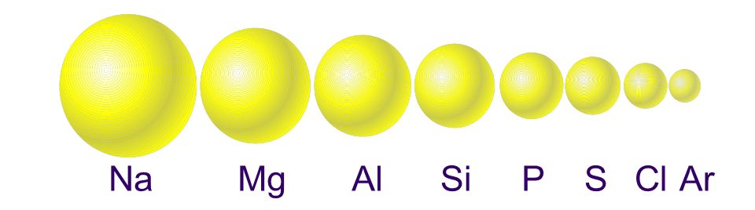
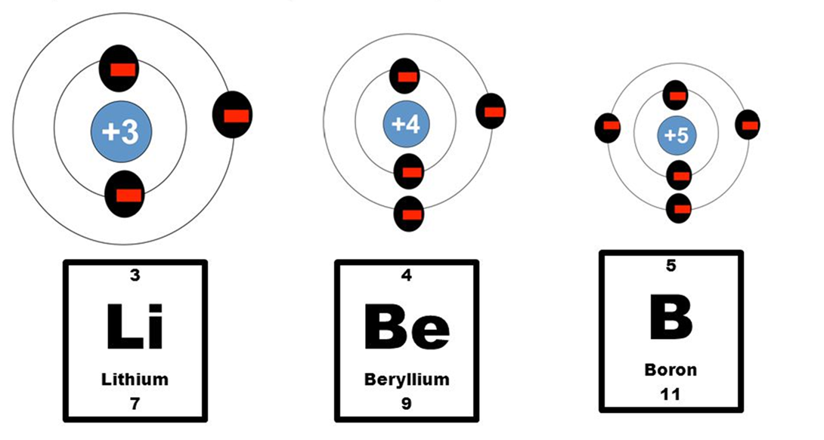
Periodic Trends: Atomic Radius (size)
Atomic radius decreases as you move across a period, left to right.
WHY?
Nuclear charge is a measure of how strongly protons pull on electrons.
More protons = more charge = more pull = smaller atoms.
As you move across a group, there is an increase in nuclear charge.

Slide 13
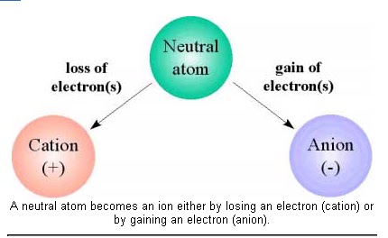
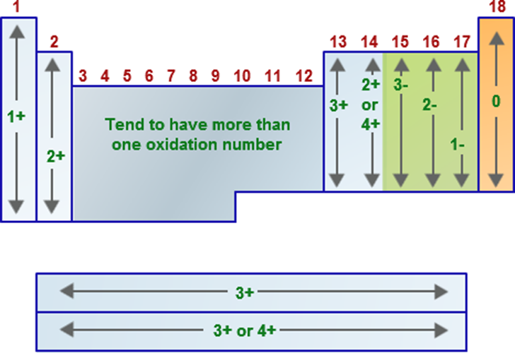
Periodic Trends: Ionic Radius
Ions are formed when an atom gains or loses an electron(s).
  Cations are positive ions formed when atoms lose electrons.
  Anions are negative ions formed when atoms gain electrons.
Atoms tend to gain or lose electrons in order to achieve the highest stability (noble gas configuration, p⁶)
Metals tend to form cations.
Non-metals tend to form anions.

Slide 14
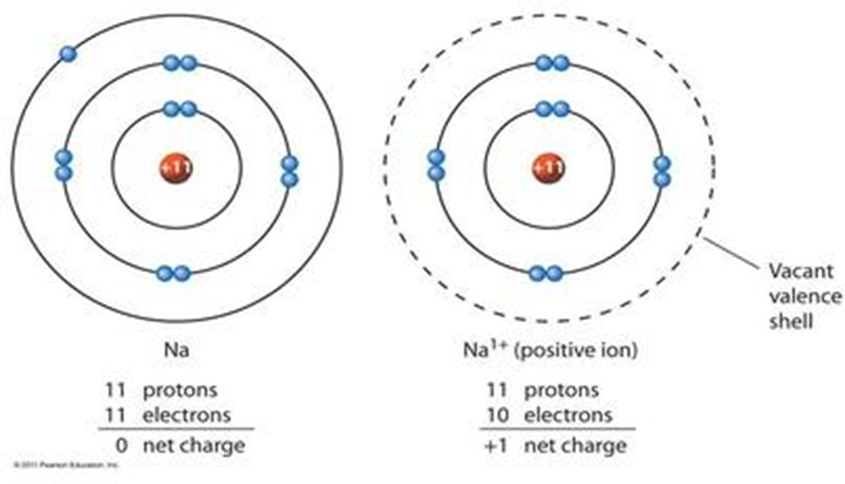
Periodic Trends: Ionic Radius
Cations have a smaller ionic radius compared with their atoms.
WHY?
A.
This is due to:
A. Decrease in energy level with loss of valance electron.
B. Increased nuclear charge on each electron.
B.
More pull per electron by the nucleus.

Slide 15
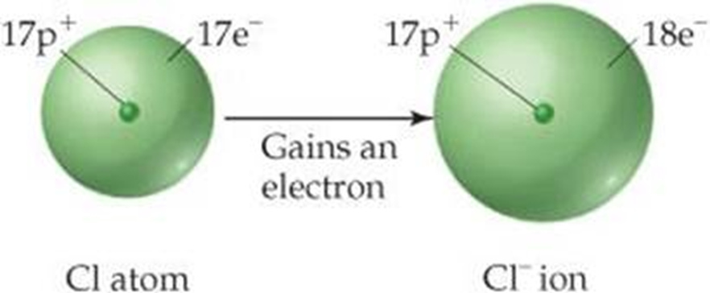
Periodic Trends: Ionic Radius
Anions have a larger ionic radius compared with their atoms.
Less pull per electron by the nucleus.
WHY?
This is due to:
A. Decrease in nuclear charge on each electron
B. Increased electrostatic repulsions by electrons.

Slide 16
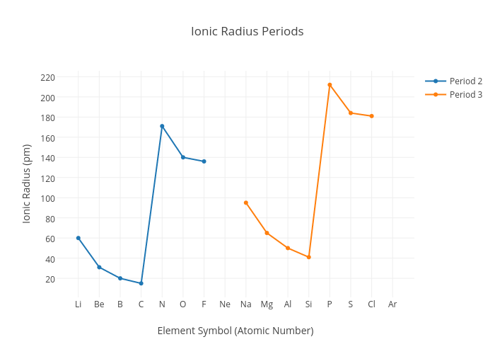
Compare Nitride (N³⁻)with Carbon ion (C⁴⁺)
- N³⁻ has 7 protons and 10 electrons.
- C⁴⁺ has 6 protons and only 2 electrons! (And those electrons are in the n =1 energy level!). C⁴⁺’s will have a way smaller ionic radius.
Compare Fluoride (F¹⁻)with Sodium ion (Na¹⁺)
- Both have 10 electrons.
- F¹⁻ has 9 protons, Na⁺¹ has 11 protons.
Compare Nitride (N³⁻)with Oxide (O²⁻)
-Both have 10 electrons.
- N³⁻ has 7 protons, O²⁻ has 8. Thus O²⁻’s 10 electrons are pulled in closer resulting in smaller radius.
Compare Lithium ion (Li¹⁺)with Beryllium ion (Be²⁺)
-Both have 2 electrons.
- Be²⁺ has 4 protons, Li¹⁺ has only 3. Thus Be²⁺’s 2 electrons are pulled in closer resulting in smaller radius.

Slide 17
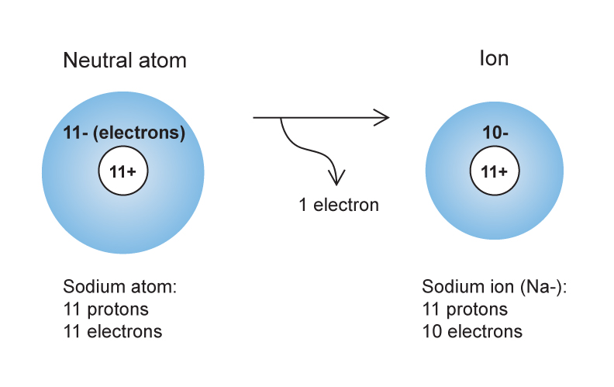
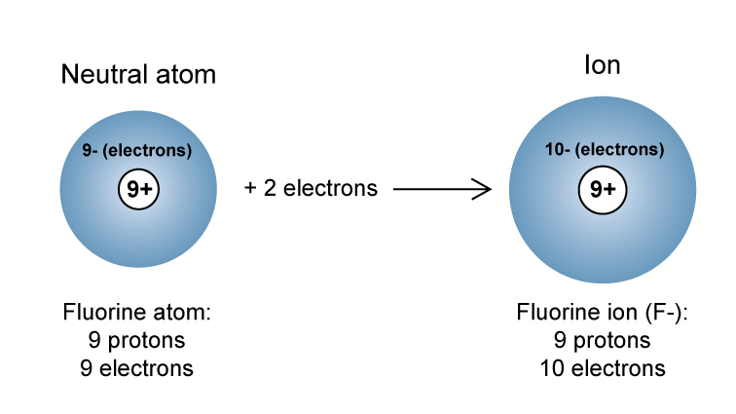
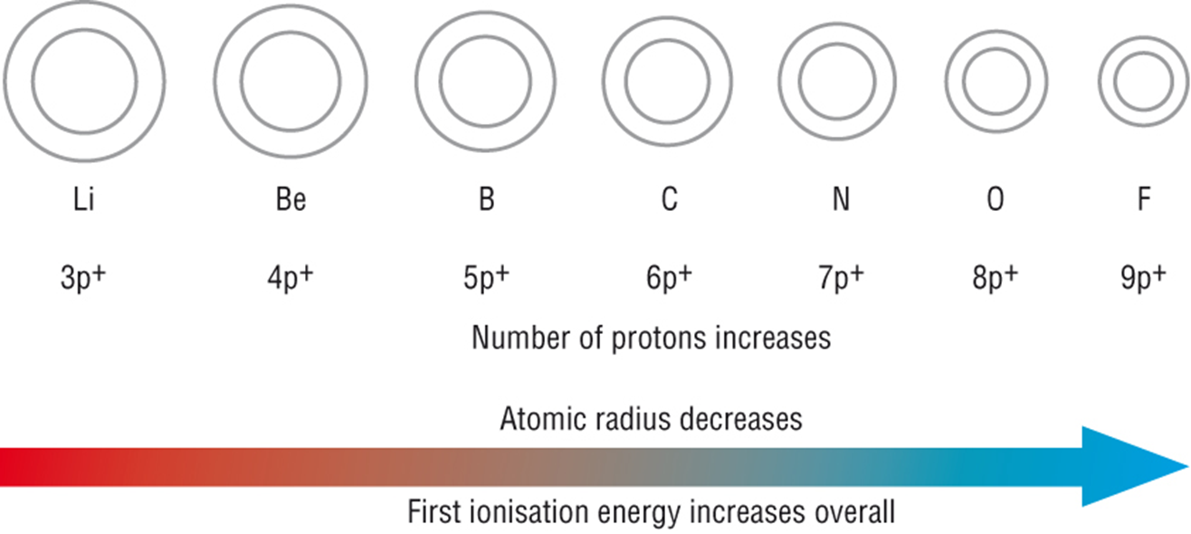
Recap
Atoms Increase in radius down a group due to increasing energy levels.
When atoms gain electrons (anions) their ions are larger due to decreased nuclear charge and increased electrostatic repulsion.
When atoms lose electrons (cations) their ions are smaller due to increased nuclear charge and a decrease in energy level.
Atoms decrease across a period due to increased nuclear charge.

Slide 18
HW6.2
Assigned: Wednesday, Oct. 25
Due: Thursday, Oct. 26
DUE ON SEPARATE SHEET OF PAPER
a. Of Cesium (Cs), Hafnium (Hf) and Gold (Au), which has the smallest atomic radius?
b. Explain your answer in terms of the periodic table.
Given the following electron configurations: Q: 3s²3p⁵ R: 3s¹ T:2s²2p⁴
a. Which are in the same period?
b. Give the name of each element and state to what group it belongs.
c. Which element would you predict to have the smallest ionic radius?
d. Which element would you predict to have the largest atomic radius?
e. What charge of ion is each most likely to be obtained when making a compound?
Hydrogen can be an atom (H); or ions (H⁻¹) or (H⁺¹). Arrange these 3 in order of increasing size. Label one of them cation and one of them anion.
Arrange these elements in order of decreasing atomic size: sulfur, chlorine, aluminum, and sodium. Does your arrangement demonstrate a periodic trend or a group trend?
Which element in each pair has atoms with a larger atomic radius?
a. sodium, lithium b. strontium, magnesium c. carbon, germanium d. selenium, oxygen
Which particle has the larger radius in each atom/ion pair?
a. Na, Na⁺ b. S, S²⁻ c. I, I⁻ d. Al, Al³⁺
How does the ionic radius of a typical metal compare with its atomic radius?
As you move down a group, atomic radii tends to _________ due to more ________ __________. As you move across a period, atomic radii tend to ________ due to an increase in ________ _______.

Slide 19
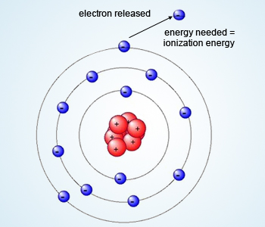
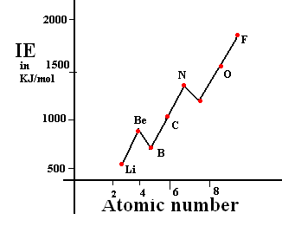
Periodic Trends: Ionization Energies
Ionization energy is the amount of energy needed to remove an electron from an atom to create a cation.
The lower the ionization energy, the easier it is to remove an electron from an atom.
Ionization energy increases across a period due to the increase in nuclear charge.
WHY?
Due to the increase in nuclear charge.

Slide 20
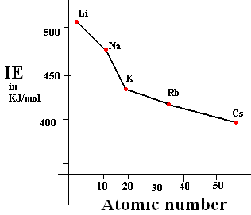
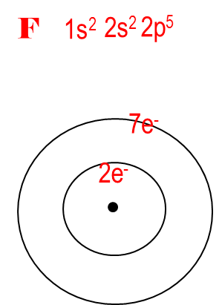
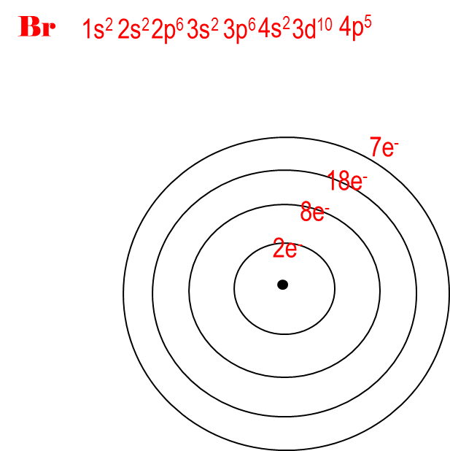
Periodic Trends: Ionization Energies
Ionization energy decreases down a group.
WHY?
The decrease down a group is due to increased shielding of the valance electrons from the inner electrons.
The 7 valance electrons of Br have 28 inner electrons between them and the nucleus.
The 7 valance electrons of F have only 2 inner electrons between them and the nucleus.
This effect is called shielding, and is responsible for a decreased nuclear charge on valance electrons.

Slide 21
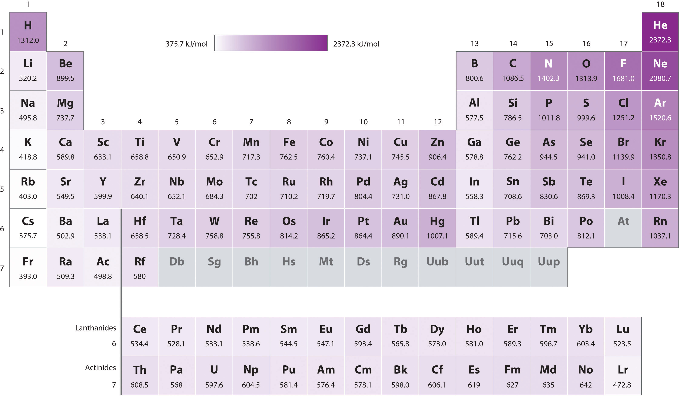
Ionization Energies
#3!
Obviously, Nobel Gases don’t want to lose electrons. So their ionization energy is very high.
But why is N higher than O?
Why is Zn, Cd, Hg so high?
#2!
#2!
#1!
Don’t forget about the 2nd and 3rd best stable electron configurations!!!!!

Slide 22
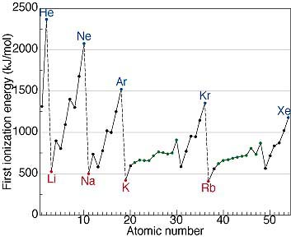
Clear Trend????
Although the general trend of ionization energies is increasing across a period, it is better to have an understanding of which elements have an electron to lose so you can recognize the trend buckers.
The trend as you move down a group is a decrease in ionization energy. This is due to an increase in distance from the outer electrons to the nucleus as well as increased nuclear shielding.

Slide 23
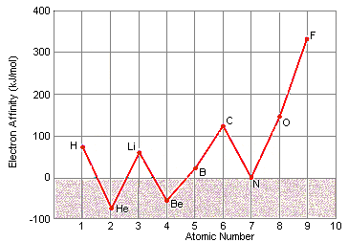
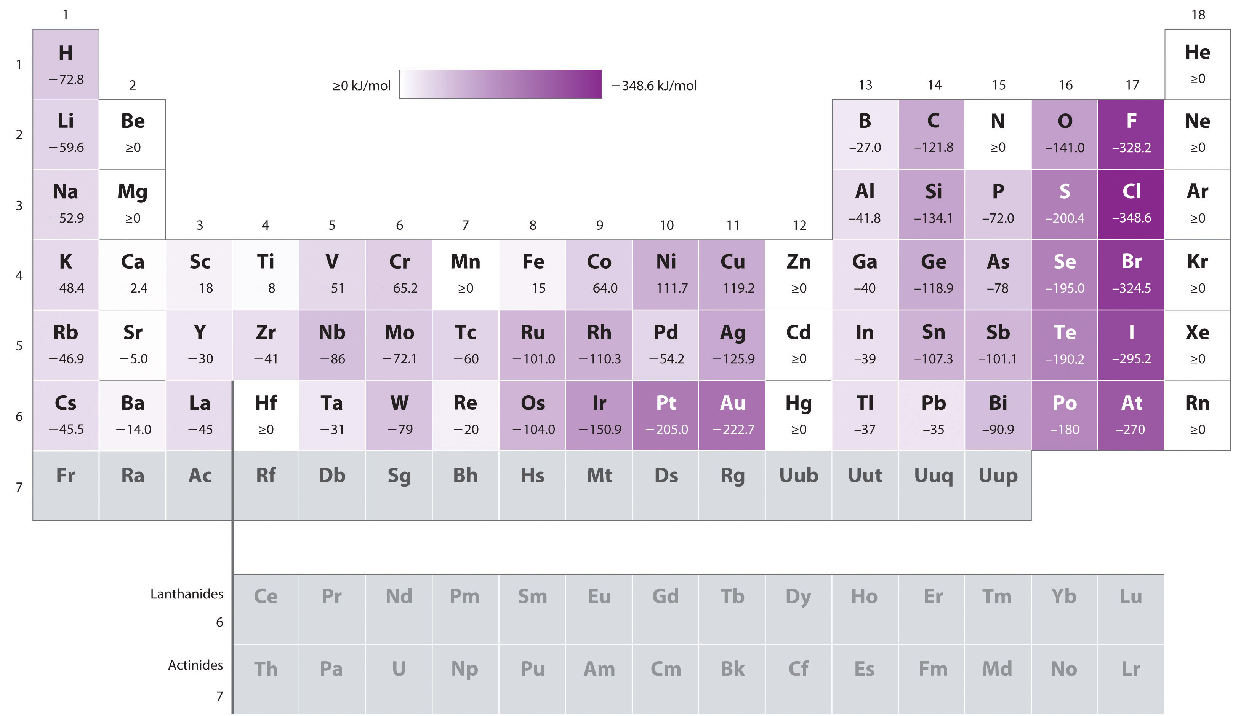
Periodic Trends: Electron Affinities
Electron Affinity is a measure of energy released when an electron is added to an atom to make it an anion.
-
The higher the negative value of electron affinity, the more easier it is to add an electron to an atom.
Electron Affinities are varied across a period due to the stability of atoms (s², d⁵, d¹⁰, p³).
Electron Affinities generally tend to decrease down a group due to increased shielding.

Slide 24
HW6.3
Assigned: Thursday, Oct. 26
Due: Friday, Oct. 27
DUE ON SEPARATE SHEET OF PAPER
Without looking at the ionization table, arrange the following in terms of 1st ionization energy:
Li, O, C, K, Ne, and K.
What is electron affinity? What is the sign for the value of an atom with a high electron affinity?
Arrange the following in order of decreasing electron affinity: C, O, Li, Na, Rb, and F.
Explain how each of the following affects ionization energy: nuclear charge, shielding, valance electron energy level.
Write the following in order of increasing ionization energy:
a. Be, Mg, Sr, b. Bi, Cs, Ba
Which of the following has the greatest atomic radius?
a. sodium or lithium b. strontium or magnesium c. carbon or germanium
The ionization energy tends to _________ as atomic number increases in any horizontal row or period.
A column, or group will show a decrease in ionization energy as atomic number ______.
Metals have ______ first ionization energies and nonmetals have ________ ionization energies.
Nonmetals tend to have ______ electron affinities than metals with the exception of group ______.

Slide 25
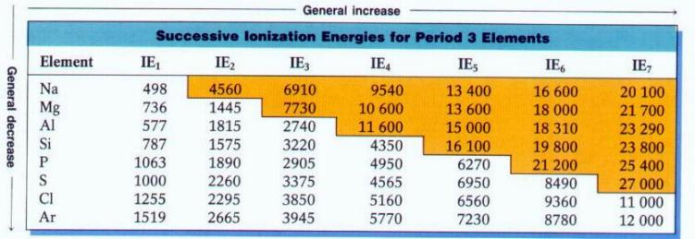
Periodic Trends: Multiple Ionization Energies
After removing the first electron, it is possible to remove additional electrons.
  The energy to remove the second electron is called the second ionization energy.
  The energy to remove the third electron is called the third ionization energy, etc.
Notice the 2nd ionization energy for Na is 10x as great as the 1st. This is due to the fact that removing a 2nd electron from sodium would be to remove one from an inner shell (closer to the nucleus).
For all elements, the 2nd IE is greater because of the increased nuclear force.
But IE becomes really great once you go down a valance shell.
(In Yellow)

Slide 26
WHY?
Successive Ionization Energies
  IE increases for each electron is removed
  Large jump in I.E. occurs after all valence
  electrons are removed
  Al (1s²2s²2p⁶3s²3p¹)
  1st I.E. 578 ^{kJ}/_{mol} Al⁺¹ (1s²2s²2p⁶3s²)
Al⁺¹ (1s²2s²2p⁶3s²)
2nd I.E. 1817 ^{kJ}/_{mol} Al⁺² (1s²2s²2p⁶3s¹)
Al⁺² (1s²2s²2p⁶3s¹ )
3rd I.E. 2745 ^{kJ}/_{mol} Al⁺³ (1s²2s²2p⁶)
Al⁺³ (1s²2s²2p⁶)
4th I.E. 11,578 ^{kJ}/_{mol} Al⁺⁴ (1s²2s²2p⁵)

Slide 27
  Al (1s²2s²2p⁶3s²3p¹)
  Al⁺¹ (1s²2s²2p⁶3s²)
  Al⁺¹ (1s²2s²2p⁶3s²)
Al⁺² (1s²2s²2p⁶3s¹)
Al⁺² (1s²2s²2p⁶3s¹ )
Al⁺³ (1s²2s²2p⁶)
Al⁺³ (1s²2s²2p⁶)
Al⁺⁴ (1s²2s²2p⁵)
.
578 ^{kJ}/_{mol}
2e⁻
8e⁻
3e⁻
.
2e⁻
8e⁻
2e⁻
1817 ^{kJ}/_{mol}
.
2e⁻
8e⁻
2e⁻
.
2e⁻
8e⁻
1e⁻
.
2745 ^{kJ}/_{mol}
2e⁻
8e⁻
1e⁻
.
2e⁻
8e⁻
.
2e⁻
8e⁻
11,578 ^{kJ}/_{mol}
.
2e⁻
7e⁻

Slide 28
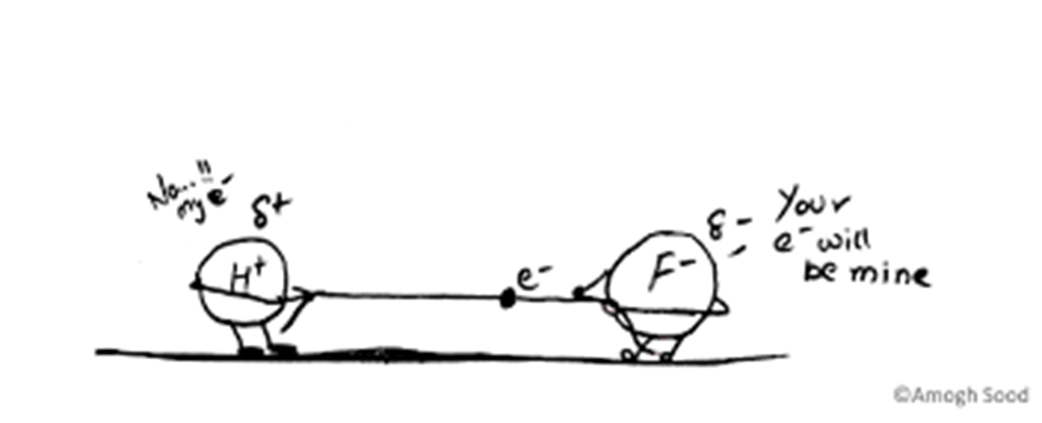
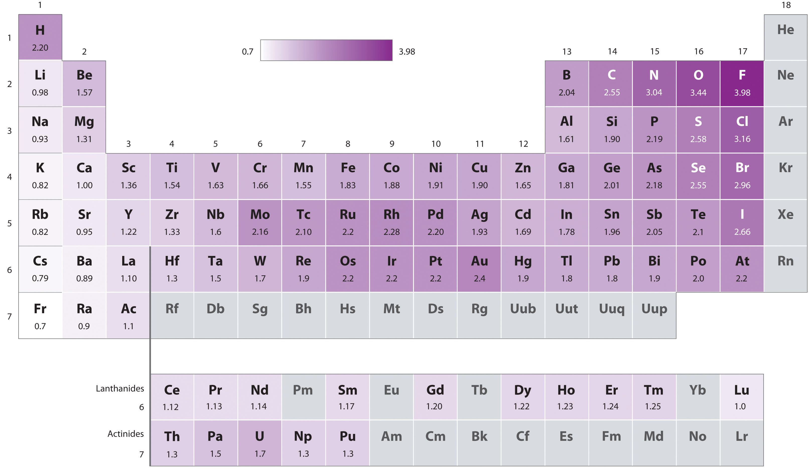
Periodic Trends: Electronegativity
The electronegativity of an element indicates the relative ability of its atoms to attract electrons in a chemical bond.
The greater the electronegativity, the more an atom pulls on shared electrons in a bond.
Electronegativity's increase across a period and decrease down a group. (Exception is the Noble Gases)

Slide 29
HW6.4
Assigned: Friday, Oct. 27
Due: Tuesday, Oct. 31
DUE ON SEPARATE SHEET OF PAPER
Test Review
Define the following:
a. ionization energy b. shielding effect c. electron affinity d. electronegativity e. atomic radius
Explain why carbon has such a large jump for the fifth ionization energy.
Write the following in order of increasing ionization energy: Na⁺¹, Al⁺¹, Na⁻¹
Which of the following is more electronegative?
a. chlorine or fluorine b. carbon or nitrogen c. arsenic or calcium
What law states that the chemical properties of elements repeat in a periodic fashion based on their atomic number?
What is the modern periodic table arranged by? Who is credited with first arranging it as in this way?
Mendeleev arranged his periodic table by ________.
Why are noble gases not included in the electronegativity values?
When the elements in each pair are chemically combined, which element in each pair has a greater attraction for electrons?
a. Ca or O b. O or F c. H or O d. K or S

Slide 30
HW6.4
Assigned: Friday, Oct. 27
Due: Tuesday, Oct. 31
DUE ON SEPARATE SHEET OF PAPER
Test Review
10. Fill in the following table:
Group | Family Name | Valence electrons
Group IA
Group IIA
Group IIIA | -----------------------------
Group VA | -----------------------------
Group VIA
Group VIIA
Group VIIIA
11. For which of these properties does lithium have a larger value than potassium?
a. first ionization energy
b. atomic radius
c. electronegativity
d. ionic radius
12. Give a reason for each of the following comparisons:
a. Calcium has a smaller second ionization energy than does potassium.
b. Lithium has a larger first ionization energy than does cesium.
c. Magnesium has a larger third ionization energy than does aluminum.

Slide 31
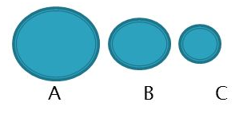
HW6.4
Assigned: Friday, Oct. 27
Due: Tuesday, Oct. 31
DUE ON SEPARATE SHEET OF PAPER
Test Review
13. Why does it take more energy to remove a 4s electron from zinc than from calcium?
14. The following spheres represent Ca, Ca2+ and Mg2+. Which one is which?
Explain your reasoning.
15. Identify each property below as more characteristic of a metal or a nonmetal.
a. a gas at room temperature. b. brittle c. malleable
d. poor conductor of electricity e. shiny
16. Which noble gas does not have eight electrons in its highest energy level?
17. Which of the following are symbols for representative elements: Na, Mg, Fe, Ni, Cl?
18. In which pair of elements are the chemical properties of the elements most similar? Explain your reasoning.
a. sodium and chlorine b. nitrogen and phosphorus c. boron and oxygen
19. Would you expect metals or nonmetals in the same period to have higher ionization energies? Give a reason for your answer.
20. Locate each of the following elements in the periodic table and decide whether its atoms are likely to form anions or cations.
a. sodium b. fluorine c. calcium d. potassium e. iodine f. beryllium

