Slide 1
Electrons in the Atom II
Unit 5: The quantum mechanical model

Slide 2
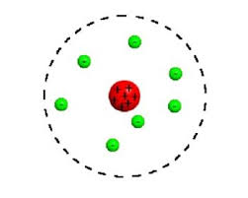
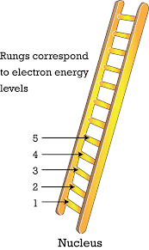
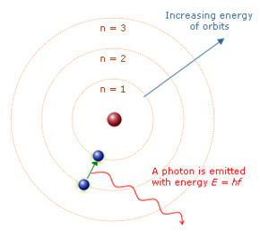
Evolution of the Atomic Model
Thomson’s Model had electrons dispersed in a giant positive charge.
Rutherford's model adds the nucleus
Bohr’s model explains that electrons exist only at distinct energy levels.
This is like rungs on a latter. You can step on a rung, but not in between any. Same with electrons. They can only exist at an energy level, not between it.

Slide 3
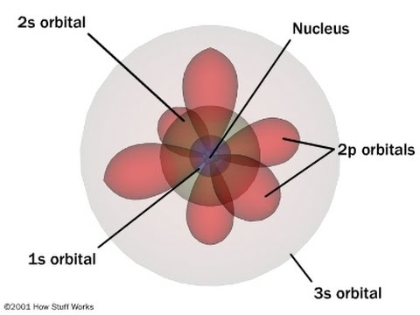
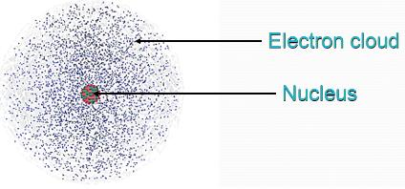
Quantum Mechanical Model
But the Bohr model isn’t the end of the story!
Shrodinger, de Broglie et al contributed to Bohr’s model to produce our modern model, The Quantum Mechanical Model (QMM)
In the QMM, electrons occupy distinct energy levels, as Bohr predicted, but those orbitals have 3 dimensional shapes.
Because electrons move too fast to see, their 3-D shapes are often referred to as ‘the electron cloud’.

Slide 4
Quantum Numbers
The location of electrons are defined by 4 quantum numbers:
Principal (n)
Angular Momentum (l)
Magnetic (m _{l})
Spin (m_{s})
No 2 electrons can have the same set of 4 quantum numbers.

Slide 5
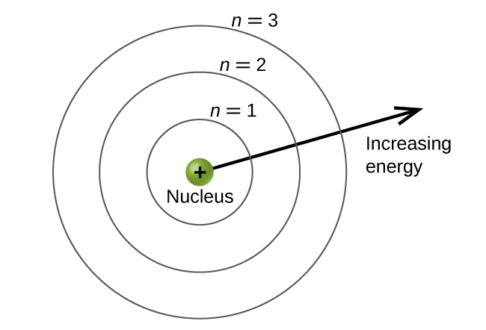
1. Principal Energy Number (n)
This is the energy level.
This represents the distance from the nucleus.
Larger n = farther from the nucleus = more energy.
2n² = maximum number of electrons that can be found on the energy level.
n² = maximum number of orbitals that can be found in this energy level.
(There are more than 3 energy levels.)

Slide 6
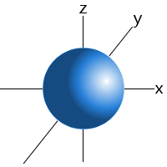
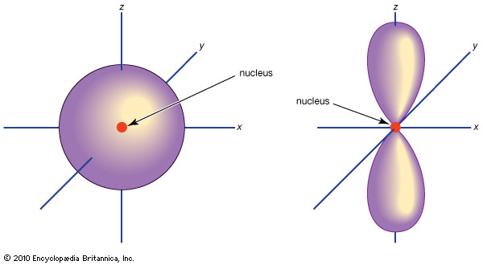
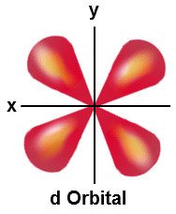
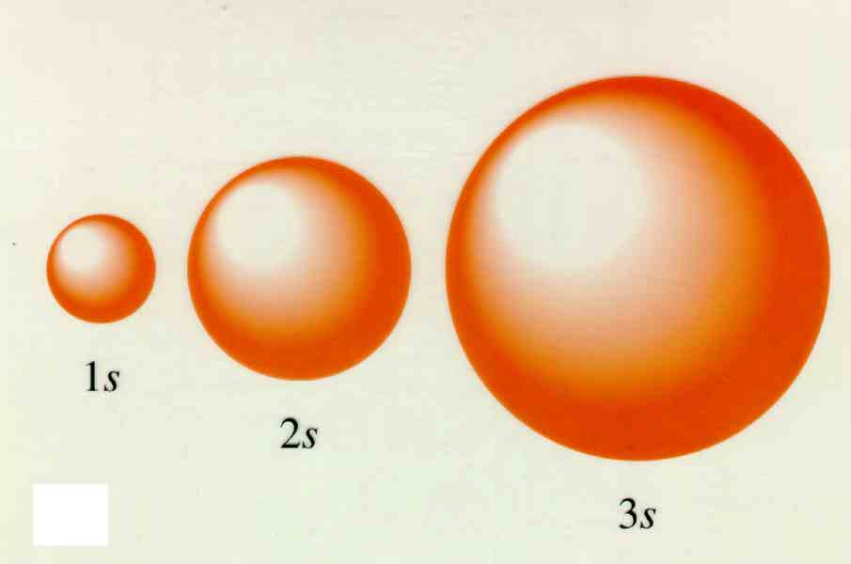
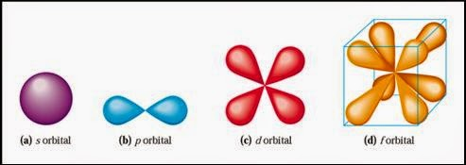
2. Angular Momentum (l) (Sublevel)
The Angular Momentum describes the shape of the orbital.
Each principal energy level can contain n numbers of sublevels.
n=1 contains 1 sublevel, the s.
n=2 contains 2 sublevels, the s and p.
n=3 contains 3 sublevels, the s, p and d.
A d orbital is shaped like a double bowtie.
n=4 contains 4 sublevels, the s, p, d and f.
The s sublevel is spherical in shape.
An f orbital is crazy shaped.
The 2s is larger than the 1s, and the 3s is larger than the 2s, etc.
A p orbital is shaped like a bowtie.

Slide 7
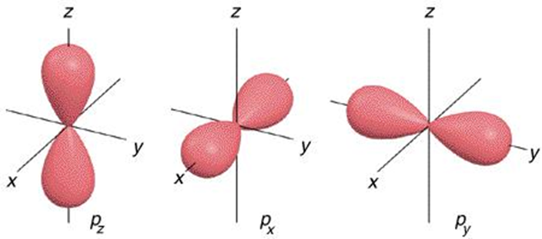
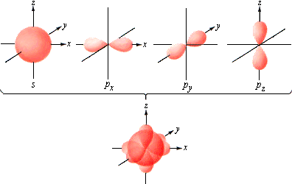
3. Magnetic (m _{l})
The magnetic quantum number describes the orientation of the orbital around the nucleus.
The s orbital has only 1 orientation around the nucleus.
A p orbital has 3 orientation around the nucleus.
NOTE: You are not responsible for knowing the different orientations (p_{z}, p_{z}, p_{y}) just that p has 3 orientations.
RECALL, the number of orbitals a principal energy level can have is n².
Energy level 1, n = 1, 1² = 1 orbital, the 1s.
Energy level 2, n = 2, 2² = 4 orbitals, 2s, three 2p’s!

Slide 8
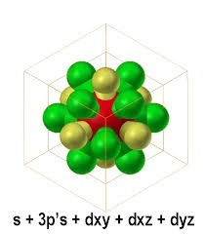
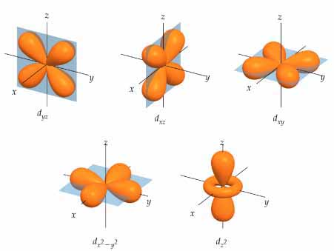
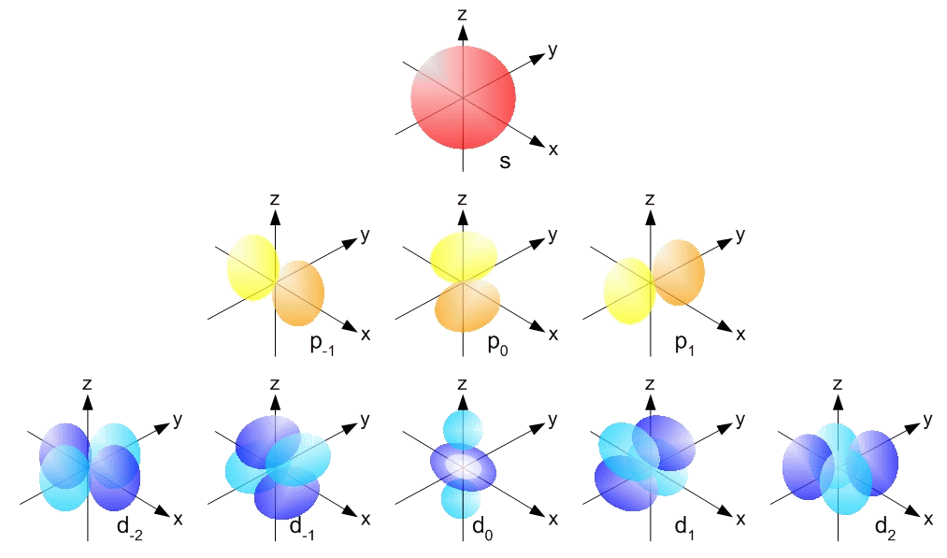
3. Magnetic (m _{l})
The d orbital has 5 orientations around the nucleus.
Notice, this image only shows three of the d orbitals.
How crazy would all 5 look!?
Which two are missing?
Energy level 3, n = 3, 3² = 9 orbital:
the 3s, three 3p’s, five 3d’s in the 3rd energy level!

Slide 9
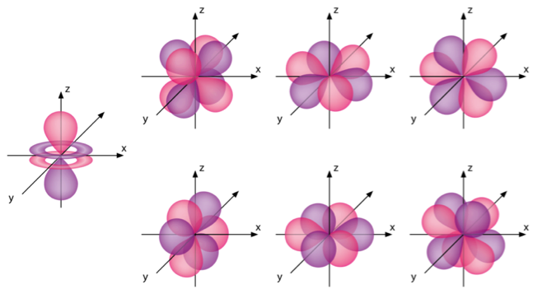
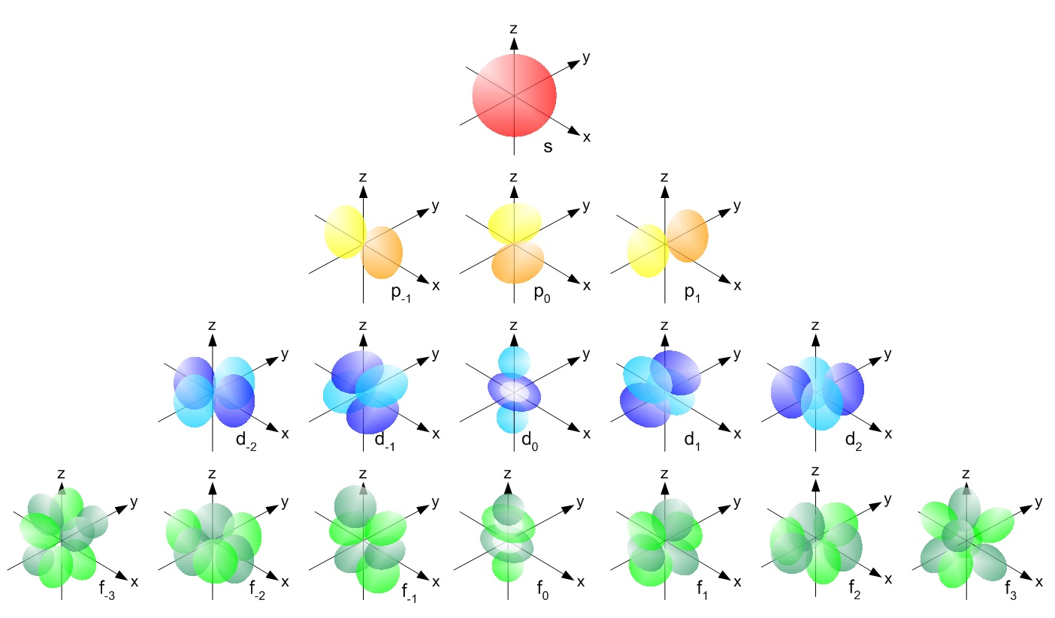
3. Magnetic (m _{l})
The f orbital has 7 orientations around the nucleus.
Energy level 4, n = 4, 4² = 16 orbitals:
the 4s, three 4p’s, five 4d’s and seven 4f’s in the 4th energy level!
In theory, the g orbital would follow the f, and h would follow the g and so on down the alphabet.
How many different orientations do you think the g and h orbitals would have?

Slide 10
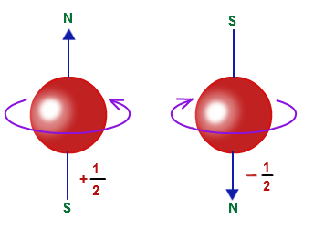
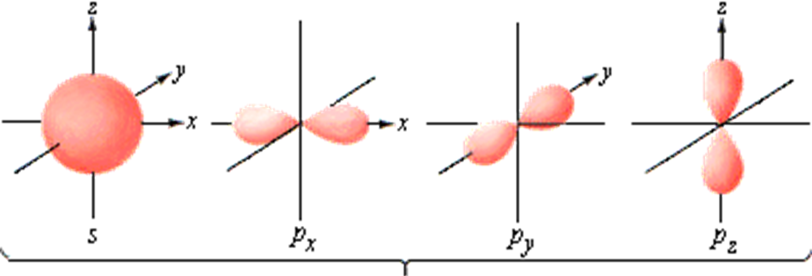
4. Spin (m_{s})
The fourth quantum number is the spin of the electrons.
Each orbital can hold 2 electrons.
Electrons have the same, negative charges.
To negate their repulsion, electrons spin in opposite directions (+¹/₂ or -¹/₂).
RECALL: 2n² = maximum number of electrons that can be found on the energy level.
2 e⁻
Energy level 1, n=1, has 1 orbital, the 1s. Each orbital can hold 2 electrons, so 1s = 2 electrons, 2x1² = 2 electrons on the first energy level.
2 total e⁻
Energy level 2, n=2, has 4 orbitals, the 2s, and three 2p’s. Each orbital can hold 2 electrons. 2x2² = 8 electrons on the 2nd energy level.
Electrons spinning in opposite directions.
2 e⁻
2 e⁻
2 e⁻
2 e⁻
8 total e⁻

Slide 11
HW5.1
Assigned: Thursday, Oct 5 Due: Friday, Oct 6 DUE ON A SEPARATE SHEET OF PAPER
Sketch 1s, 2s, and 2p orbitals using the same scale for each.
How many orbitals are in the 2p sublevel?
The letters s, p, d and f refer to which quantum number?
How many sublevels are possible at the 3rd energy level? How many total orbitals? How many total electrons could be contained at the 3rd energy level?
How many sublevels are possible at the 7th energy level? How many total orbitals? How many total electrons could be contained at the 7th energy level?
What is the maximum number of electrons an orbital can contain?
If two electrons are at the same energy level, in the same sublevel, in the same orientation, and the first is spinning clockwise, what direction is the second spinning?
How many sublevels are contained in each of these principal energy levels? a. n = 1 b. n = 2 c. n =3 d. n = 4

Slide 12
Expressing an Atoms Electrons
There are many ways to express an atoms electrons. We will focus on 3:
A. Orbital Diagrams B. Electron Configurations C. Lewis Dot Structures
The rules governing electrons in an atom governed by 4 rules:
Atoms are neutrally charged, # of protons = # of electrons.
Aufbau Principal
Pauli Exclusion Principal
Hund‘s Rule

Slide 13
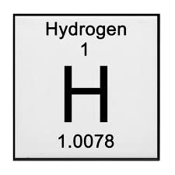
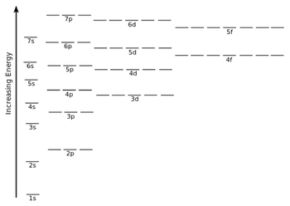
Aufbau Princiapl
Hydrogen:
1 proton, 1 electron
Aufbau Principal states that electrons occupy the orbitals of lowest energy first.
Line or Box represents the orbital
Orbital Diagram:
Arrow indicates the electron
Number of electrons in sublevel
Lowest energy level, 1s
Electron Configuration:
1s¹
Principal Energy Level
Sub Level

Slide 14
Pauli Exclusion Principal
Pauli Exclusion Principal states that a maximum of 2 electrons can occupy the same orbital, but they must have opposite spins.
2 electrons, both in the 1s orbital, with opposite spins.
Show the two empty p orbitals
He:
Li:
Be:
B:
Orbital Diagram:
1s²
1s²2s¹
1s²2s²
1s²2s²2p¹
Electron Configuration:

Slide 15
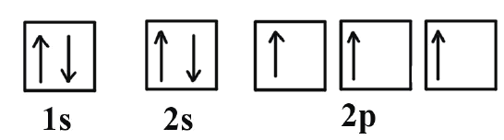
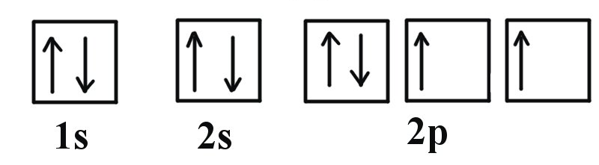
Hund’s Rule
Hund’s Rule states that electrons with the same spin will occupy empty orbitals of the same energy, before they go back and pair up with opposite spins.
C:
N:
O:
Orbital Diagram:
One electron now in each of the 2p
Electron Configuration:
1s²2s²2p²
1s²2s²2p³
1s²2s²2p⁴

Slide 16
Examples
Write the orbital diagram for fluorine (F):
Write the electron configuration for Neon (Ne):
1s²2s²2p⁶
1s²2s²2p⁶3s¹
Write the electron configuration for sodium (Na):
1s²2s²2p⁶3s²3p³
Write the electron configuration for phosphorus (P):
Write the orbital diagram for calcium (Ca):
↑↓
↑↓
↑↓
↑↓
↑↓
↑↓
↑↓
↑↓
↑↓
↑↓
1s
2s
2p
3s
3p
4s
Write the orbital diagram for nickel (Ni):
↑↓
↑↓
↑
↑
↑
↑
↑
↓
Ni:
↑↓
↑↓
↑↓
↑↓
↑↓
↑↓
↑↓
↑↓
↓
↓
1s
2s
2p
3s
3p
4s
3d

Slide 17
Aufbau!
4s is lower energy than 3d!
So, according to Aufbau 4s fills first, then 3d,
Then 4p,
Then 5s,
Then 4d
etc.

Slide 18
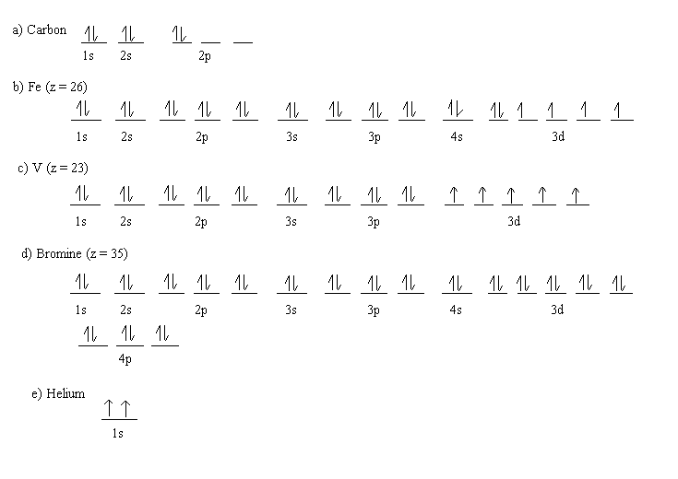
HW5.2
Assigned: Friday, Oct 6 Due: Monday, Oct 9 DUE ON A SEPARATE SHEET OF PAPER
Write the electron configuration for the following: a. Sodium b. Chlorine d. Cadmium d. Radium (Yes it is a big one. DO IT!)
Show the orbital diagrams for the atoms in 1 a-c.
State what rule is being violated in the following orbit diagrams. (If nothing is being violated, write OK.) Rules include: Wrong numbers of electrons Aufbau Principal Hund’s Rule Pauli Exclusion Principal

Slide 20
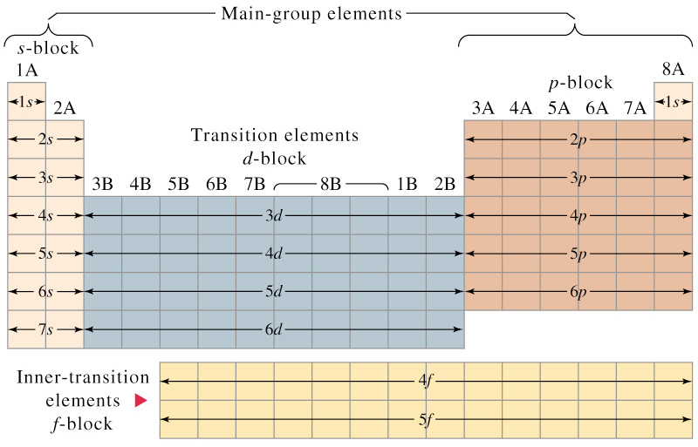
Periodic Table Organization
The periodic table is organized by orbital block.
Each period represents a principal energy level (n).

Slide 21
HW5.3
Assigned: Monday, Oct 9 Due: Tuesday, Oct 10 DUE ON A SEPARATE SHEET OF PAPER
Give the electron configurations for atoms of these elements: a. Na b. K c. I d. Ne
How many electrons are in the second energy level of an atom of each element? a. chlorine b. phosphorus c. potassium
Write orbital diagrams for the elements that are identified by these atomic numbers: a. 7 b. 9 c. 12 d. 36
Give the symbol for the atom that corresponds to each electron configuration. a. 1s²2s²2p⁶3s²3p⁶ b. 1s²2s²2p⁶3s²3p² c. 1s²2s²2p⁴ d. 1s²2s²2p⁶3s²3p⁶4s¹
Examine the following orbital filled diagrams and determine which rule (# e⁻, Aufbau, Pauli, or Hund) is being violated. If nothing is wrong, write correct.
a. carbon:
b. Sc :
c. Ne :
↑↓
↑↓
↑↓
1s
2s
2p
↑↓
↑↓
↑↓
↑↓
↑↓
↑↓
↑↓
↑↓
↑↓
↑↓
↑↓
↑↓
↑↓
↑↓
↑
1s
2s
2p
3s
3p
3d
4s
↑↓
↑↑
↑↓
↑↓
↑↓
1s
2s
2p

Slide 22
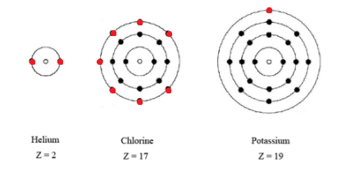
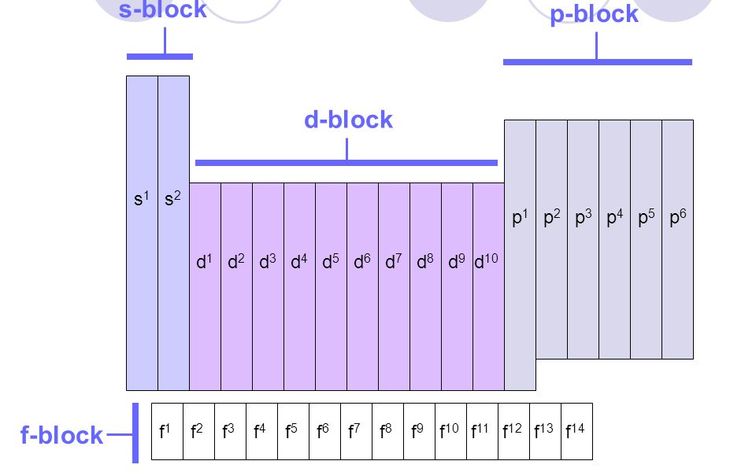
Valance Electrons and Stability
Only red electrons are valance.
Valance electrons are electrons in an atom’s outermost energy level.
Titanium (Ti): 1s²2s²2p⁶3s²3p⁶4s²3d²
The outermost energy level is n=4, so Titanium has 2 valance electrons.
Atoms want to have the most stable arrangement of their electrons.
The most stable arrangements are those with full energy levels.
Next in stability are those with full sublevels.
Third are those with half-full sublevels.
Any other arrangement needs no special consideration.

Slide 23
Exceptional Electron Configurations
In order to achieve a more stable configuration, electrons will rearrange themselves from the configuration predicted by the Aufbau Principal.
Elements with exceptional configurations take one electron from the s and add it to the d.
Although there are several elements with exceptional configurations, you are responsible for knowing that Cr, Mo, Cu, Ag and Au have exceptional electron configurations.
Cr -
↑↓
↑↓
↑↓
↑↓
↑↓
↑↓
↑↓
↑↓
↑↓
↑↓
↑
↑
↑
↑
1s
2s
2p
3s
3p
4s
3d
↑↓
↑↓
↑↓
↑↓
↑↓
↑↓
↑↓
↑↓
↑↓
↑
↑
↑
↑
↑
↑
MORE STABLE!
1s
2s
2p
3s
3p
4s
3d
Cr – 1s²2s²2p⁶3s²3p⁶4s¹3d⁵
Cu -
↑↓
↑↓
↑↓
↑↓
↑↓
↑↓
↑↓
↑↓
↑↓
↑↓
↑↓
↑↓
↑↓
↑↓
↑
1s
2s
2p
3s
3p
4s
3d
↑↓
↑↓
↑↓
↑↓
↑↓
↑↓
↑↓
↑↓
↑↓
↑
↑↓
↑↓
↑↓
↑↓
↑↓
MORE STABLE!
1s
2s
2p
3s
3p
4s
3d
Cu – 1s²2s²2p⁶3s²3p⁶4s¹3d¹⁰

Slide 24
HW5.4
Assigned: Tuesday, Oct 10 Due: Thursday, Oct 12 DUE ON A SEPARATE SHEET OF PAPER
Write the electron configuration for the following: a. Mo b. Ag
Show the orbital diagrams for the atoms in 1a, b
Why do the actual electron configurations for some elements differ from those assigned using the Aufbau Principal?
Which of these orbital designations is invalid? a. 4s b. 2d c. 3f d. 3p
What is the maximum number of electrons that can go into each of the following sublevels? a. 2s b. 4s c. 4p d. 4f e. 3p f. 3d g. 5s h. 5p
What is meant by 3p³?
How many electrons are in the highest occupied energy level of the following atoms? a. barium b. aluminum c. sodium d. oxygen
Give the symbols and names of the elements that correspond to the following configurations: a. 1s²2s²2p⁶3s¹ b. 1s²2s²2p³ c. 1s²2s²2p⁶3s²3p⁶4s²3d²
How many valance electrons are in each atom? a. potassium b. carbon c. magnesium d. oxygen

Slide 25
Lewis Dot Structures
Represent the paired 2, 2s e⁻
Lewis Dot structures provide a way of showing the electrons an atom has available for bonding.
Bonding electrons are generally the valance electrons (s and p).
Lewis Dot structures show just the s and p electrons.
Be: 1s²2s²
The two single dots around carbon represent the two unpaired p e⁻
B: 1s²2s²2p¹
Chemical Symbol represents the nucleus and inner shell electrons.
C: 1s²2s²2p²
O: 1s²2s²2p⁴
H: 1s¹
Li: 1s²2s¹
Keep the two 1s electrons together as they are paired up.
Oxygen has the 2 unpaired p’s and the one paired p.
1s aren’t valance, so they aren’t shown in a dot structure.
He: 1s²

Slide 26
HW5.5
Assigned: Thursday, Oct 12 Due: Friday, Oct 13 DUE ON A SEPARATE SHEET OF PAPER
TEST REVIEW
Write the electron configuration of Uranium; state the numbers of electrons in each energy level and stat which levels are not filled.
Identify the elements with the following electron configurations. a. 1s²2s²2p⁶3s²3p⁴ b. 1s²2s²2p⁶3s²p⁶4s¹3d⁵ c. 1s²2s²2p⁶3s²3p⁶4s²3d¹⁰4p³
Draw the lewis dot structure for each 2a-c.
Why does the 4s orbital fill in before the 3rd energy level is full?
Indicate whether each of the following electron transitions emits energy or requires the absorption of energy. a. 3p to 3s b. 3p to 4s c. 2s to 2p d. 1s to 2s
How many paired electrons are there in an atom of each element? a. helium b. sodium c. boron d. oxygen
An atom of an element has two electrons in the first energy level and five electrons in the second energy level. Write the electron configuration for this atom and name the element. How many unpaired electrons does an atom of this element have?
Arrange the following sublevels in order of decreasing energy: 2p, 4s, 3s, 3d, and 3p.
Write the orbital diagram for Bismuth, (Bi)
What is the maximum number of electrons one orbital can hold?
How many sublevels can be found at the 4th principal energy level?

