Slide 1
Electrons in Atoms
Unit 4

Slide 2
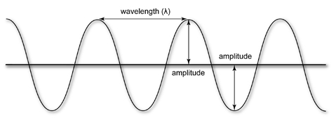
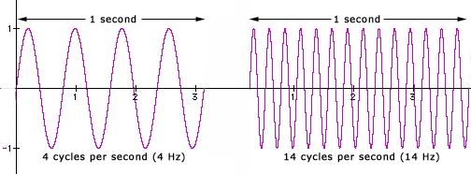
Properties of Light
Light acts as a wave when propagating through space and as a particle when interacting with matter.
Wavelength (λ) – distance between two identical points on a wave.
This is measured in units of distance (m, nm, etc.)
Amplitude (A) – The displacement of the wave from the equilibrium position.
Frequency (ν) – how many wave cycles (the distance of one wavelength) pass a point in a certain amount of time.
This is measured in cycles per second called hertz (Hz or 1/s)
Low Frequency
High Frequency

Slide 3
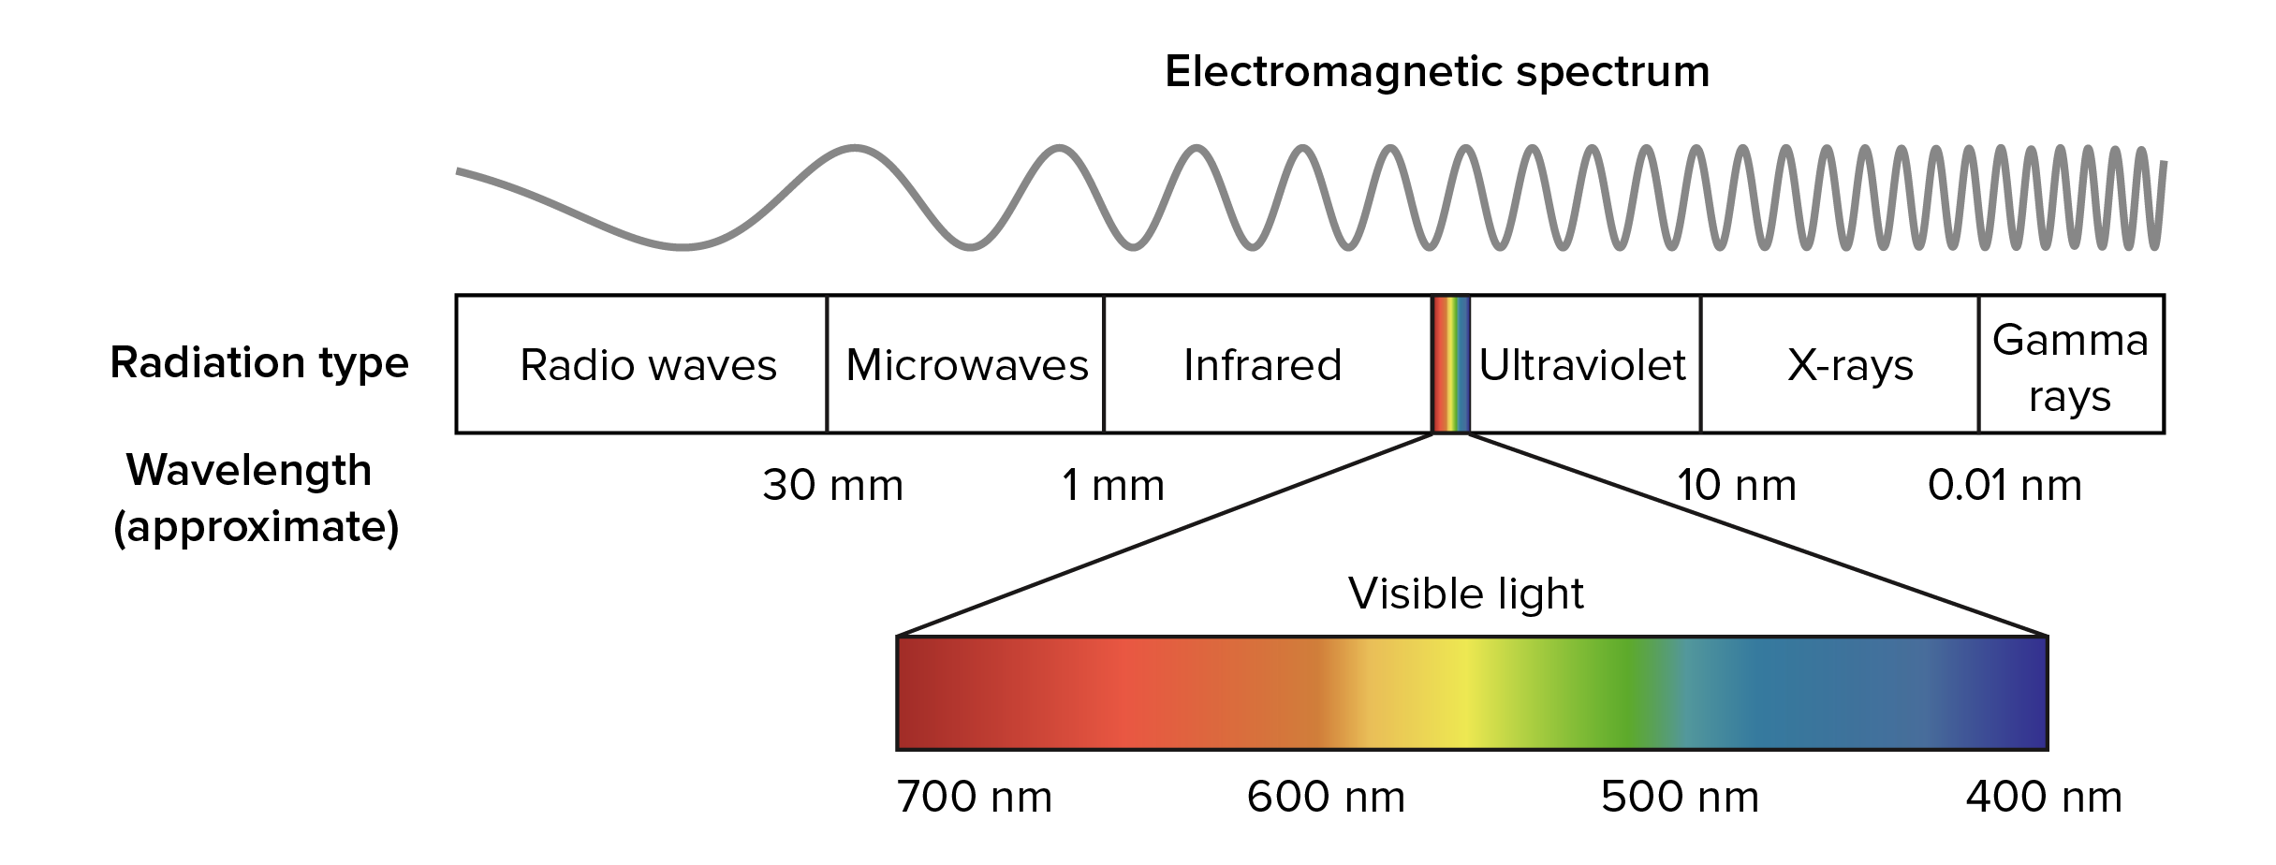
The Electromagnetic Spectrum
You are responsible to memorize the relative positions of each of bands of the electromagnetic spectrum. (This includes the order of the colors of visible light: ROYGBIV).

Slide 4
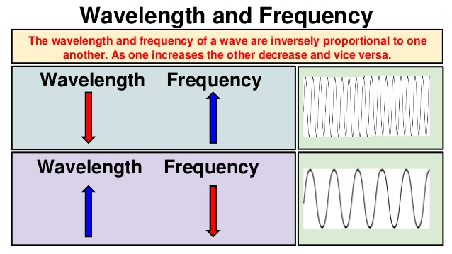
The Speed of Light
Frequency and wavelength are inversely proportional.
Recall: wavelength (λ) is measured in distance (m) and frequency (ν) is measured in 1/s.
Thus multiplying wavelength and frequency would result in: m · 1/s = m/s
That’s a speed.
Thus, λ · ν = speed.
All Electromagnetic Waves travel at the same speed, the speed of light (c)
c = λ · ν
c = 3.00x10⁸ m/s

Slide 5
Practice Problems
Radiowaves have a longer wavelength.
1.a. Which has a longer wavelength, radiowaves or gamma rays?
b. Which has a higher frequency, radiowaves or gamma rays?
c. Which travels faster, radiowaves or gamma rays?
2. Determine the wavelength of the light emitted by a sodium vapor lamp if the frequency of the radiation is 5.10x10¹⁴ hz. In what region of the electromagnetic spectrum does this light exist?
Gamma Rays have a higher frequency.
They travel at the same speed! 3.00x10⁸ m/s
c = λ·ν
λ = 3.00x10⁸m/s 5.10x10¹⁴ 1/s
5.88x10⁻⁷ m 10⁹ nm = 588 nm 1 m
λ = c ν
588 nm = visible light, (green)
λ =5.88x10⁻⁷ m
3. Determine the frequency of light whose wavelength is 0.500 nm. In what region of the electromagnetic spectrum is this radiation located?
A light with wavelength 0.500 nm would fall between 0.01 nm and 10 nm making it an x-ray.
c = λ·ν
0.500 nm 1 m = 5.00x10⁻¹⁰ m 10⁹ nm
ν = 3.00x10⁸m/s 5.00x10⁻¹⁰ m
ν = c λ
ν = 6.00x10¹⁷ hz or 1/s

Slide 6
HW 4.1
Assigned: Monday, Sep 25 Due: Tuesday, Sep 26 Due on Separate Piece of Paper
Arrange the following in order of decreasing wavelength. a. infrared radiation from a heat lamp, b. dental x-rays, c. signal from a shortwave radio station.
Draw a diagram and label each term: a. wavelength, b. amplitude, c. cycle.
What is meant by the frequency of a wave? What are the units of frequency? Describe the relationship between frequency and wavelength.
List the colors of the visible spectrum in order of increasing wavelength.
Sodium vapor lamps are used to illuminate streets and highways. The very bright light emitted by these lamps is actually due to two closely spaced emission lines in the visible region of the electromagnetic spectrum. One of these lines has a wavelength of 5.890x10⁻⁷m, and the other line has a wavelength of 5.896x10⁻⁷m. a. Calculate the frequencies of these radiations. b. In what region of the visible spectrum do these lines appear?
What is the wavelength of light with a frequency of 6.65x10¹⁴ Hz?
What is the frequency of light if its wavelength is 695 nm?
Bonus: The average distance between Earth and Mars is about 2.08x10⁸ km. How long would it take to transmit television pictures from Mars to Earth?

Slide 7
Planck’s Constant
In 1900, German physicist Max Planck determined that energy (light) was radiated in packets or bundles of energy he named quanta. (singular quantum).
Light particles (called photons) contain specific amounts of energy.
Planck found a direct relationship between energy and frequency of a photon.
As frequency increases of a radiant particle, the energy of the photon also increases.
E = h ∙ ν
Since x-rays have high frequencies, they have large energies. Since radio waves have low frequencies, they have small energies.
E = Energy h = Plancks’ constant = 6.63x10⁻³⁴ Js ν = frequency

Slide 8
Practice Problems
Calculate the wavelength of radiation with a frequency of 8.43x10⁹ Hz.
Calculate the energy of a photon whose wavelength is 400. nm.
c = λ∙ν
c = λ∙ν
λ = ? m
= 400. nm
1 m 10⁹nm
= 4.00x10⁻⁷m
λ = c ν
ν = c λ
λ = 3.00x10⁸ m/s 8.43x10⁹ ¹/_{s}
ν = 3.00x10⁸m/s 4.00x10⁻⁷m
λ = 3.55872x10⁻² m
= 3.56x10⁻² m
ν = 7.50x10¹⁴ ¹/_{s}
What is the energy of a photon whose frequency is 5.00x10¹⁵ Hz.
E = h ∙ ν
E = h∙ν
E = 6.63x10⁻³⁴Js ∙ 7.50x10¹⁴ ¹/_{s}
E = (6.63x10⁻³⁴ Js) ∙ (5.00x10¹⁵ ¹/_{s})
E = 4.9725x10⁻¹⁹ J
= 4.97x10⁻¹⁹ J
E = 3.315x10⁻¹⁸ J
= 3.32x10⁻¹⁸ J

Slide 9
HW 4.2
Assigned: Tuesday, Sep 26 Due: Wednesday, Sep 27 Due on Separate Piece of Paper
What has more energy, a photon of infrared light, or a photon of ultraviolet light?
What is the energy of green light with a frequency of 5.80x10¹⁴ ¹/_{s}?
How much energy is in a photon of light with wavelength 580 nm?
How much energy is in a photon of light with a frequency of 5.47.10¹⁴ Hz?
What is the frequency of light with energy of 4.05 x 10⁻¹⁹J?
What is the frequency of light with wavelength of 423 nm?
Draw a diagram of 2 waves of different frequency and label the amplitude and wavelength on each. Label one as high frequency and one as low frequency.
At what speed do all electromagnetic waves travel?
What scientist determined the relationship of frequency to energy of electromagnetic radiation?
Infrared radiation, uv radiation from the sun, a green traffic light, the signal from a radio tower, dental x-ray, microwaves.
Arrange the radiation shown above in order of increasing wavelength.
Arrange the radiation above in order of increasing frequency.
Which order (a or b) will be correct for increasing energy?
Bonus: (must be solved as a factor-label conversion problem for credit)
Determine the amount of time in minutes that will be required for light to travel from Earth to Mars? (the distance from Earth to Mars is 1.29.10⁵ miles)

Slide 10
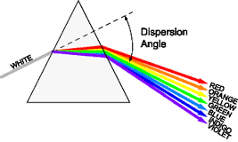
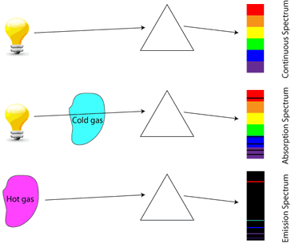
Atomic Spectra of Elements
Isaac Newton noticed that light is split up into its component colors when passed through a prism.
Neil’s Bohr noticed when you shown light through an element in its gaseous state, the resulting spectrum was not continuous; there were missing gaps of color.
Conversely, when that heated gas was cooled, and passed through a prism, those missing gaps of color reappeared!

Slide 11
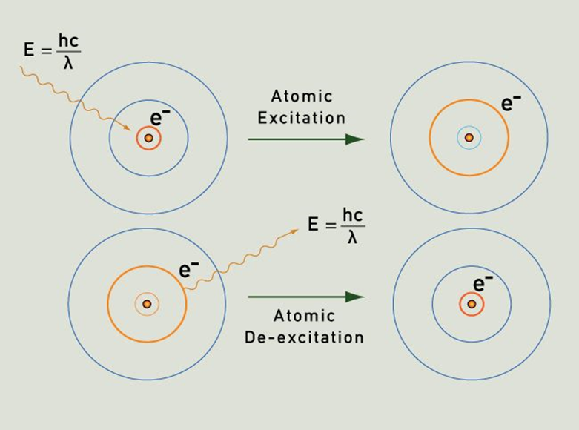
Bohr Model
Bohr theorized that electrons could only exist at distinct energy levels.
A quantum of energy, in the form of light, could excite electrons to jump from one energy level to the next. But electrons CANNOT exist between energy levels.
Without sustained energy the excited electron cannot stay in the higher energy level, and thus falls back to its ‘ground state’. When this happens, it emits the exact amount of energy that it absorbed.

Slide 12
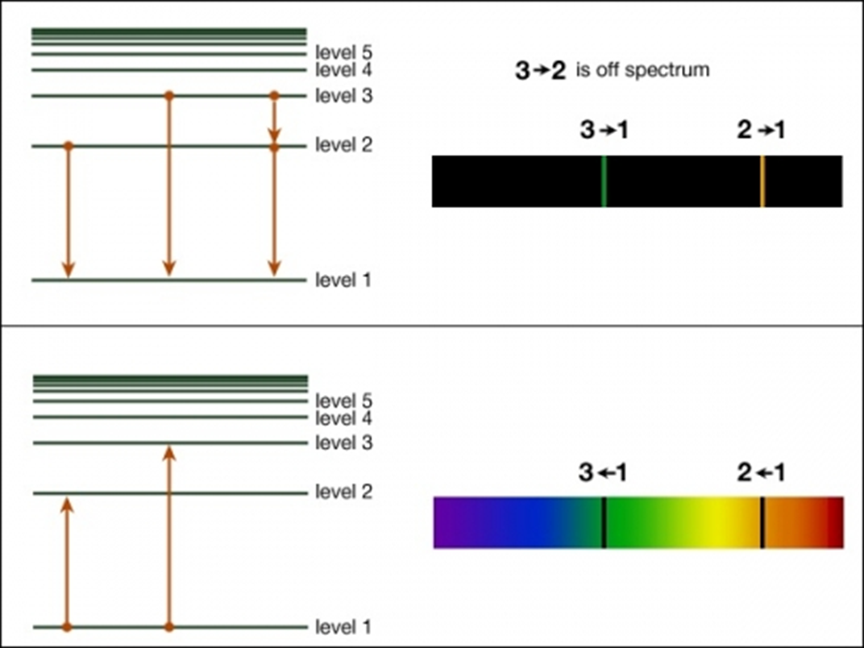
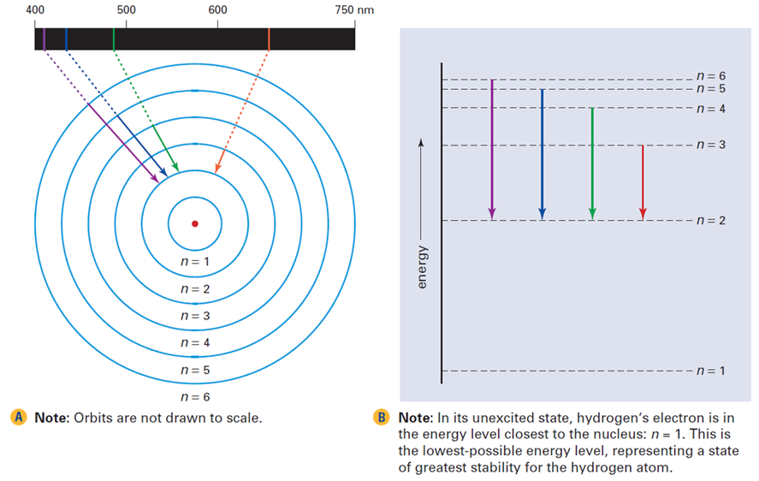
An Explanation of Atomic Spectra
Emission Spectra are created when excited electrons fall back to their ground state, emitted energy (light)
Absorbance spectra correspond to the exact wavelength of light absorbed by an electron as it is excited to higher energy levels.
An element’s absorption or emission spectrum is like a fingerprint and can be used to identify the element.

Slide 13
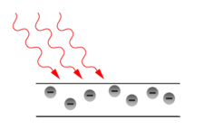
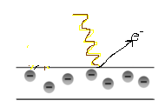
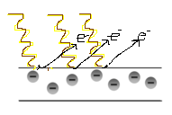
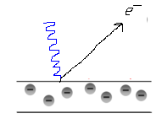
The Photoelectric Effect
Einstein showed that light behaved as a particle when interacting with matter through his explanation of the photoelectric effect.
The photoelectric effect is the ejecting of e-’s from an active metal’s surface by shining light on the surface of the metal.
Bright Red Light
Dim Yellow Light
Bright Yellow Light
Dim Blue Light
It was shown that red light, even very bright red light, could not eject an electron.
But even very dim yellow light could eject an electron.
The brighter the light above the threshold, the more electrons are ejected.
The higher the frequency above the threshold, the faster the electrons are ejected.
Threshold Frequency

Slide 14
HW 4.3
Assigned: Wednesday, Sep 27 Due: Monday, Oct 2 Due on Separate Piece of Paper
If the energy required to eject an electron from a photoactive metal is 3.10.10⁻¹⁹ J, determine the threshold frequency (E = h ν) for this metal.
a. Calculate if 600. nm light will eject an electron from the metal in problem #1? b. Will very dim 600. nm light eject an electron from this metal? c. Will very bright light with a frequency of 4.50x10¹⁴ Hz eject the metal’s electron? d. What would be the different of an ejected electron if 100 nm light were shown on the metal?
What scientist presented experimental evidence of light’s particle nature?
What will happen if the following will occur? a. Monochromatic (one color) light shining on cesium metal is just above the threshold frequency. b. The intensity of the light increases, but the frequency remains the same. c. Monochromatic light of a shorter wavelength is used.
What has more energy, a photon of infrared light or a photon of ultraviolet light?
A piece of lithium metal is struck by a wave of red light and a wave of green light. Which of these two waves is traveling fastest when it hits the lithium?

Slide 15
HW 4.4
Assigned: Monday, October 2 Due: Tuesday, October 3 Due on Separate Piece of Paper
Use a diagram to illustrate each term for a wave/ a. wavelength b. amplitude c. frequency
Consider the following regions of the electromagnetic spectrum (i) ultraviolet, (ii) X-ray, (iii) visible, (iv) infrared, (v) radio wave, (vi) microwave. a. Arrange them in order of decreasing wavelength. b. Arrange them in order of decreasing frequency.
List the colors of the visible spectrum in order of increasing wavelength.
What has more energy, a photon of infrared light or a photon of ultraviolet light?
What is the energy of green light with a frequency of 5.80x10¹⁴ 1/s?
What happens when a hydrogen atom absorbs a quantum of energy?
Suppose your favorite AM radio station broadcasts at a frequency of 1150 kHz. What is the wavelength, in centimeters, of the radiation from the station?
A mercury lamp emits radiation with a wavelength of 4.36x10⁻⁷ m. a. What is the wavelength of this radiation in cm? b. In what region of the electromagnetic spectrum is this radiation? c. Calculate the frequency of this radiation.

Slide 16
HW 4.4
Con’t
9. Of yellow, green, x-ray, and radio waves, what has: a. The longest wavelength b. the highest frequency? c. the smallest energy per photon?
10. What equation shows the relationship of wavelength and frequency?
11. What equation shows the relationship of wavelength and energy?
12. Calculate the wavelength and energy for electromagnetic radiation with a frequency of 4.50x1014 Hz. In what region of the electromagnetic spectrum is this radiation located?
13. Determine the energy associated with light with a wavelength of 100. nm. What portion of the electromagnetic spectrum will it be located?
14. Explain why black lines appear on an absorption spectrum (using the terms ground state and excited state). Draw on the atomic scale what is happening in absorption.
15. Explain why colored lines appear on an emission spectrum (using the terms ground state and excited state). Draw on the atomic scale what is happening in emission.
Bonus: How many seconds will it take light to travel a distance of 2.39x10⁶ miles from earth to the moon? (use factor label method)

Slide 18
Emission Spectrum
IR
6
Energy of photon depends on the difference in energy levels
Bohr’s calculated energies matched the IR, visible, and UV lines for the H atom
5
4
3
2
1

