Slide 1
Atomic Structure
Unit 3

Slide 2
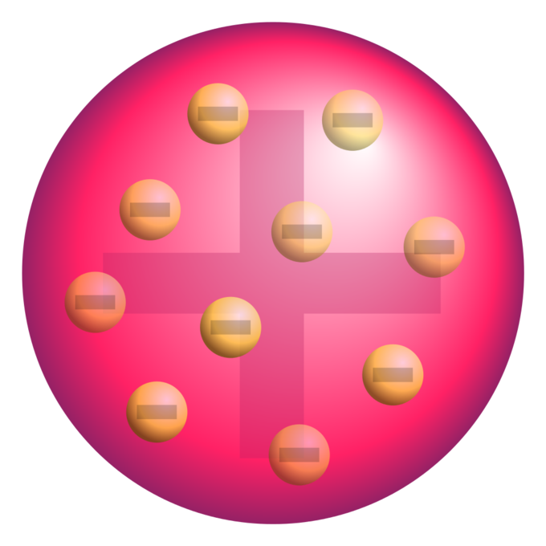
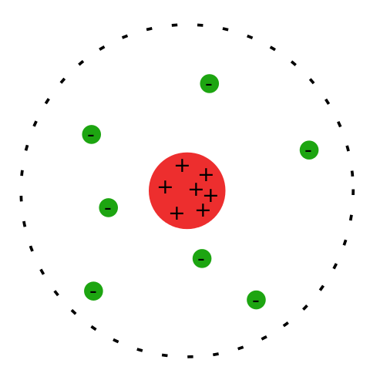
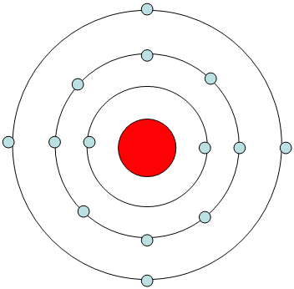
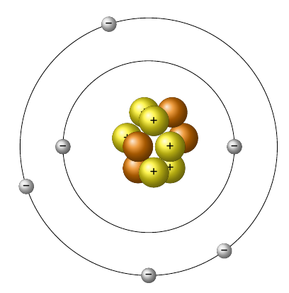
Quick Review of the History of the Atom
400 B.C. – Democritus is first to suggest existence of ‘indivisible and indestructible’ atom.
1840 – John Dalton formulates ‘Dalton’s Atomic Theory’.
1886 – Eugen Goldstein determines atoms have a positive charge called ‘protons’.
1897 – J.J. Thomson discovers electrons, and their relative mass with cathode rays.
1909 – Robert Millikan does oil drop experiment to determine charge of electron.
1911 - Ernest Rutherford does gold foil experiment and postulates existence of a ‘nucleus’.
1913 – Neils Bohr determines electrons exist only at ‘fixed energy levels’.
1932 – James Chadwick confirms the existence of another subatomic particle; the neutron.

Slide 3
Law of Definite Proportions
Dalton postulated that atoms combine in simple whole-number ratios.
If the ratio of atoms of each element in a compound is fixed, then the ratio of their masses must also be fixed.
Example:
Every water molecule is 2 H : 1 O
2(1.01 g H) : 16.00 g O
Example:
Every water molecule is 11.21% H and 88.88% O by mass.
2.02 g H 18.02 g H₂O
X 100% = 11.21% H
2.02 g H + 16.00 g O
18.02 g H₂O
16.00 g O
18.02 g H₂O
X 100% = 88.88% O

Slide 4
Law of Multiple Proportions
Whenever the same two elements form more than one compound, the different masses of one element that combine with the same mass of the other element are in the ratio of small whole numbers.
Both compounds are made of oxygen and nitrogen.
16.00 g O 1.14204 g O
14.01 g N 1.000 g N
1.14204 g O
2.28408 g O
2:1 Ratio of oxygen
2(16.00) g O 2.28408 g O
14.01 g N 1.000 g N
Example: Carbon reacts with oxygen to form two compounds. Compound A contains 2.41 g of carbon for 3.22 g of oxygen. Compound B contains 6.71 g of carbon for each 17.9 g of oxygen. What is the lowest whole-number ratio of carbon that combines with a given mass of oxygen?
Compound A
2.41 g C 3.22 g O
0.74845 g C 1.00 g O
0.74845 g C
0.37486 g C
2 g C
1 g C
2:1 ratio of C
6.71 g C 17.9 g O
0.37486 g C 1.00 g O
Compound B

Slide 5
HW 3.1
1a. What scientist is credited with the discovery of the electron?
b. What instrument was used to discover the electron.
c. What else did this scientist discover about the electron?
2a. What scientist is credited with the discovery of the charge of the electron?
b. What experiment was used to discover the charge of the electron.
c. Towards which node (positive or negative) did the cathode ray bend to indicate the charge of electrons?
3. What scientist was the first to come up with an atomic model based upon experimental evidence?
4. What about Dalton’s theory is known to be untrue?
5. Lead forms two compounds with Oxygen. One compound contains 2.98 g of lead and 0.461 g of Oxygen. The other compound contains 9.89 g of Lead and 0.763 g of Oxygen. What is the lowest whole number ratio of Lead that combines with a given mass of Oxygen?
Assigned: Monday, 9/11
Due: Tuesday, 9/12
Due On Separate Sheet of Paper

Slide 6
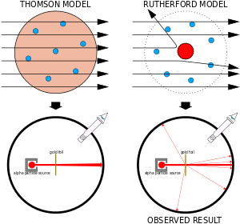
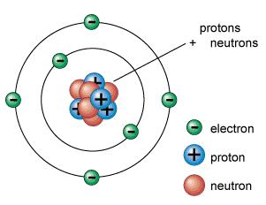
The Nucleus
In 1886, Goldstein determines there is a positive charge in atoms, termed ‘protons’.
Thomson determined that the mass of a proton was nearly 2,000 times greater than the mass of an electron.
1911, Rutherford’s team shot alpha particles at gold foil. Because some alpha particles bounced back, it was determine that atoms must have a small, dense, positively charged nucleus.
1932, Chadwick discovers 3rd subatomic particle, the neutron, also determined to be in the nucleus. Neutron is neutrally charged, but has the mass of a proton.

Slide 7
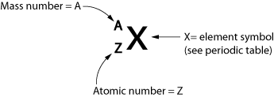
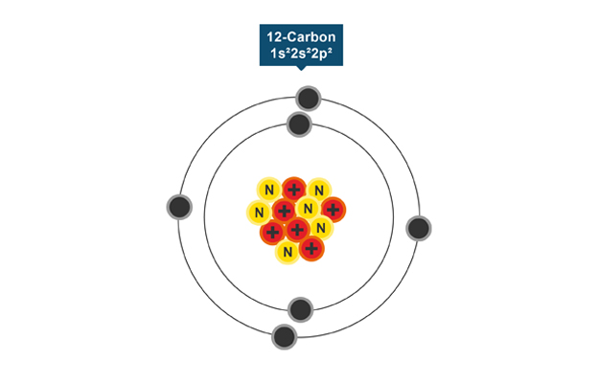
Atomic Number and Mass Number
The atomic number (symbol Z) represents the number of protons present in an atom of an element is used to identify the element.
The mass number (symbol A) represents the total number of p⁺ and n⁰. A = # of protons + # of neutrons

Slide 8
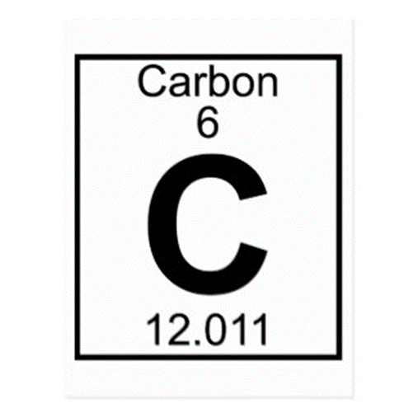
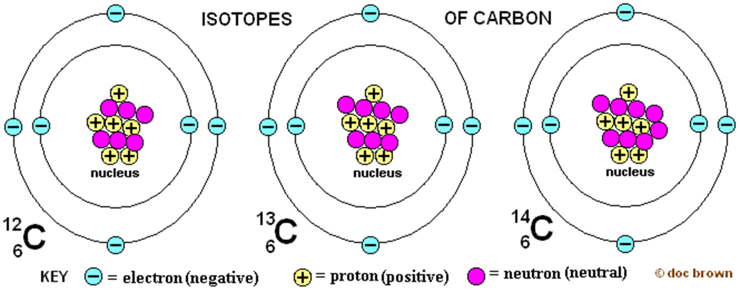
Isotopes and Atomic Mass
Isotopes are atoms that have the same number of protons, but different numbers of neutrons.
The atomic mass of an element is a weighted average mass of the atoms in a naturally occurring sample of the element.
12 – 6 = 6 n⁰
13 – 6 = 7 n⁰
14 – 6 = 8 n⁰
Example: The atomic mass of copper is 63.55. Which of coppers two isotopes is more abundant: copper-63 or copper-65?
Copper-63

Slide 9
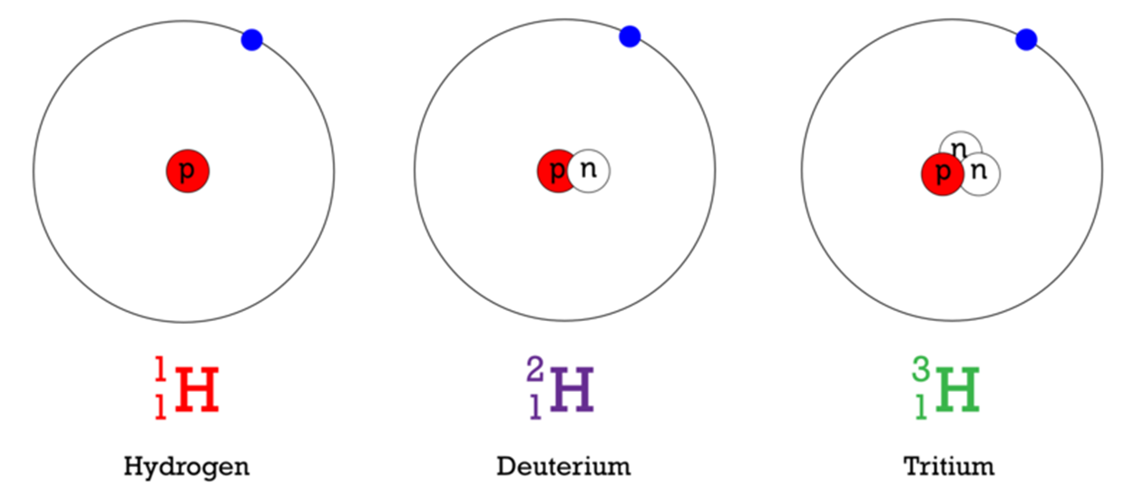
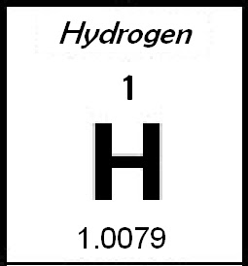
Examples
Write the isotope symbol for each of the isotopes of hydrogen shown below:
If the atomic mass of hydrogen is 1.0079 amu, how many neutrons do most hydrogen atoms have?
What is the atomic mass of silicon if 92.21% of its atoms have a mass of 27.977 amu, 4.70% have a mass of 28.976 amu, and 3.09% have a mass of 29.974 amu?
Nearly every hydrogen atom has 0 neutrons.
Atomic mass = (0.9221 x 27.977 amu) + (0.0470 x 28.976 amu) + (0.0309 x 29.974 amu)
Atomic mass = 25.7976 amu + 1.3619 amu + 0.92620 amu
Atomic mass = 28.09 amu

Slide 10
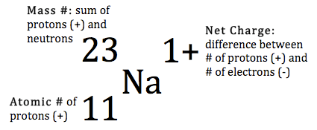
Properties of Subatomic Particles and Ions
Because mass of an atom is extremely small, chemists discuss the mass of atoms using the atomic mass unit (amu).
One amu is the mass of 1/12th of a carbon-12 atom.
All atoms have a neutral charge, they contain equal numbers of protons and electrons.
An atom that lost or gained an electron is called an ion.
Example: How many protons, neutrons, and electrons are contained in ²³Na⁺¹ and ³⁶Cl⁻¹?
²³Na⁺¹ 11p⁺, 10e⁻, 12n⁰
³⁶Cl⁻¹ 17p⁺, 18e⁻, 19n⁰

Slide 11
HW 3.2
What experimental evidence led Rutherford to conclude that the atom is mostly empty space?
How did Rutherford’s model of the atom differ from Thomson?
The element copper has naturally occurring isotopes with mass numbers of 63 and 65. The relative abundance and atomic masses are 69.2% for mass = 62.93 amu, and 30.8% for mass = 64.93 amu. Calculate the average atomic mass of copper.
Which of argon’s three isotopes is most abundant: argon-36, argon-38, or argon-40? (Hint: the atomic mass of argon is 39.948 amu.)
The atomic masses of elements are generally not whole numbers. Explain why.
Why is an atom electrically neutral?
What does the atomic number of each atom represent?
Complete the following table:
9. How many protons, neutrons and electrons are contained in ⁴⁰Ca⁺² and ¹⁶O⁻²?
Bonus: Lithium has two naturally occurring isotopes. Lithium-6 has an atomic mass of 6.015 amu; lithium-7 has an atomic mass of 7.016 amu. The atomic mass of lithium is 6.941 amu. What is the percentage of naturally occurring lithium-7?
Assigned: Tuesday, 9/12
Due: Wednesday, 9/13
Due on Separate Sheet of Paper
ELEMENT NAME | ELEMENT SYMBOL | ATOMIC NUMBER | MASS NUMBER | PROTONS | NEUTRONS
 | H | 1 |  |  | 0
 | He |  | 4
Lithium |  |  |  |  | 4
 | O | 8 | 16
 | F |  |  |  | 10
Neon |  |  | 20
 | Na |  |  |  | 12

Slide 12
HW 3.3
Assigned: Wednesday, 9/13 Due: Thursday, 9/14
Due On Separate Sheet of Paper
Round all answers to the hundredths place. Untamed Science
1. Calculate the average atomic mass of chromium.
Isotope mass (amu) fractional abundance
Cr-50 49.946 0.043500
Cr-52 51.941 0.83800
Cr-53 52.941 0.095000
Cr-54 53.939 0.023500
Iodine is 80.0% ¹²⁷I, 17.0% ¹²⁶I, and 3.0% ¹²⁸I. Calculate the average atomic mass of iodine.
Calculate the average atomic mass of lithium, which occurs as two isotopes that have the following atomic masses and abundances in nature:
6.017 amu, 7.30% and 7.018 amu, 92.70%.
4. What is the average atomic mass of iron if iron-55 occurs 15% and iron-56 occurs 85%?
5. Calculate the average atomic mass of magnesium using the following data for three magnesium isotopes.
Isotope mass (amu) fractional abundance
Mg-24 23.985 0.7870
Mg-25 24.986 0.1013
Mg-26 25.983 0.1117
6. How many protons, neutrons and electrons are contained in ⁵⁶Fe⁺³; ³¹P⁻³
7. Use the periodic table to complete the following table.
Isotope Symbol A Z # p⁺ # nº # e⁻
Calcium - 48 _______ ___ ___ ____ ____ ____
___________ ²³⁸₉₂U __ ___ ___ ___ ___
___________ ______ 21 10 ___ ___ ___
___________ ______ ___ ___ 28 31 ___

Slide 13
Relative Mass to Numbers of Atoms
The Mole – The mole of a substance is 6.02x10²³ (Avagadro’s number) representative particles of that substance.
1 dozen roses = 12 roses 1 mole roses = 6.02 x10²³ roses
Molar Mass – the mass of 1 mole of a substance is called the molar mass and has units of g/mol.
Example Problems: What is the mass of 3.5 mol of copper?
? g Cu
= 3.50 mol Cu
63.546 g Cu 1 mol Cu
= 222.411 g Cu
= 222 g Cu
How many moles of aluminum are contained in 11.9 g of aluminum?
? mol Al
= 11.9 g Al
1 mol Al 26.981 g Al
= 0.44105 mol Al
= 0.441 mol Al
How many moles are present in 1.20 x10⁸ atoms of silver?
? mol Ag
= 1.20 x10⁸ atoms Ag
1 mol Ag
6.02 x10²³ atoms Ag
= 1.9934 x10⁻¹⁶ mol
= 1.99 x10⁻¹⁶ mol Ag
How many grams of copper are present in 3.01 x10²³ atoms of copper?
? g Cu
= 3.01 x10²³ atoms Cu
1 mol Cu
6.02 x10²³ atoms Cu
63.546 g Cu
1 mol Cu
= 31.773 g Cu
= 31.8 g Cu

Slide 14
HW 3.4
1. What is the mass in grams of 2.25 moles of iron?
2. What is the mass in grams of 0.35 moles of potassium?
3. How many moles of Calcium are in 5.00 g of Calcium?
4. How many moles of Gold are in 3.60.10⁻⁵ g of Gold?
5. How many moles of Lead are contained in 1.50.10¹² atoms of Lead?
6. How many moles of Tin are in 2500 atoms of Tin?
7. What is the mass in grams of 7.5.10¹⁵ atoms of Nickel?
8. How many atoms of Sulfur are in 4.00 g of Sulfur?
Assigned: Friday, 9/15 Due: Monday, 9/18 Due on Separate Sheet of Paper
HW 3.5
1. What is the mass in grams of: a. 1.00 moles of Lithim (Li)?
b. 6.02.10²³ atoms of Carbon (C)?
How many moles of atoms are in: a. 6.02.10²³ atoms of Neon (Ne)?
b. 3.25.10⁵ g of Lead (Pb)?
3. How many atoms are in each of the following: a. 1.50 moles of Sodium (Na)?
b. 7.02 grams of Silicon (Si)?
4. What is the mass in grams of the following: a. 4.50.10¹² atoms of chlorine (Cl)?
b. 25 atoms of Tungsten (W)?
5. Determine the number of atoms in the following: a. 5.40 grams of Boron (B)?
b. 0.02550 grams of Platinum (Pt)?
Assigned: Monday, 9/18 Due: Tuesday, 9/19 Due on Separate Sheet of Paper

Slide 15
Representative Particles
A mole is often used to measure;
Atoms – smallest particle of an element that retains the properties of an element (ex. Ca, Na, Fe). 6.02x10²³ atoms = 1 mol of an element
Formula Unit – smallest portion of an ionic compound that retains the properties of the ionic compound. An ionic compound is a compound composed of metals and nonmetals or polyatomic ions. (ex. NaCl, BaF₂, CaCO₃). 6.02x10²³ formula units = 1 mol of an ionic compound
Molecule – smallest portion of a covalent compound that retains the properties of the covalent compound. A covalent compound is composed of nonmetals and/or metalloids (ex. H₂O, BaF₃, NH₃). 6.02 x1023 molecules = 1 mol of a covalent compound
Examples: Given 6.00 g of Ca(NO₃)₂, determine the number of moles.
1 Ca (40.08 g Ca/mol)
? mol Ca(NO₃)₂
= 6.00 g Ca(NO₃)₂
1 mol Ca(NO₃)₂
164.10 g Ca(NO₃)₂
+ 2 N (14.01 g N/mol)
= 0.036563 mol Ca(NO₃)₂
+ 6 O (16.00 g O/mol)
= 0.0366 mol Ca(NO₃)₂
164.10 g Ca(NO₃)₂/mol
Given 8.00 g of Ca(NO₃)₂, determine the number of formula units of Ca(NO₃)₂.
? for u’s Ca(NO₃)₂
= 8.00 g Ca(NO₃)₂
1 mol Ca(NO₃)₂
164.10 g Ca(NO₃)₂
6.02x10²³ Ca(NO₃)₂
1 mol Ca(NO₃)₂
= 2.9348x10²² for u’s Ca(NO₃)₂
= 2.93x10²² for u’s Ca(NO₃)₂

Slide 16
HW 3.6
Problems:
1. Convert 15.9 grams of calcium hydroxide (Ca(OH)₂) to moles.
2. a. Convert 4.56 moles of cuprous sulfate (Cu₂SO₄) to formula units.
b. Convert 4.56 moles of cuprous sulfate to grams.
3. a. Convert 6.95 . 10²⁵ molecules of sulfur hexafluoride (SF₆) to grams
b. Convert 6.95 . 10²⁵ molecules of sulfur hexafluoride (SF₆) to moles.
4. How many chloride ions are present in 8.39 . 10¹² formula units of calcium chloride (CaCl₂)?
5. How many moles are present in 24.7 g of Iron (III) oxide (Fe₂O₃)?
6. Convert 200. grams of sodium carbonate (Na₂CO₃) to formula units.
How many oxygen atoms are present in 2.55 kg of cobalt (II) phosphate Co₃(PO₄)₂?
Bonus: Complete the magic square.
Draw your own table. The sum of the number in a row should equal the sum of the numbers in a column.
Clues: (Give answers to the nearest whole number)
Number of electrons in Br₂
Number of grams in 3.0 moles of Neon
Atomic number of Zn
Mass number of Calcium-40
Number of grams in 1.0 mole of sodium hydroxide (NaOH).
Molar mass of sulfur trioxide (SO₃)
Number of protons in an atom of Tin.
Number of grams in 0.60 moles of calcium carbonate (CaCO₃).
The sum of the atomic number of aluminum, chlorine, and calcium.
What is the magic number?
Assigned: Tuesday, 9/19 Due: Wednesday, 9/20 Due On Separate Sheet of Paper
1 | 2 | 3
4 | 5 | 6
7 | 8 | 9

