Slide 1
Scientific measurement
Unit 2

Slide 2
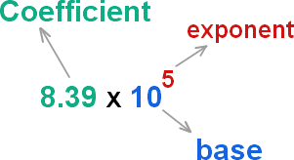
Scientific Notation
In chemistry, you will often encounter very large or very small numbers.
Size of an atom
1 gram of hydrogen contains 602,000,000,000,000,000,000,000 hydrogen atoms.
Very large and small numbers are more easy to work with by writing them in scientific notation.
In scientific notation, a given number is written as the product of two numbers: a coefficient and 10 raised to a power.
EX. 602,000,000,000,000,000,000,000 can be written in scientific notation as 6.02 x 10²³
The coefficient must be 1 ≤ x < 10

Slide 3
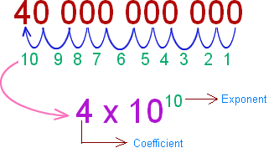
Large Numbers
For numbers greater than 10, ie 40,000,000,000 the exponent is positive and equals the number of places that the original decimal point has been moved to the left.
Ex.
6.3 x 10⁶ = 6,300,000
94,700 = 9.47 x 10⁴

Slide 4
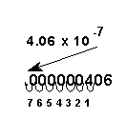
Small Numbers
Numbers less than one have a negative exponent when written in scientific notation. The value of the exponent equals places the decimal has been moved to the right.
Ex.
0.000 008 = 8 x 10⁻⁶
7.36 x 10⁻³ = 0.00736

Slide 5
HW 2.1
Assigned Friday, 8/18
Due Monday, 8/19
Due on Separate Sheet of Paper. Use Wikipedia as your reference for your answers.
For each question, list the desired quantity in both standard form and scientific notation. Don’t Forget proper Units!
What is the volume, in km³, of the Atlantic Ocean?
What is the average distance between Earth and Sun in km?
How many seconds are in a week?
What is the temperature of Neptune (ºC)
The mass, in kg, of 1 atomic mass unit.

Slide 6
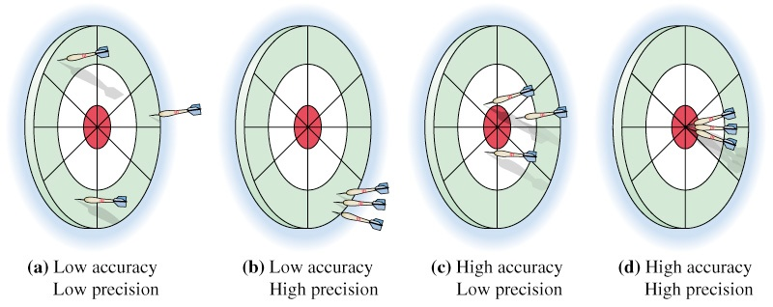
Accuracy and Precision
Accuracy refers to how close a measurement is to the theoretical value for the property being measured.
Precision refers to the reproducibility of a measurement.
A set of measurements can be precise (very close together) but not accurate (such is the case as an instrument which has been calibrated incorrectly).
A high accuracy with low precision is probably the result of instruments that are not precise enough.

Slide 7
Percent Error
The percent error shows the amount by which the experimental value differs from the accepted value.
Experimental value is the value measured in lab.
Accepted value is the value for the measurement based on reliable references.
EX. Water boils at 100ºC. In lab, Eric and Karen recorded a temperature of 99.1ºC when their water boiled. What is their percent error?
|experimental value – accepted value|
_______________________________
Percent error =
X 100%
accepted value
%Error = ?
Experimental value = 99.1ºC
Accepted value = 100ºC
%Error = |Experimental value – accepted value|
accepted value
X 100%
%Error = |99.1ºC– 100ºC|
100ºC
X 100%
%Error = 0.9ºC
100ºC
X 100%
%Error = 0.9% Error

Slide 8
HW 2.2
Assigned Monday, 8/21
Due Tuesday, 8/22
Complete Accuracy and Precision Worksheet

Slide 9
SI Prefixes
Qualitative Measurements: A description of a property based upon your senses.
EX. The compound is red, has a pungent odor, a rough texture and feels very dense.
Quantitative Measurements: A description of a property based upon comparison to a standard of measure. Here, the measurement is expressed with a unit.
EX. The mass of the graphing calculator is 454 g, the volume of water bottle which is allowed in the hallway is 250 mL.
Memorize:
Prefix | Symbol | Value | Factor
mega | M | 1,000,000 | 10⁶
kilo | k | 1,000 | 10³
deci | d | 0.1 | 10⁻¹
centi | c | 0.01 | 10⁻²
milli | m | 0.001 | 10⁻³
micro | µ | 0.000 001 | 10⁻⁶
nano | n | 0.000 000 001 | 10⁻⁹
pico | p | 0.000 000 000 001 | 10⁻¹²

Slide 10
SI Units
Metric unit for Length is the meter (m).
1 km = 1000 m 1 dm = 0.1 m
Metric unit for Volume is the liter (L).
1 mL = 0.001 L 1 L = 1,000,000 µL
MEMORIZE: 1 cm³ = 1 ml 1 dm³ = 1 L
Metric unit for Mass is the kilogram (kg).
1 kg = 1000 g 1000 mg = 1 g
Metric unit for Temperature is Kelvin (K)
The Celsius scale is based on the properties of water.
100ºC water boils, 0ºC water freezes.
But, Celsius has negative values, and sometimes we can’t use negative values. Thus Kelvin is the Celsius scale with no negative values.
K = 273 + ºC
EX. 19ºC + 273 = 292 K
Metric unit for amount of a substance is the mole.
One mole of any substance has exactly the same number of particles, 6.02x10²³
Metric unit for time is the second (s)
1 s = 1000 ms

Slide 11
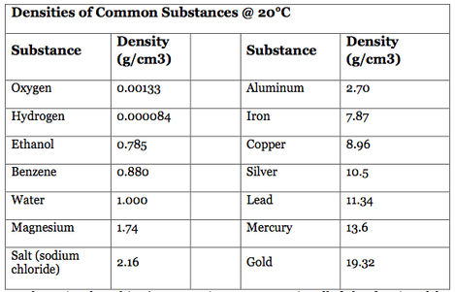
Density
Density is the ratio of the mass of an object to its volume.
Densities are tabulated at a certain temperature due to the fact that as temperatures change the volume of the object expands.

Slide 12
HW 2.3
Assigned Tuesday, 8/22
Due Wednesday, 8/23
Due on Separate Sheet of Paper
How are accuracy and precision evaluated?
Surgical instruments may be sterilized by heating at 170ºC for 1.5 hours. Convert 170ºC to kelvins.
A weather balloon is inflated to a volume of 2.2 x 10³L with 374 g of helium. What is the density of helium in grams per liter?
Write the SI base unit of measurement for each of these quantities.
a. time b. length c. temperature d. mass e. amount of substance
Order these units from smallest to largest: cm, µm, km, mm, dm, pm. Then give each measurement in terms of meters.
Rank these numbers from smallest to largest: a. 5.3x10⁴ b. 57 x 10³ c. 4.9x10⁻² d. 0.0057 e. 5.1x10⁻³ f. 0.0072 x 10²
7. Comment on the accuracy and precision of these basketball free-throw shooters.
a. 99 of 100 shots are made.
b. 99 of 100 shots hit the front of the rim and bounce off.
EC. How many atoms are contained in 63.55 g of copper (hint, look at Cu on the periodic table)

Slide 13
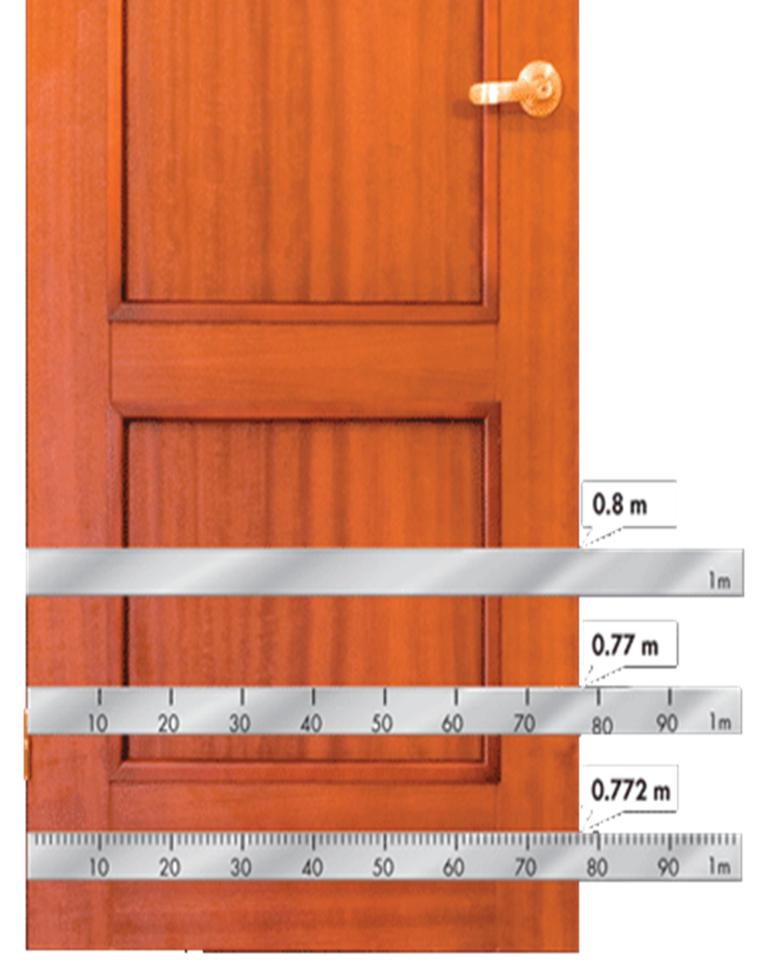
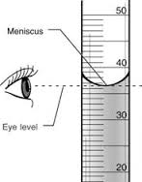
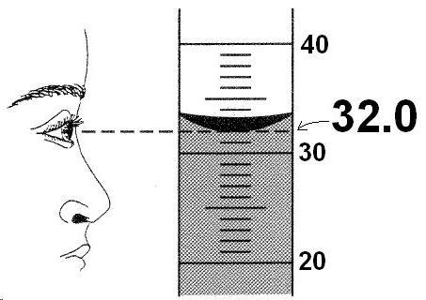
Significant Digits
In science properties are measured and therefore there are only a certain number of digits in a measurement that are known reliably.
Significant Digits allow us to express the precision of our tools
The number of significant digits in a measurement contains all the digits that can be read from the measuring instrument plus one digit that is estimated.
Bad precision
We know that it is between 36 mL and 37 mL.
We can guess one digit: 36.5 mL
Good precision
When a measurement is on a line, the estimated digit is zero.
Estimated digit is 0

Slide 14
Counting Significant Digits
Every nonzero digit in a reported measurement is assumed to be significant.
24.7 meters 0.743 meter 714 meters ALL HAVE 3 Sig Digs
Zeros appearing between nonzero digits are significant.
7003 meters 40.29 meters 1.503 meters ALL HAVE 4 Sig Digs
Leftmost zeros appearing in front of nonzero digits are not significant. They act as placeholders. By writing the measurements in scientific notation, you can eliminate such placeholding zeros.
0.0071 meter 0.42 meter 0.000 099 meter EACH ONLY HAS 2 Sig Digs
= 7.1x10⁻³ meter = 4.2x10⁻¹ meter = 9.9x10⁻⁵meter
Zeros at the end of a number and to the right of a decimal point are always significant.
43.00 meters 1.010 meters 9.000 meters ALL OF THESE HAVE 4 Sig Digs
Zeros at the rightmost end of a measurement in the absence of a decimal are not significant.
300 meters (1sd) 7000 meters (1sd) 27,210 meters (4sd)
There are two situations in which numbers have infinite significant digits: 1. A number that is counted is exact. 2. A defined quantity, such as those found with a system of measurement.
23 people in class 60 mins = 1 hour 100 cm = 1 m ALL OF THESE HAS INFINITE Sig Digs

Slide 15
Rounding, Adding, and Subtracting
Once you determine the number of digits to be kept, look at the digit to the right of the last digit to be kept. If the digit to the right is 0-4 round down or 5-9 round up).
EX. a. 314.721 meters (round to four)
b. 0.001 775 meter (two)
c. 8792 meters (two)
When adding and subtracting, the answer must have the same number of decimal places as the measurement containing the least number of decimal places.
EX. 61.2 meters + 9.35 meters + 8.6 meters
314.7 meters
0.0018 meter or 1.8x10⁻³ meter
8800 meters
79.15 meters
tenths
hundredths
tenths
79.2 meters

Slide 16
Examples
Count the significate digits in each measured length.
a. 0.05730 meter
b. 8765 meters
c. 0.00073 meter
d. 40.007 meters
Round each measurement to three significant digits. Write your answers in scientific notation.
a. 87.073 meters
b. 4.3621 x 10⁸ meters
c. 0.01552 meter
Perform each operation. Express your answers to the correct number of significant digits.
a. 9.44 meters – 2.11 meters
b. 1.36 meters + 10.17 meters
c. 34.61 meters – 17.3 meters
a. 4 sd
b. 4 sd
c. 2 sd
d. 5 sd
a. 8.71 x 10¹ meters
b. 4.36 x 10⁸ meters
c. 1.55 x 10⁻² meters
a. 7.33 meters
b. 11.53 meters
c. 17.3 meters

Slide 17
Multiplication and Division and Mixed Operation Rules
When multiplying and dividing, the answer must have the same number of significant digits as the measurement containing the least number of significant digits.
EX. a. 7.55 meters x 0.34 meter
b. 2.10 meters² / 0.70 meter
When doing a mixed operation problem, underline the non-significant digits, but DO NOT round until the end of all operations.
EX. A student measures the depth of a swimming pool to be 2.14 meters at its deepest end. The accepted value is 2.20 m. What is the students percent error?
a. 2.567 meters²
a. 2.6 meters²
3 sd
2 sd
b. 3 meters
b. 3.0 meters
3 sd
2 sd
% Error = |AV – EV| x 100% AV
% Error = 0.027272 x 100%
% Error = ?
Accepted Value = 2.20 m
Experimental Value = 2.14 m
% Error = |2.20 m – 2.14m| x 100% 2.20 m
% Error = 2.7272%
% Error = 0.06 m x 100% 2.20 m
% Error = 3%

Slide 18
Examples
Solve each problem. Give your answers to the correct number of significant digits and in scientific notation.
8.3 meters x 2.22 meters
8432 meters² / 12.5 meters
35.2 seconds x 1 minute 60 seconds
a. 1.8 x 10¹ m²
b. 6.75x10² m
c. 5.87 x10⁻¹ mins
What is the percent error for a mass measurement of 17.7 g, given that the correct value is 21.2 g?
% Error = ?
AV = 21.2 g
EV = 17.7 g
% Error = 0.1651 x 100%
% Error = |AV – EV| x 100% AV
% Error = |21.2 g – 17.7 g| x 100% 21.2 g
% Error = 16.51%
% Error = 3.5 g x 100% 21.2 g
% Error = 17%

Slide 19
HW 2.4
Assigned: Wednesday 8/23 Due: Thursday 8/24 Due on a Separate Piece of Paper
How many significant digits are in each measurement? a. 143 grams b. 0.074 meter c. 8.750x10⁻² gram d. 1.072 meters
Round each measurement to three significant digits. Write your answers in scientific notation. a. 9009 meters b. 1.7777x10⁻³ meters c. 629.55 meters
Find the total mass of three diamonds that have masses of 14.2 grams, 8.73 grams, and 0.912 gram.
Calculate the volume of a warehouse that has measured dimensions of 22.4 meters by 11.3 meters by 5.2 meters. (Volume = l x w x h)
A technician experimentally determined the boiling point of octane to be 124.1ºC. The actual boiling point of octane is 125.7ºC. Calculate the percent error.
Determine the number of significant figures in each of the following measurements: a. 11 soccer players b. 0.070 020 meters c. 10,800 meters d. 0.010 square meters e. 5.00 cubic meters f. 507 thumbtacks
Solve each of the following and express each answer in scientific notation and to the correct number of significant digits. a. (5.3 x 10⁴) + (1.3x10⁴) b. (7.2x10⁻⁴)/(1.8x10³) c. 10⁴ x 10⁻³ x 10⁶ d. (9.12x10⁻¹) – (4.7x10⁻²) e. (5.4x10⁴) x (3.5x10⁹)

Slide 20
Metric Conversions Factor Label Method (it’s a must!)
Steps:
1. Write down what you are trying to determine.
2. Write an equal sign and the measurement given.
3. Use the conversion factors. Whatever unit is the numerator be sure it is the denominator of the next step.
4. Determine how many significant digits to keep (Defined quantities have an infinite number of significant digits. All English to English and metric to metric conversion factors are defined).
Examples:
Convert 0.84 m to cm
Convert 0.143 hours to seconds
? cm
= 0.84 m
100 cm 1 m
= 84 cm
? s
= 0.143 hr
60 min 1 hr
60 s 1 min
= 515 s

Slide 21
Density Calculations Using Factor Label
EX. A copper penny has a mass of 3.1 g and a volume of 0.35 cm³. What is the density of copper?
? g cm³
= 3.1 g 0.35 cm³
= 8.857 g cm³
= 8.9 g cm³
EX. The mass of a cube is 10.932 g. The length of an edge is 2.36 cm. Determine the cube’s density.
? g cm³
= 10.932 g 2.36 cm x 2.36 cm x 2.36 cm
= 0.832 g cm³
EX. Determine the mass of a material that has a density of 13.6 g/mL and a volume of 35 cm³.
? g
= 35 cm³
1 mL 1 cm³
13.6 g 1 mL
= 476 g
= 480 g
EX. Determine the volume of a material that has a density of 13.6 g/mL and a mass of 76.2 g.
? mL
= 76.2 g
1 mL 13.6 g
= 5.60 mL

Slide 22
HW 2.5
Assigned: Thursday, 8/24 Due: Friday, 8/25 Due on Separate Piece of Paper MUST USE FACTOR LABEL METHOD!
A bar of silver has a mass of 68.0 g and a volume of 6.48 cm³. What is the density of silver?
A 68 g bar of gold is cut into three equal pieces. How does the density of each piece compare to the density of the original gold bar?
How many seconds are in an exactly 40-hour work week?
An atom of gold has a mass of 3.271 x 10⁻²² g. How many atoms of gold are in 5.00 g of gold?
Convert the following: a. 0.044 km to meters b. 4.6 mg to grams c. 0.107 g to centigrams
What is the volume of a piece of 14.8 g of boron if the density of boron is 2.34 g/cm³?
What is the mass in grams, of a sample of cough syrup that has volume of 50.0 cm³? The density of cough syrup is 0.950 g/cm³.

Slide 23
HW 2.6
Assigned: Friday, 8/25 Due: Monday, 8/28 Due on Separate Sheet of Paper MUST USE FACTOR LABEL METHOD!
What is the volume of a paperback book 21 cm tall, 12 cm wide, and 3.5 cm thick?
A weather balloon is inflated to volume of 2.2x10³L with 374 g of helium. What is the density of helium in grams per liter?
How many seconds are there in exactly 1 week?
An experiment requires that each student use an 8.5-cm length of magnesium ribbon. How many students can do the experiment if there is a 570-cm length of magnesium ribbon available?
Convert the following: a. 15 cm³ to liters b. 7.38 g to kilograms c. 6.7 s to milliseconds d. 94.5 g to micrograms
What volume of mercury is required to obtain 4.62 grams of mercury if the density of mercury is 13.5 g/cm³?

Slide 24
More Metric to Metric Conversions
Convert 31.5 cg to mg
? mg
= 31.5 cg
1 g
100 cg
1000 mg
1 g
= 315 mg
Convert 718 nm to cm
1 m
1x10⁹ nm
100 cm
1 m
? cm
= 718 nm
= 7.18 x10⁻⁵ cm
Convert 531 cm³ to m³
? m³
= 531 cm x cm x cm
1 m
100 cm
1 m
100 cm
1 m
100 cm
= 5.31 x10⁻⁴ m³
Convert 60.0 km/hr to cm/s
? cm s
= 60.0 km 1 hr
1 hr 60 min
1 min 60 s
1000 m 1 km
100 cm 1 m
= 1670 cm s

Slide 25
HW 2.7
Assigned: Monday, 8/28 Due: Tuesday, 8/29 Due on Separate Sheet of Paper MUST USE FACTOR LABEL METHOD!
Make the following conversions. a. 157 cs to seconds b. 42.7 L to milliliters c. 261 nm to millimeters
A plastic ball with a volume of 19.7 cm³ has a mass of 15.8 g. Would this ball sink or float in a container of gasoline? (density of gasoline is 0.77 kg/L).
What is the mass of a cube of aluminum that is 3.0 cm on each edge? The density of aluminum is 2.7 g/cm³.
Earth is approximately 1.5 x 10⁸ km from the sun. How many minutes does it take light to travel from the sun to Earth? The speed of light is 3.0 x 10⁸ m/s.
A cheetah can run 112 km/hr over a 100-m distance. What is the speed in meters per second?

Slide 26
Combination Units
Convert 822 dm³/s to L/min
? L min
= 822 dm³ 1 s
1 L 1 dm³
60 s 1 min
= 4.93 x 10⁴ L min
Convert 0.78 L/min to cm³/s
? cm³ s
= 0.78 L 1 min
1000 mL 1 L
1 cm³ 1 mL
1 min 60 s
= 13 cm³/s
Convert 0.95 kg/cm³ to mg/mm³
? mg mm x mm x mm
= 0.95 kg 1 cm³
1000 g 1 kg
1000 mg 1 g
100 cm 1 m
100 cm 1 m
100 cm 1 m
1 m 1000 mm
1 m 1000 mm
1 m 1000 mm
= 950 mg mm³

Slide 27
Factor Label in Multistep Density Problems
Example: Determine the number of grams present in 7.62 cm³ of a material that has density of 2.50 g/ml.
? g
= 7.62 cm³
1 mL 1 cm³
2.50 g 1 mL
= 19.05 g
= 19.1 g
Convert 1.25 g/dm³ to mg/cm³
? mg cm x cm x cm
= 1.25 g 1 dm x dm x dm
1000 mg 1 g
10 dm 1 m
10 dm 1 m
10 dm 1 m
1 m 100 cm
1 m 100 cm
1 m 100 cm
= 1.25 mg cm³
If a substance has a density of 1.25 g/cm³ how many grams would be present in 233 L of the material?
? g
= 233 L
1000 mL 1 L
1 cm³ 1 mL
1.25 g 1 cm³
= 291250 g
= 291000 g
If a substance has a density of 1.25 g/cm³ how many liters would be present in 233 kg of the material?
? L
= 233 kg
1000 g 1 kg
1 cm³ 1.25 g
1 mL
1 cm³
1 L
1000 mL
= 186.4 L
= 186 L

Slide 28
HW 2.8
Assigned: Tuesday, 8/29 Due: Wednesday, 8/30 Due on Separate Sheet of Paper
Make the following conversions. a. 0.065 km to decimeters b. 642 cg to kilograms c. 8.25 x10² cg to nanograms
Make the following conversions. a. 0.44 mL/min to microliters per second b. 7.86 g/cm² to milligrams per square millimeter c. 1.54 kg/L to grams per cubic centimeter
The density of dry air at 20ºC is 1.20 g/L. What is the mass of air, in kilograms, of a room that measures 25.0 m by 15.0 m by 4.0 m? (HINT: dm³ = L)

Slide 29
English to Metric Units
2.54 cm = 1.00 inch 1.06 quarts = 1.00 L 454 g = 1.00 lb
5280 ft = 1 mile 12 inches = 1 foot 4 quarts = 1 gallon
Examples: Billy has a mass of 65.2 kg. What would be his weight in pounds on the earth’s surface?
? lbs
= 65.2 kg
1000 g 1 kg
1.00 lb 454 g
= 143.612 lbs
= 144 lbs
How many milliliters are present in 2.3 quarts of soda?
? mL
= 2.3 quarts
1.00 L 1.06 quarts
1000 mL 1 L
= 2169.8 mL
= 2200 mL
Convert 20.0 m/s to miles/hour
? miles hour
= 20.0 m 1 s
60 s 1 min
60 min 1 hr
100 cm 1 m
1.00 in 2.54 cm
1 ft
12 in
1 mile
5280 ft
=44.7387 miles/hour
= 44.7 miles/hour
How many pounds are present in 55.0 gal of sulfuric acid if its density is 2.00 g/ml?
? lbs
= 55.0 gal
4 quarts 1 gallon
1.00 L 1.06 quarts
1000 mL 1 L
2.00 g 1 mL
1.00 lb 454 g
= 914 lbs

Slide 30
HW 2.9
Assigned: Wednesday, 8/30 Due: Thursday, 8/31 Due on Separate Sheet of Paper
1. Convert 127 lbs to kg 2. Convert 220 cm to ft.
3. Convert 33 mile/hr to km/s 4. Convert 2.20 quarts to cm³
5. Convert 8.314 lbs/gal to g/cm³ 6. Convert 12.3 nm³/s to gal/hour
7. How many gallons of water are present in 110 lbs of water? (water has a density of 1.00 g/cm³)
Bonus: How many miles will a car moving at 25.6 m/s travel in 2.50 days?

