Slide 1
Introduction to Chemistry & Matter and Change
Unit 1

Slide 2
Areas of Chemistry
Chemistry is the study of the composition, structure and properties of matter, the processes matter undergoes and the energy changes that accompany these processes.
Branches of Chemistry:
Organic Chemistry: the study of carbon containing compounds
Inorganic Chemistry: the study of non-organic substances
Physical Chemistry: the study of properties and changes of matter in relation to energy
Analytical Chemistry: the study of the identification of components and composition of materials.
Biochemistry: the study of substances and processes occurring in living things.
Theoretical Chemistry: use of mathematical models to predict chemical behaviors.
Some of these areas are applied toward a practical goal, while others are a pure form of study towards the pursuit of knowledge of chemistry for it’s own sake.

Slide 3
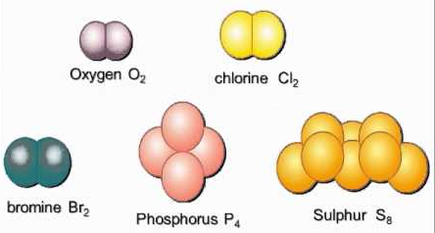
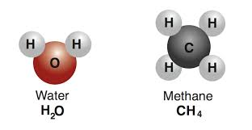
Atoms, Elements, and Compounds
Elements – pure substance that CANNOT be broken into simpler stable substances while being made of one type of element.
Atoms – smallest particle of element that retains the properties of that element.
Compounds – pure substance that CAN be broken down into simpler stable pieces, made from 2 or more elements CHEMICALLY bonded.
One bromine atom in elemental bromine.
2 atoms of hydrogen bonded with two atoms of oxygen form the compound water.

Slide 4
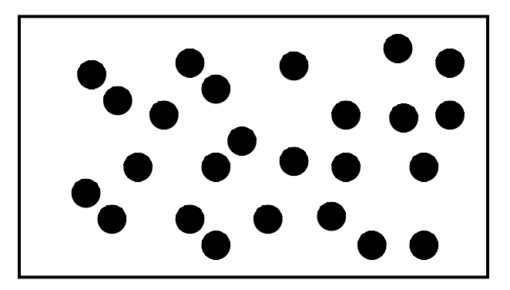
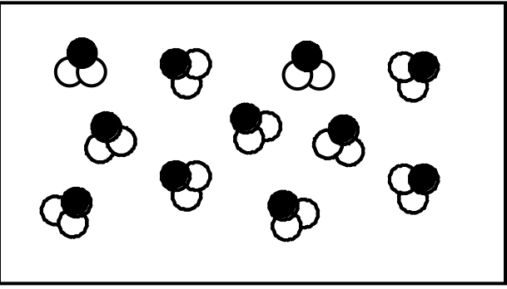
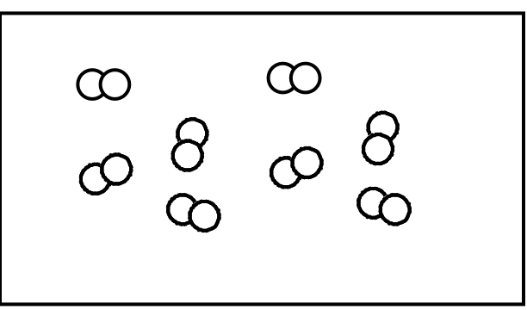
HW 1.1
Assigned: Wednesday, Aug 9th.
Due: Thursday, Aug 10th.
Due on Separate Sheet of Paper
1. Name the five of the traditional areas into which chemistry can be divided.
2. Describe the main difference between organic chemistry and inorganic chemistry.
3. How is a compound different from an element?
4. Identify each of the following as an element or compound:
a. b. c.

Slide 5
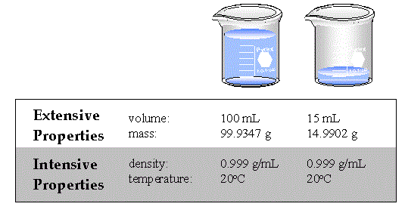
Properties of Matter
Chemical Properties – The ability of a substance to undergo a chemical change.
Physical Properties – can be measured without changing the identity of the substance.
Intensive properties DON’T depend on the amount of matter present.
EX. density, color, conductivity, melting and boiling points.
Extensive properties depend on the amount of matter present.
EX. mass, length, volume

Slide 6
Chemical and Physical Changes
Physical Changes – a change where the composition of the material does not change.
EX. change of state, break, split, grind, crush
Chemical Changes – Ability to change into another substance by changing the chemical composition of the substance.
EX. Charcoal burning in air, milk souring, iron rusting.
A chemical change does result in new substances!
4 Indications that a chemical change has occurred:
Color Change
Gas Produced
Energy Change
Formation of a precipitate (solid)
MEMORIZE THESE!!!!

Slide 7
HW 1.2
Assigned Thursday, August 10th
Due Friday, August 11th
Complete In Class Intensive/Extensive Labtivity & Back Side Wrkst

Slide 8
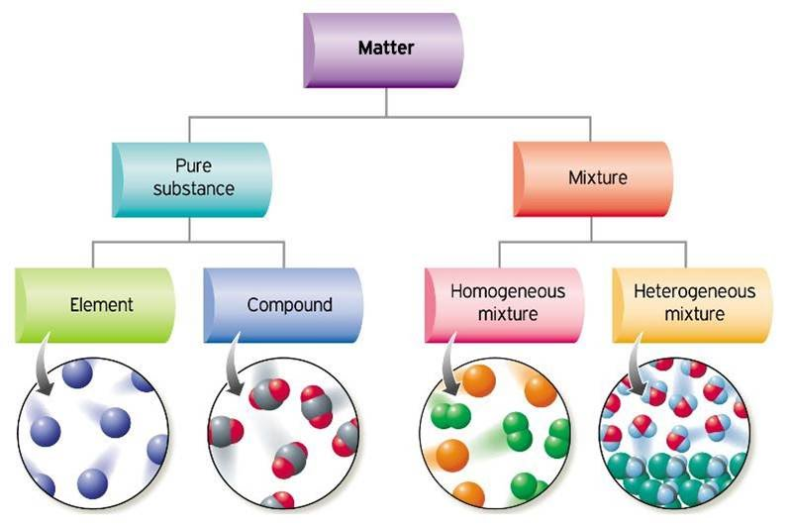
Classification of Matter
Pure Substances always have a uniform composition (same ratio of elements)
Mixtures are a physical blend of two or more components, where each retains its own properties.
Pure substances have identical properties (chemical and physical)
Heterogeneous Mixtures – not uniform throughout.
EX. Oil in water, chocolate chip cookie.
Homogeneous mixtures – uniform composition – often called solutions.
EX. Salt water, air

Slide 9
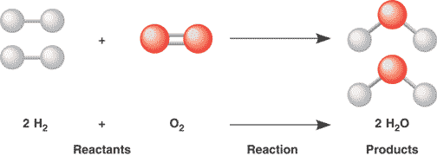
Chemical Reactions
Chemical Reactions are comprised of reactants (starting matter) and products (resulting matter).
The Law of Conservation of Mass states that in any reaction, chemical or physical, the mass of the reactants will equal the mass of the products.

Slide 10
HW 1.3
Assigned Monday, 8/14
Due Tuesday, 8/15
Complete Classification of Matter Wrkst
Complete Density Lab (Due Tuesday 8/15)

Slide 11
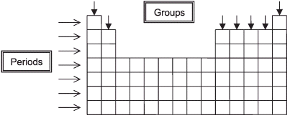
The Periodic Table
The periodic Table is organized with elements in groups of similar properties.
Vertical Columns are called groups or FAMILIES
Each group’s elements has similar chemical properties.
Horizontal Rows are called periods
Properties change in predictable ways across a period from left to right.
Elements close to each other on the table are similar in properties.

Slide 12
Metals, Non-Metals, and Metalloids

Slide 13
Metals
Metals are on the left side of the periodic table.
Conduct heat and electricity well, some are
Malleable (hammered or rolled into sheets) and Ductile (can be drawn into wire) – both of these due to high TENSILE STRENGTH (resistance to breaking when pulled)
Most have high luster (shiny looking)
Other properties of metals vary widely – some are very reactive (group 1), others are not (group 10-12) some are very soft (group 1 &2) others very hard.

Slide 14
Non-Metals, and Metalloids
Nonmetals are on the right side of the periodic table.
Most are gasses at room temp (bromine is a liquid) some are brittle solids (C, P, S, Se, I)
Poor conductors of heat and electricity.
Noble Gases are nonmetals, and don’t react with other elements.
Metalloids (some properties of metals and nonmetals) border the “stairstep”
Solids at room temperature
Somewhat less brittle and more malleable than nonmetals
SEMICONDUCTORS – conduct electricity to certain degree, used to make circuit boards & chips.

Slide 15
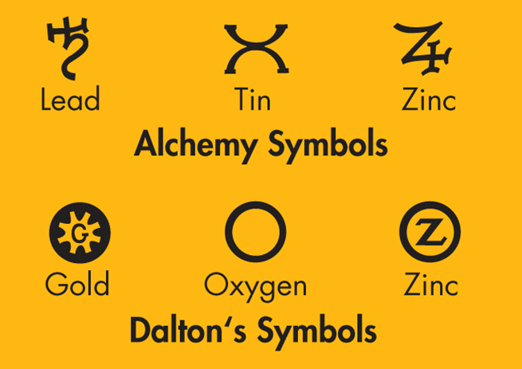
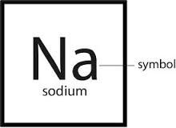
Elemental Symbols
Using symbols to represent different kinds of matter is not a new idea.
Alchemy Symbols used for hundreds of years.
John Dalton (1766 – 1844) used drawings to represent chemical elements.
The symbols used today for elements are based on a system developed by Swedish chemist Jons Jacob Berzelius (1779 -1848).
He based his symbols on the Latin names of elements.
Each element is represented by a one- or two- letter chemical symbol.
First letters of chemical symbols are capitalized.
When a second letter is used, it is lowercase.
EX. Na you may NOT use NA or na

Slide 16
HW 1.4
Assigned Tuesday, 8/15
Due Wednesday, 8/16
Due on Separate Sheet of Paper
1. Write the chemical symbol for each of the following:
a. lead, b. oxygen, c. silver, d. sodium, e. hydrogen, f. aluminum
2. What elements (by name) make up the pain reliever acetaminophen, chemical formula C₈H₉O₂N? Which element is present in the greatest proportion by number of particles?
3. Name two elements that have properties similar to those of the element calcium (Ca).
4. Classify the following materials as an element, compound, or mixture:
a. table salt (NaCl) b. salt water c. sodium (Na)
5. List 3 properties of metals.

